Slide 1
POWERSCHOOL
GETTING STARTED

Slide 2
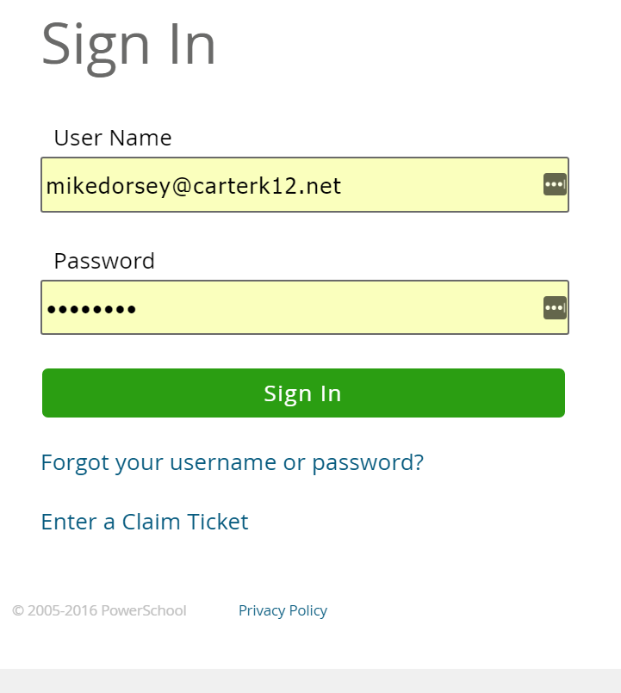
LOGGING IN TO POWERSCHOOL
Use your @carterk12.net e-mail address
You the default password which is cartercounty
Create a new password

Slide 3
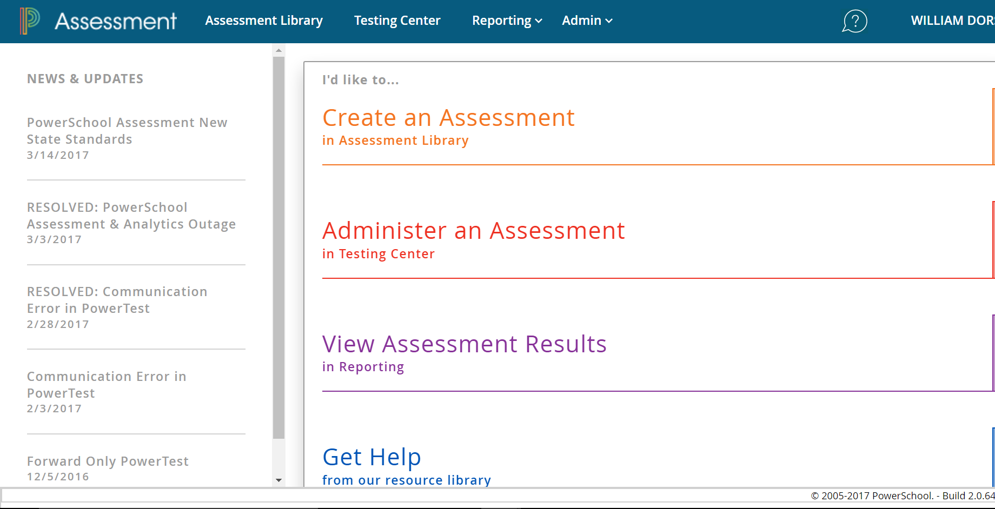
POWERSCHOOL
HOME PAGE
Assessment Library Button
From the homepage, click Assessment Library

Slide 4
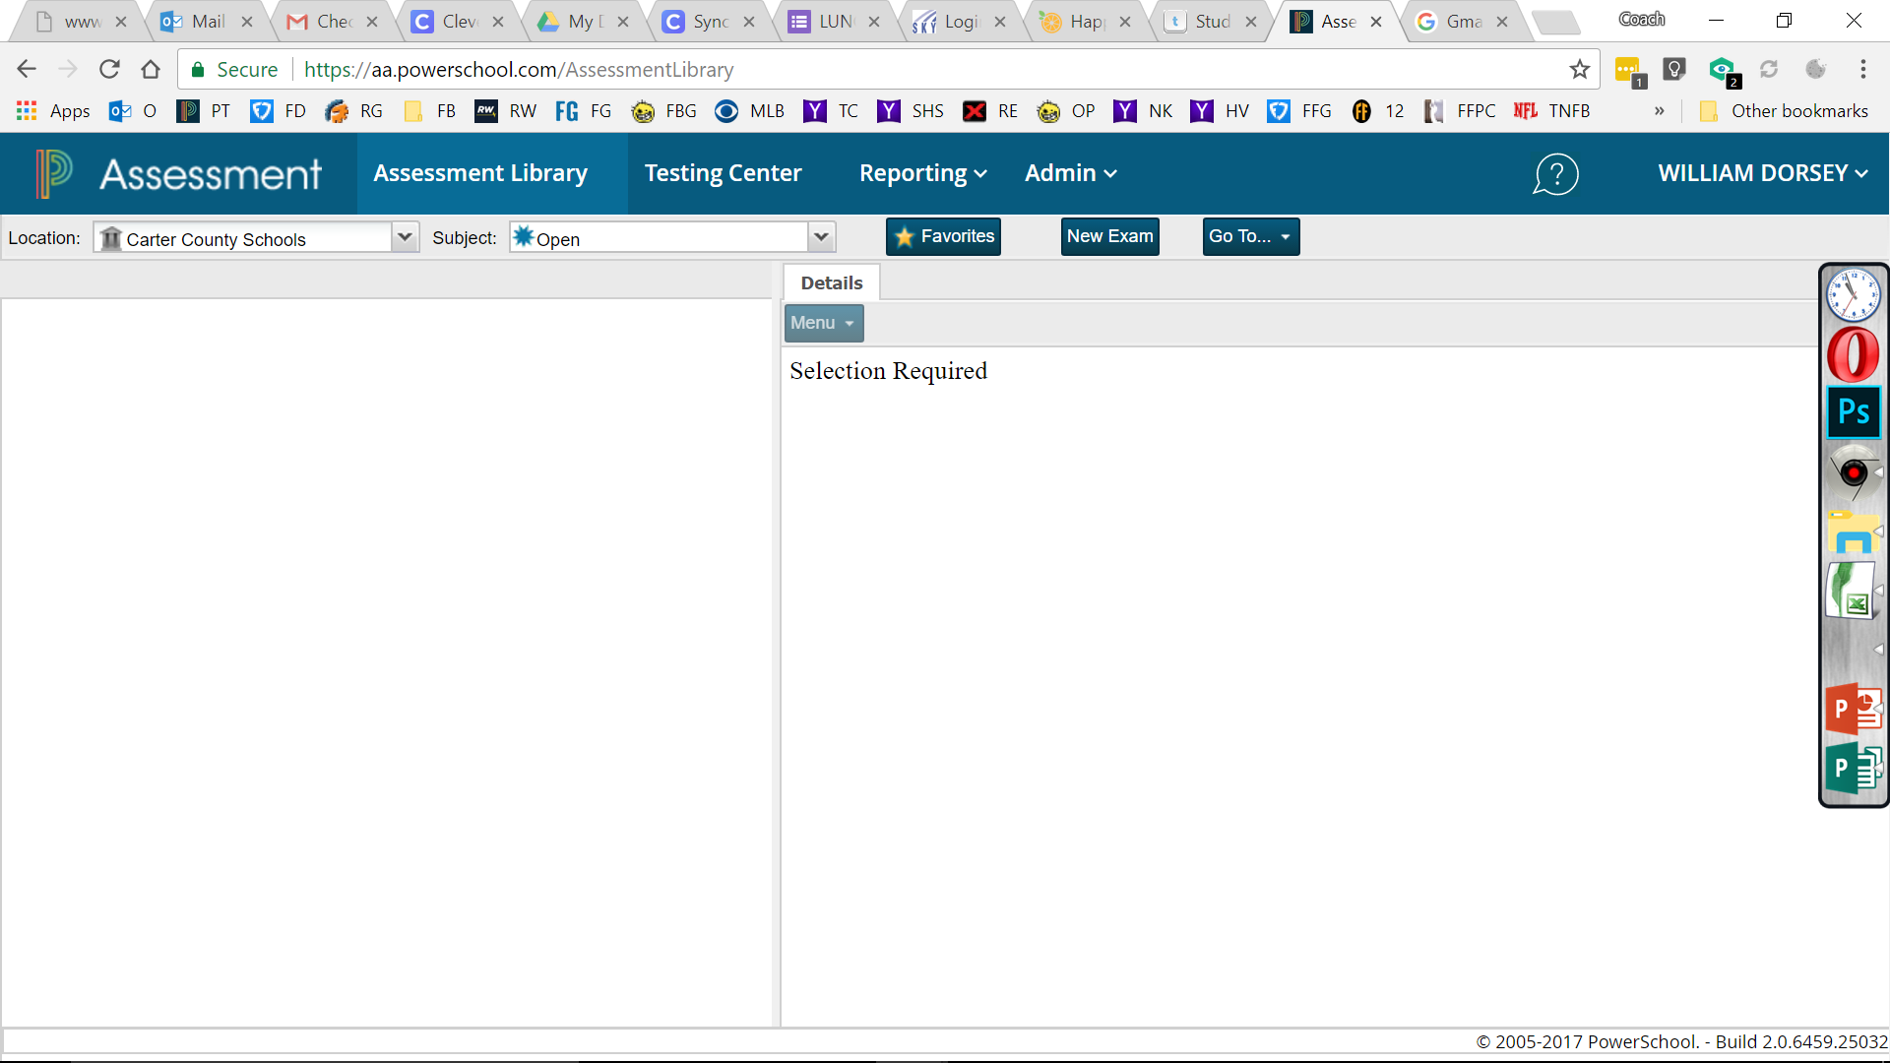
NEW EXAM
Click on the New Exam button
Click here to start creating a new exam.

Slide 5
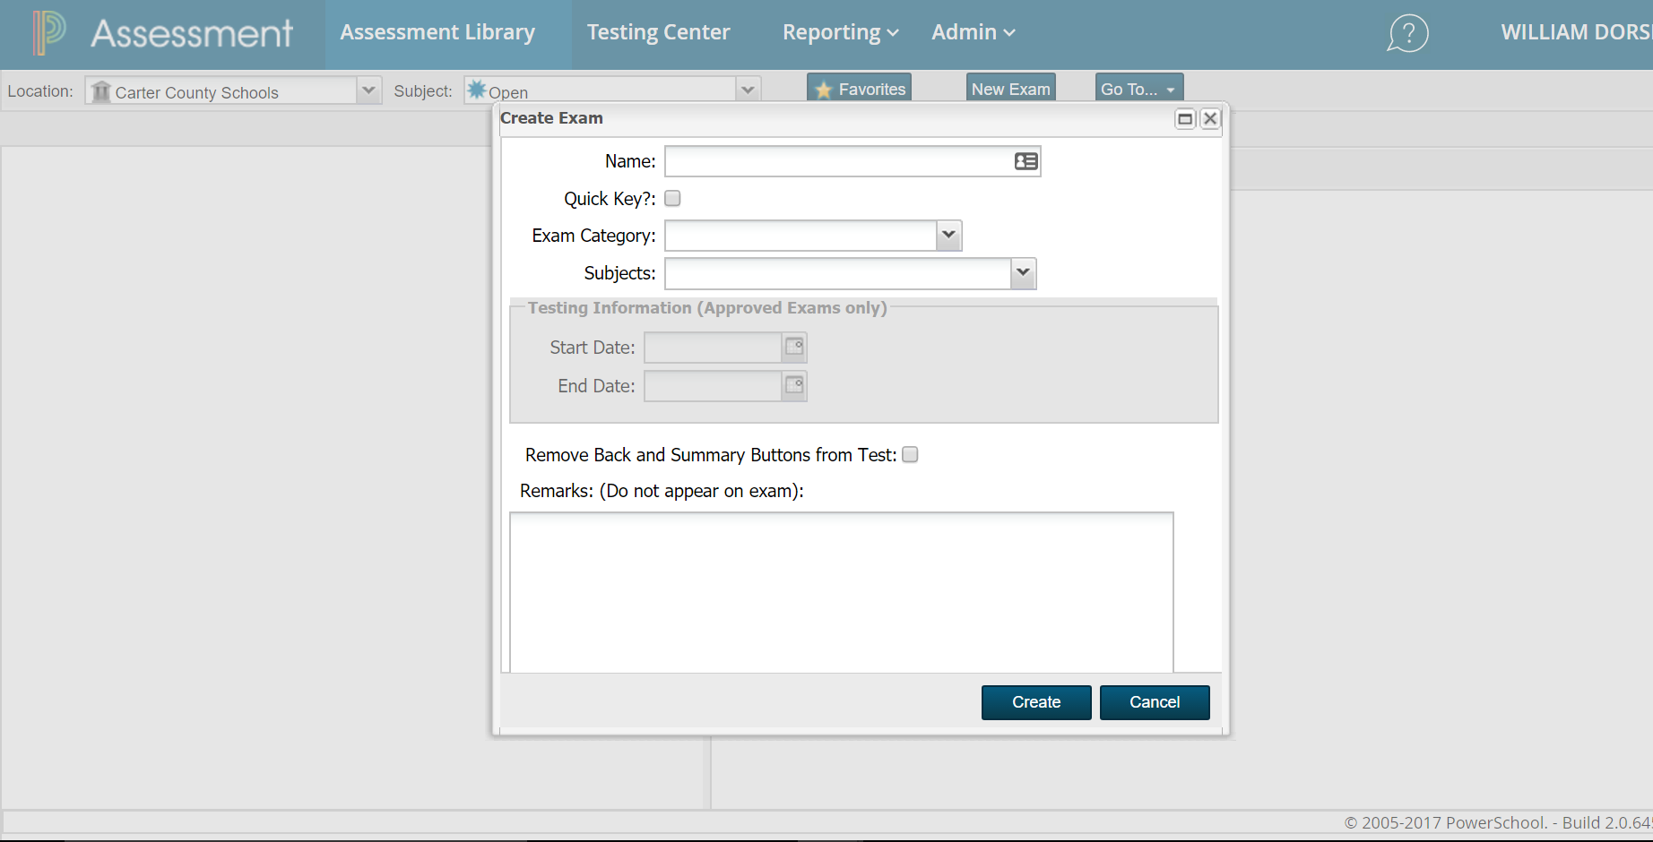
CREATING A NEW EXAM
Test name with my name Dorsey –Ancient Islam
Choose Exam Type
Dorsey – Ancient Islam
Name the test (preferably putting your last name 1st then whatever you name it).
Select Exam Category
Pre-Test

Slide 6
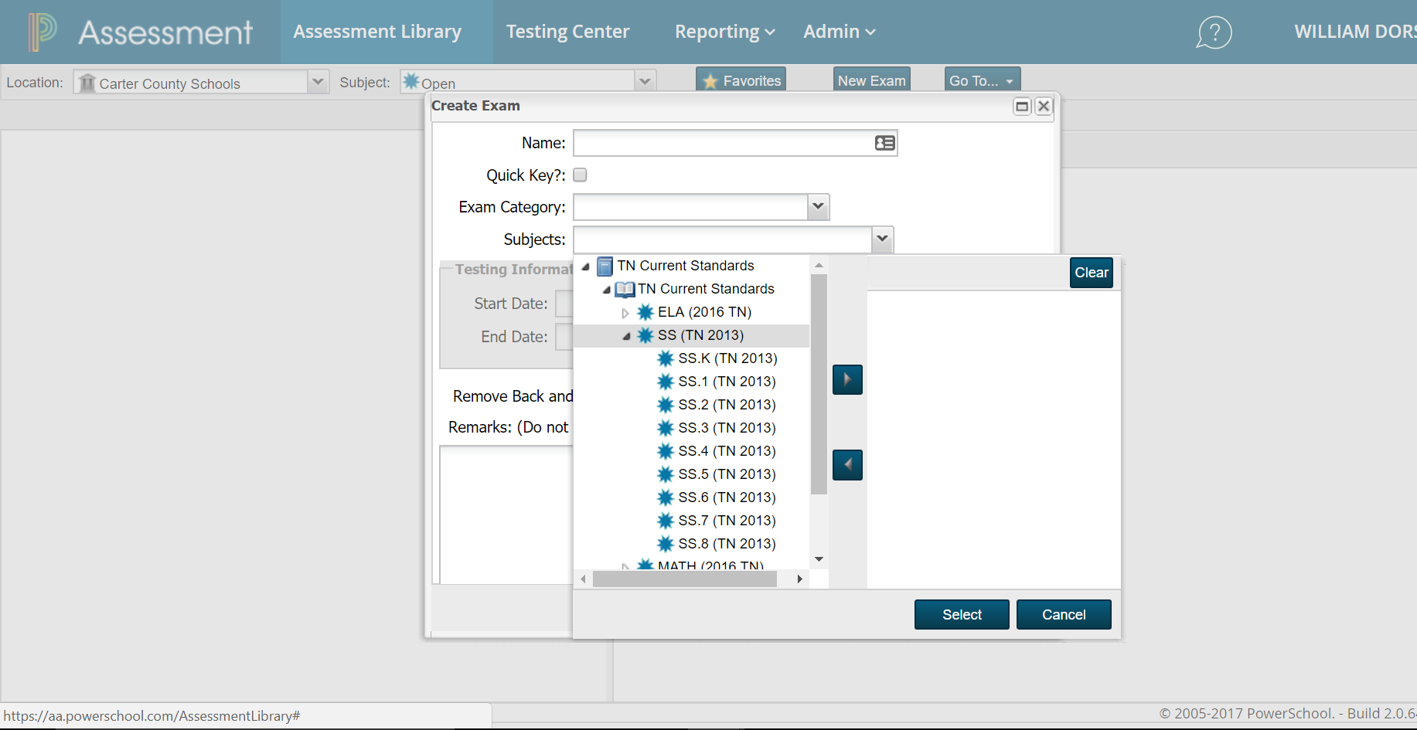
CREATING AN EXAM
(CONTINUED)
Arrow button to move grade & subject to be able to create test
Click Subject & choose TN Current Standards
Click on Subject
Choose TN Current Standards
Choose your Subject and use the right arrow key to select it.
Click Select at the bottom.
Click Create button.
Pick your grade & subject
Click Select button.

Slide 7
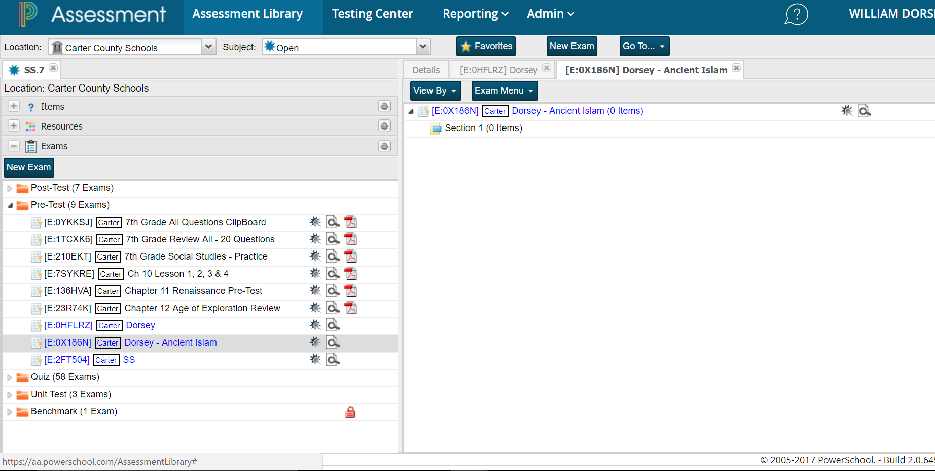
SELECTING TEST QUESTIONS
See available questions, click items.
To choose a test made by another teacher, select under Exam
To make your own test and look at the available questions, click Items at the top.
Choose another teacher’s exam from here

Slide 8
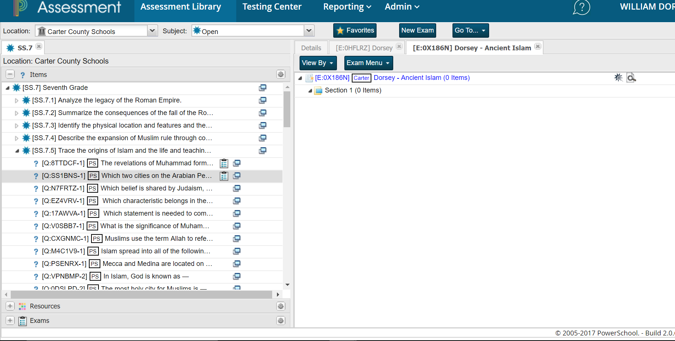
SELECTING TEST QUESTIONS
Click arrow beside the standard to reveal the questions.
Choose the standard you will be testing.
Choose the actual question
Choose your question here

Slide 9
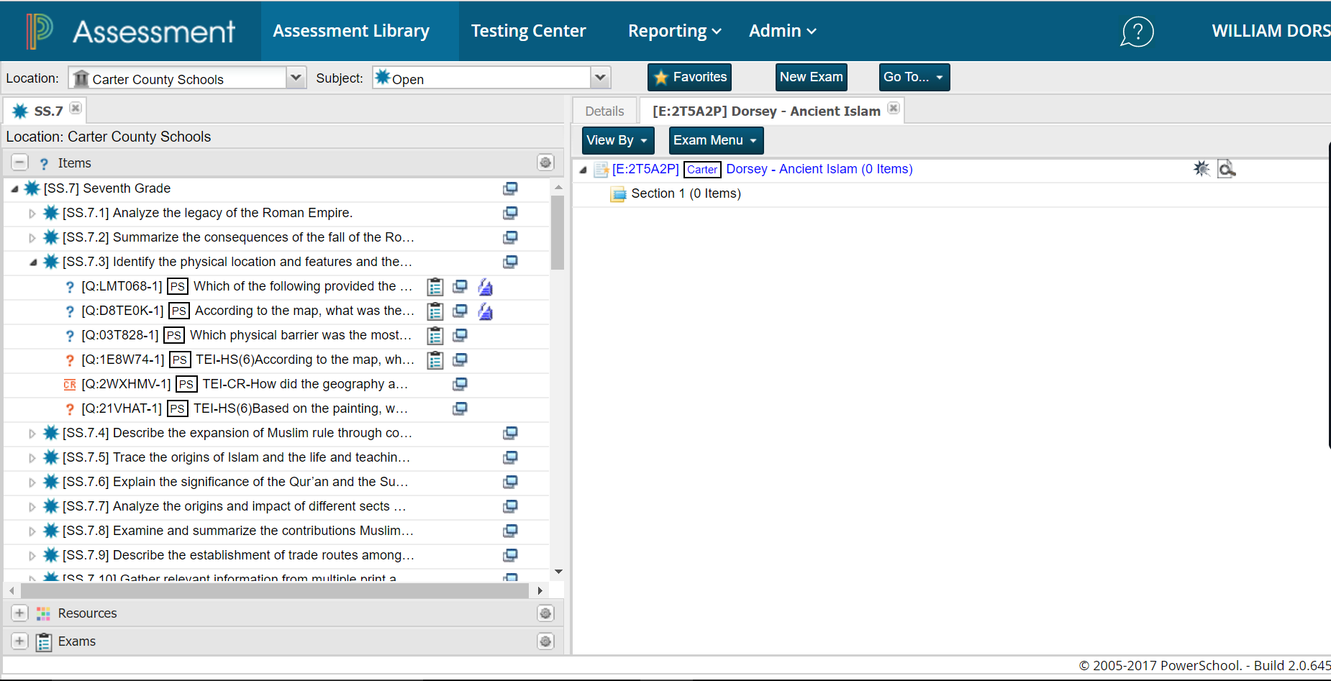
PREVIEWING QUESTIONS
Preview a question before selecting it.
Click on the viewer icon
Click on viewer icon

Slide 10
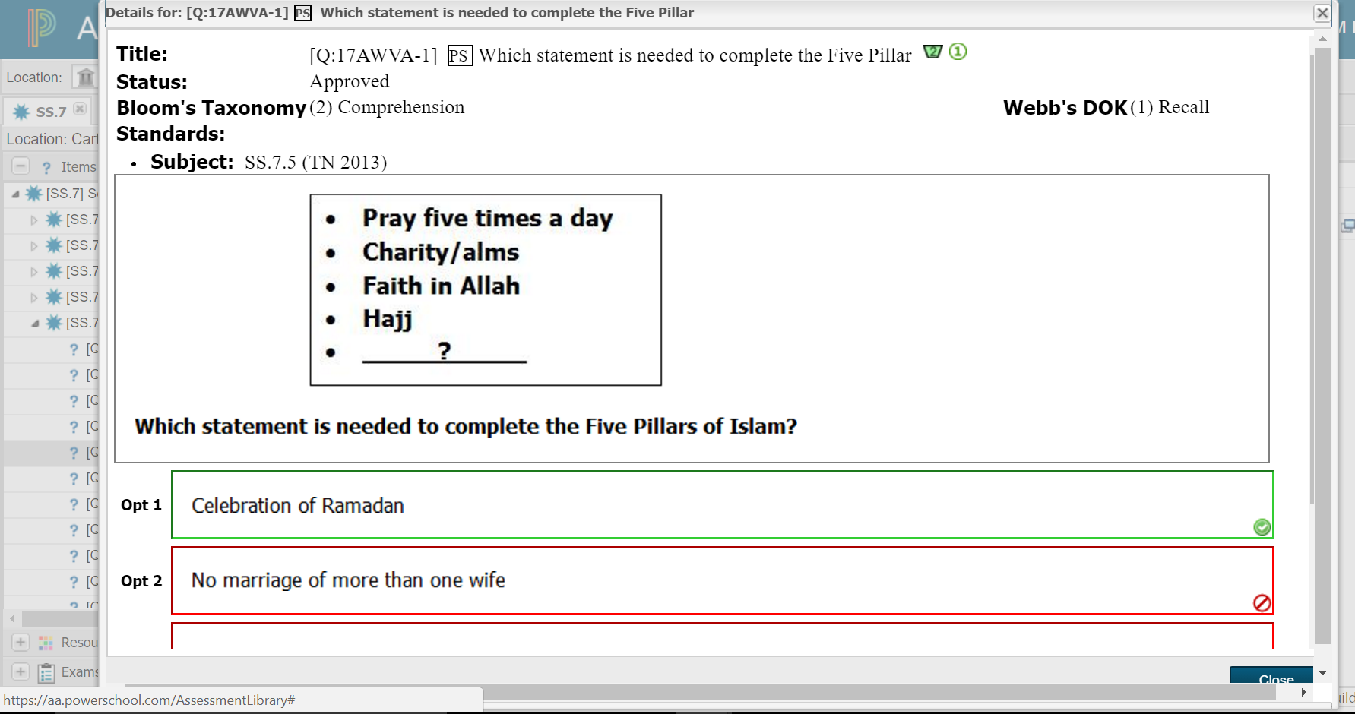
PREVIEWING QUESTIONS
Bloom’s Taxonomy
The 2 icons at the end of the Title show the question’s difficulty.
Represents Bloom’s Taxonomy
Represents Webb’s
DOK
1 to 6 with 6 being the hardest
2
Webb’s DOK
1
Question and answer with correct answer marked in green

Slide 11

ADDING QUESTIONS TO YOUR TEST
Click & hold question
Drop question here
Click and hold the question you want to add to your test
Drag it to the right side and release
To remove a question click on it, hold and drag to the left and release
Drag question to right side

Slide 12
DIFFERENT TYPES OF QUESTIONS
? Question
? Green question mark usually means multiple choice, single answer questions.
? Red question mark usually means multiple choice, drag & drop, multiple answer questions
CR Red Constructive Response means essay type questions that you have to grade.
CR Question
? Question

Slide 13
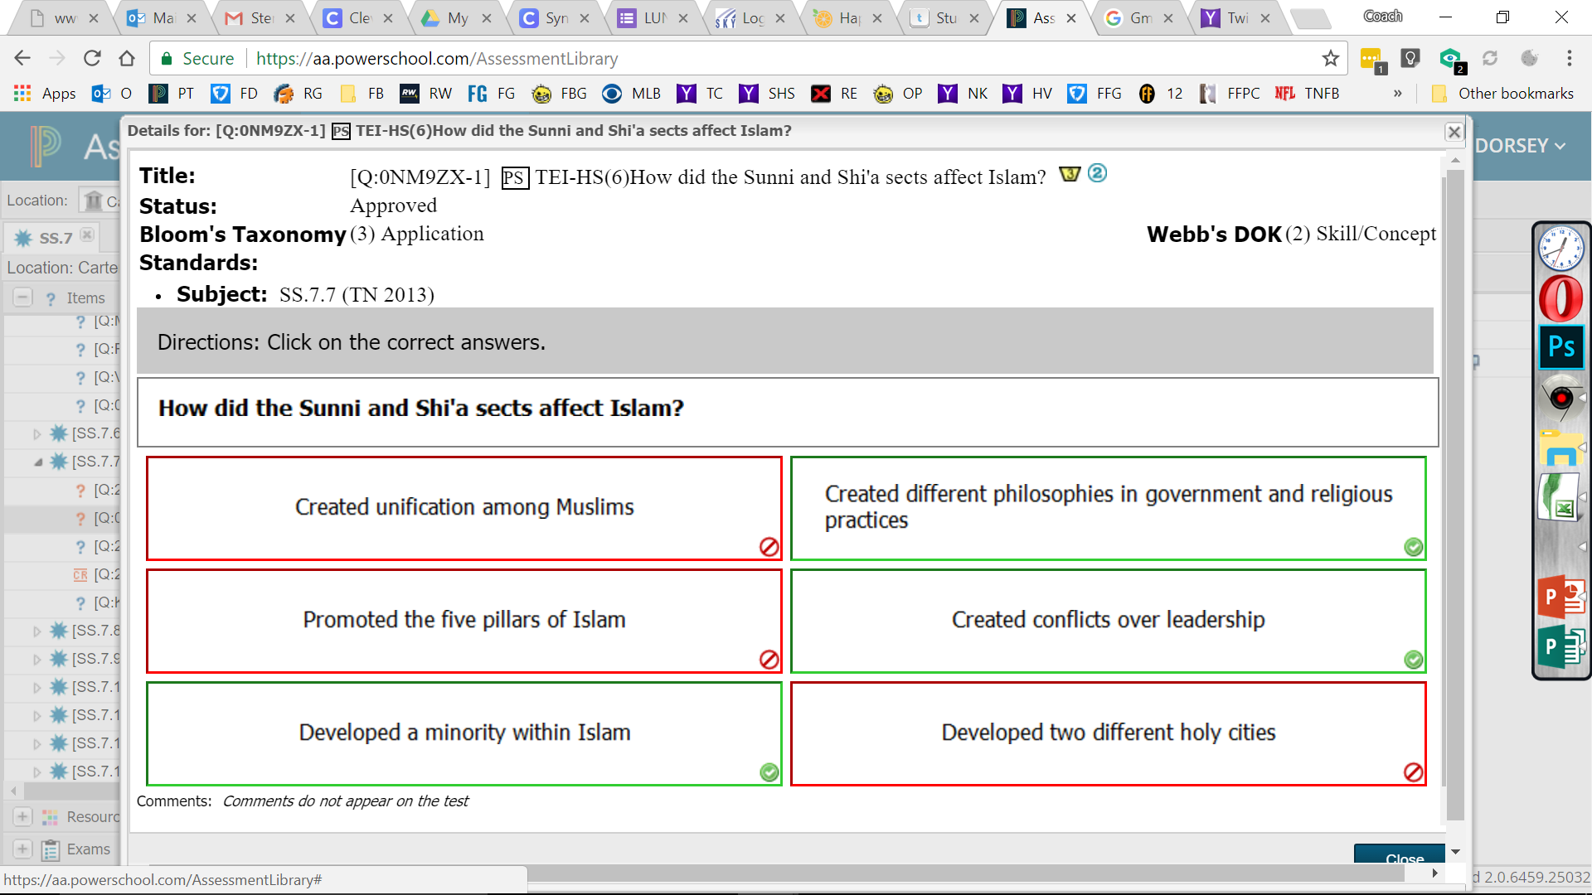
MULTIPLE ANSWER QUESTIONS
Some questions have multiple correct answers.
All correct answers must be selected to get the question right.
Correct Answer 1
Correct Answer 2
Correct Answer 3

Slide 14
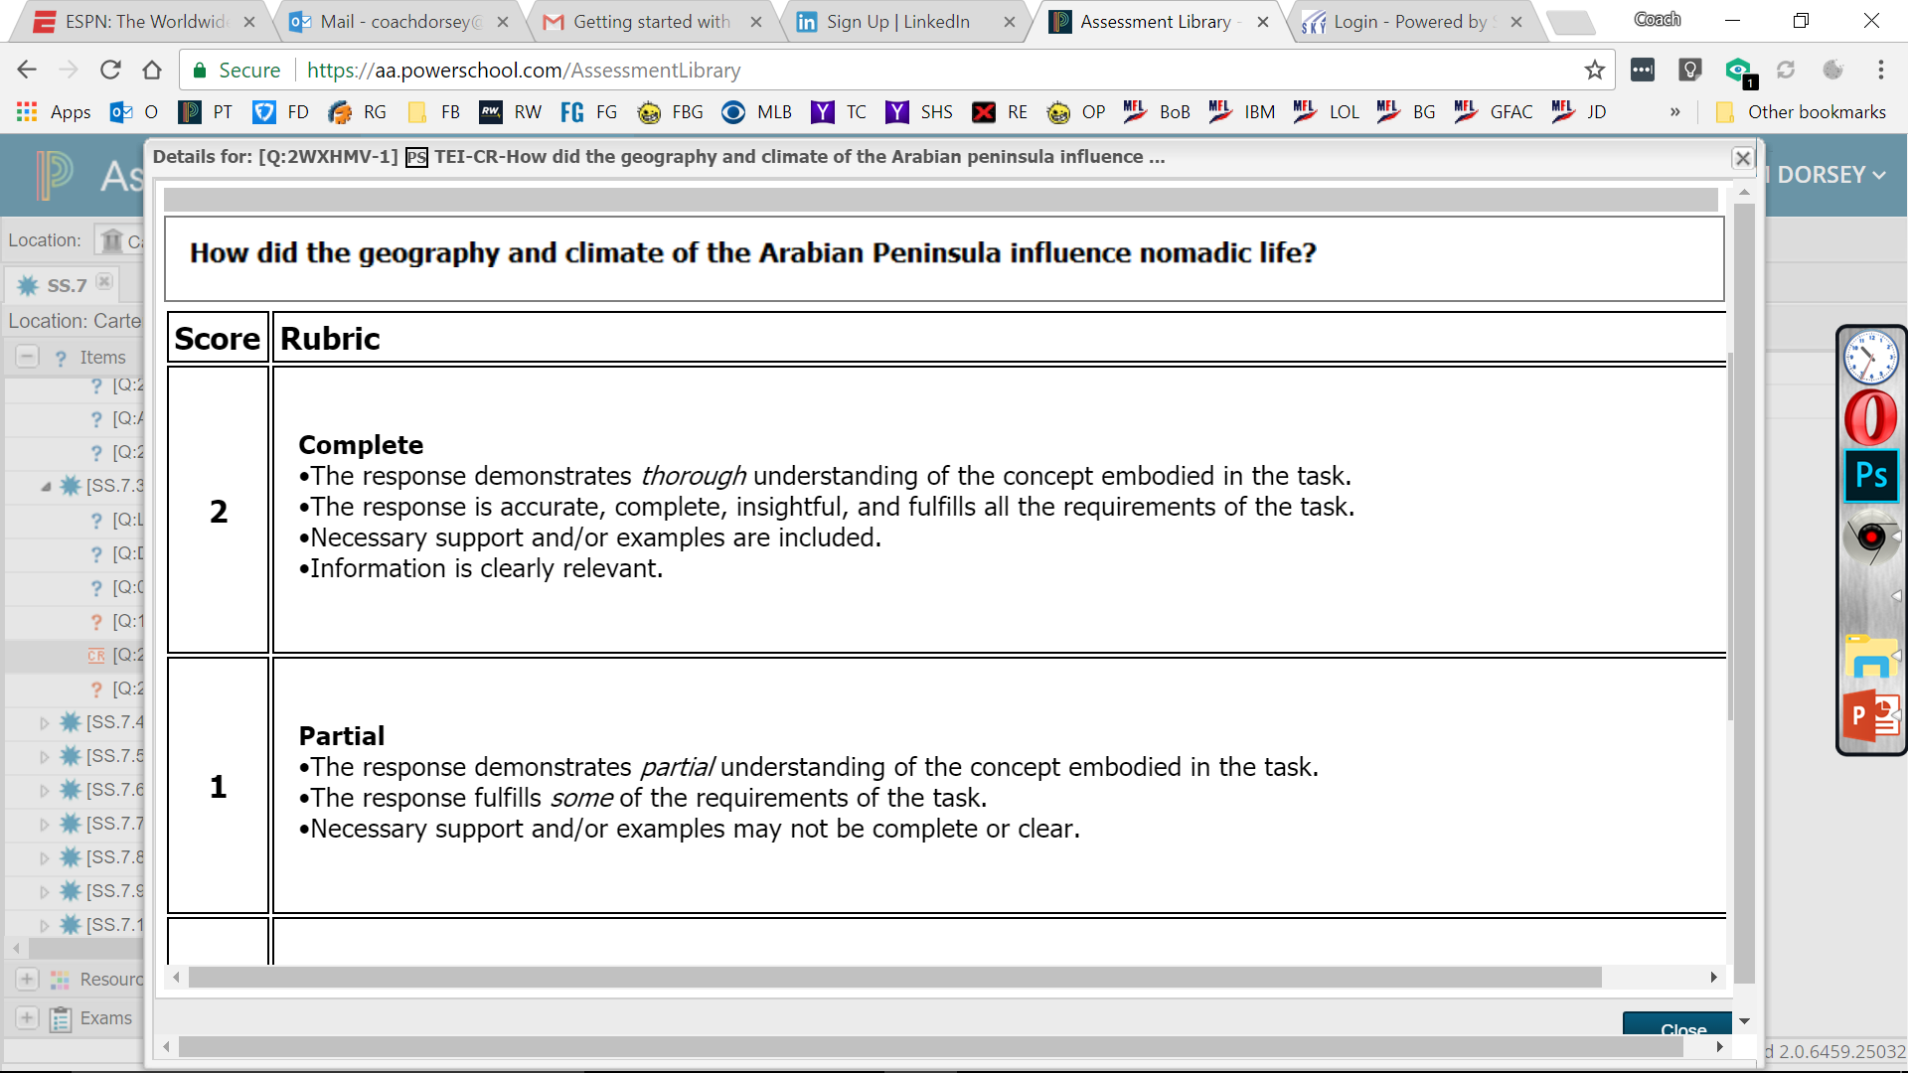
CONSTRUCTIVE RESPONSE
Constructive Response questions are essay questions.
Teachers must grade these using the provided Rubric by the program before it will grade the rest of the test.
3 scores can be given for the Constructive Responses.
2 for a complete answer; 1 for a partial answer or a 0 for an incomplete answer.
Requirements for a 2
Requirements for a 1

Slide 15
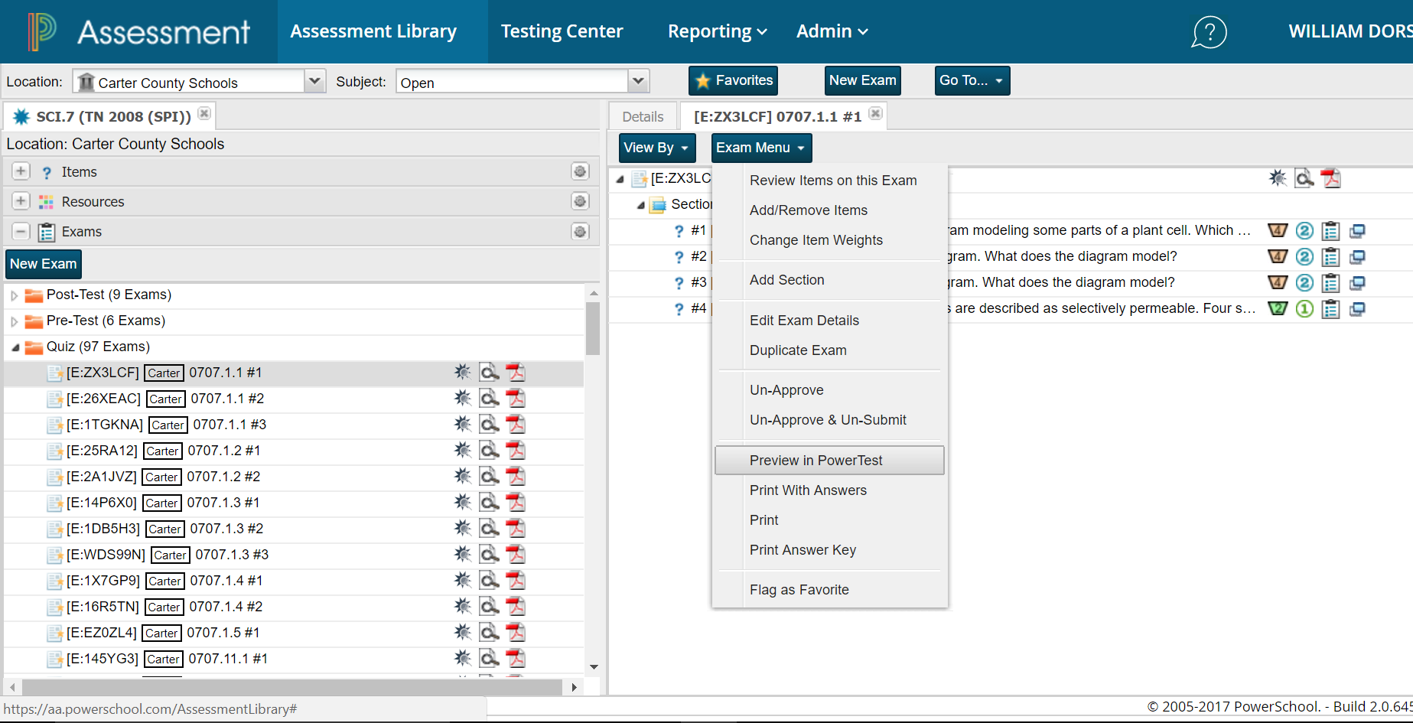
PREVIEWING IN POWER TEST
Choose an exam to preview
Click exam view & scroll down to Preview in Power Test.
Click on Power Test
Choose Exam

Slide 16
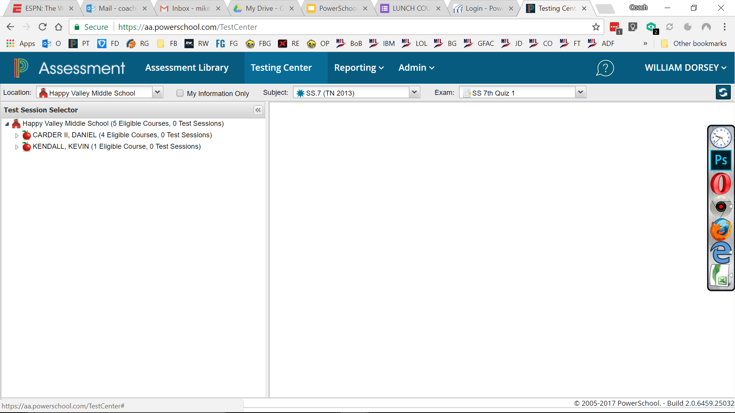
MAKING THE TEST READY FOR STUDENTS
Click Testing Center
Click Testing Center
Click Your Test
Click Subject & Grade
Click on Testing Center
Choose Subject & Grade
Find & choose your test
Choose one of your classes
Choose Your Class

