Slide 1
All About Austria
Mr. Jackson
Room 304

Slide 2
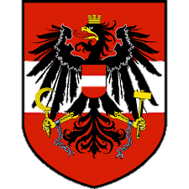
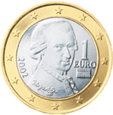
Country Information
Demonym: Austrian
Location: Central Europe
System of Government: Representative Democracy
Capital: Vienna
Largest City: Vienna
Population: 8.7 million
Climate: Temperate, Continental
Language: German
Anthem: “Land der Berge, Land am Strome“
Currency: Euro

Slide 3
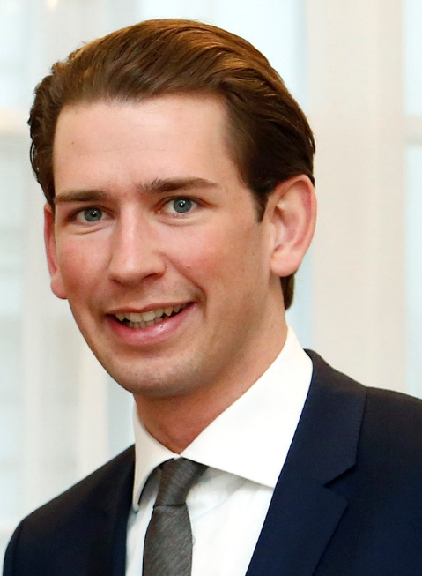
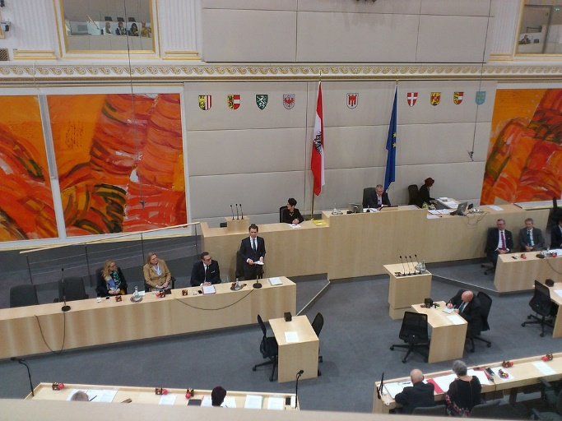
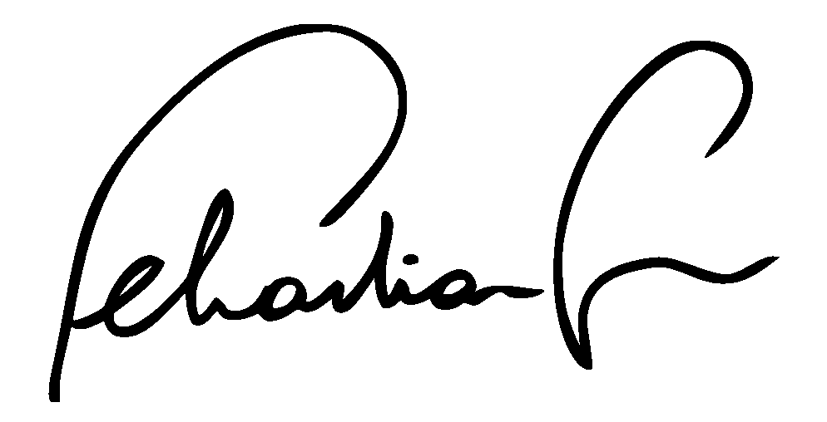
Meet the Leader
Sebastian Kurz is the Chancellor of Austria. He was elected in 2017. He is one of the youngest leaders of a country in the world. He is only 31 years old. Before he was Chancellor, he was Minister of Foreign Affairs.

Slide 4
Learn the Language
Most Austrians speak German
English | German
Hello | Hi
How are you? | Wie gehts?
Good morning | Guten morgen
Thank you | Danke schoen
My name is… | Mein name ist…
Yes, please | Ja, bitte
No, thank you | Nein, danke

Slide 5

Fly the Flag
The Austrian flag is a triband. It has three equal horizontal bands of red, white, and red.

Slide 6
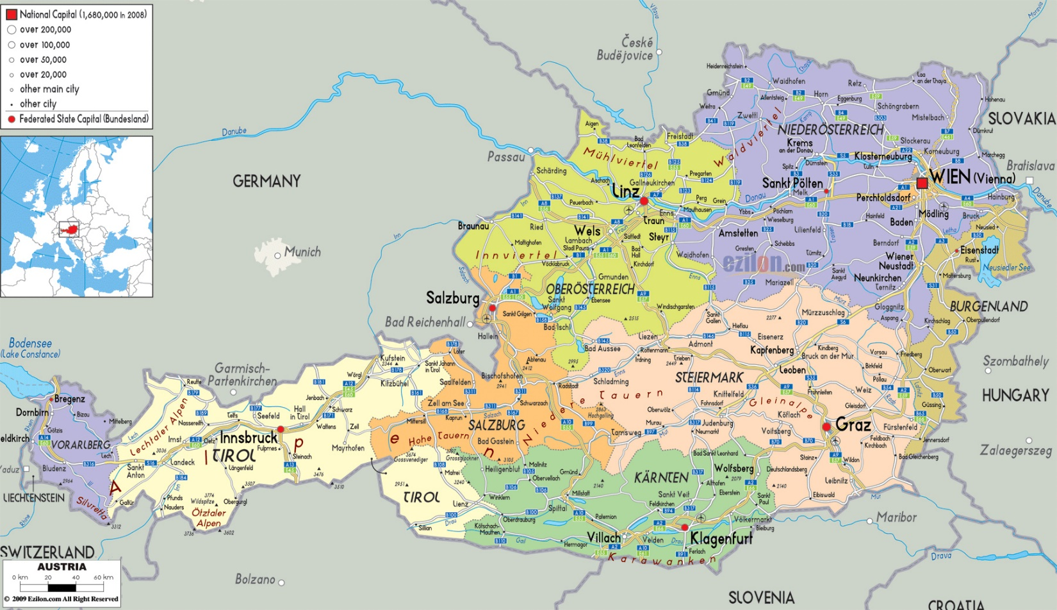
On the Map
Austria is in central Europe. It is bordered by Germany on the northwest, Switzerland on the southwest, Italy and Hungary on the south, Hungary and Slovakia on the east, and Czechia on the northeast.

Slide 7
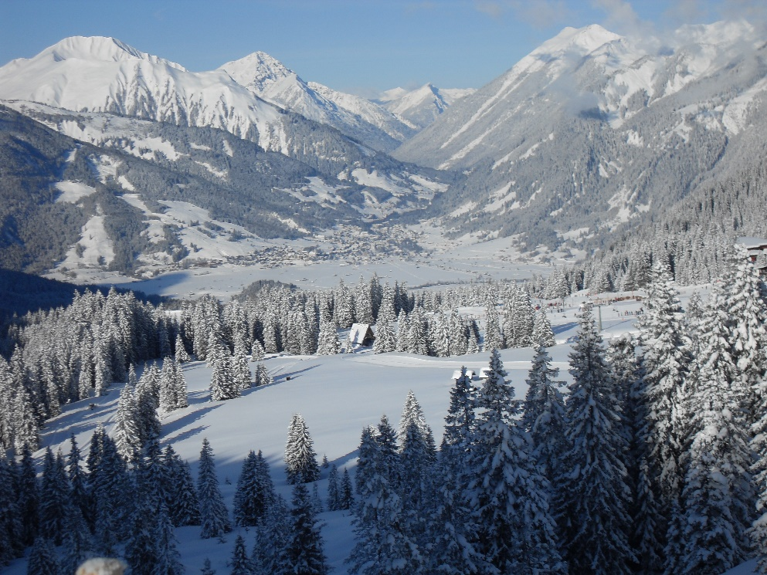
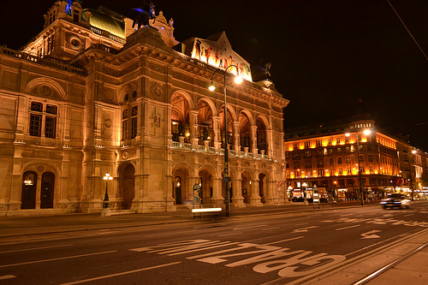
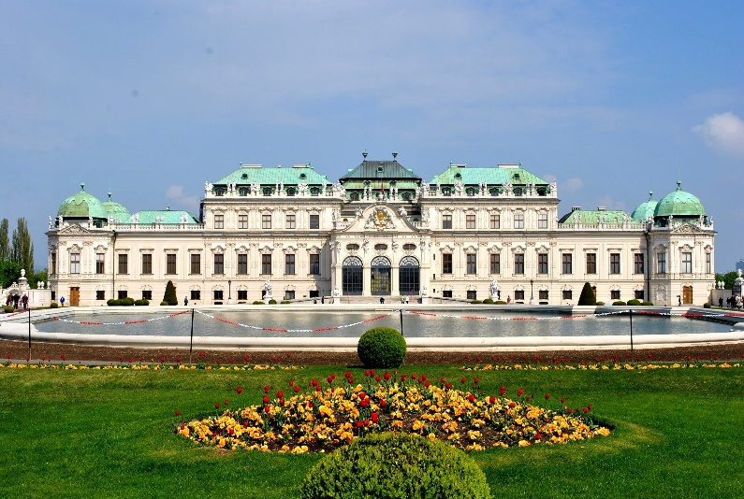
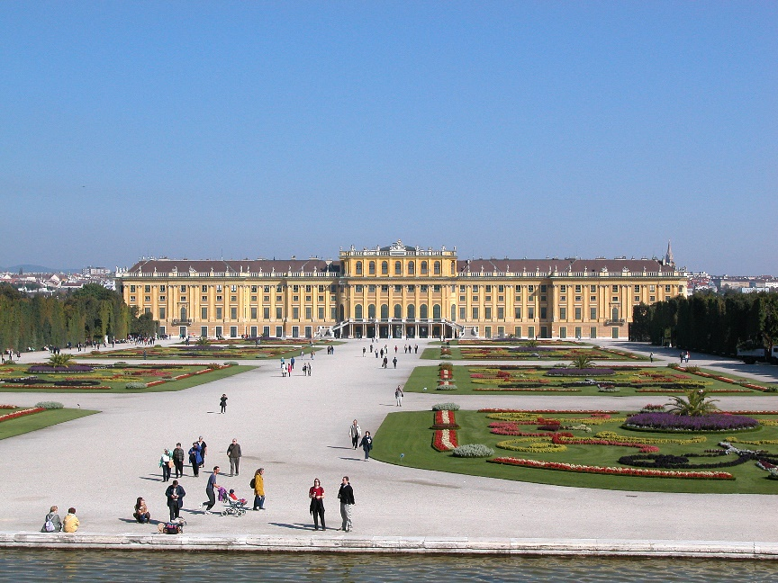
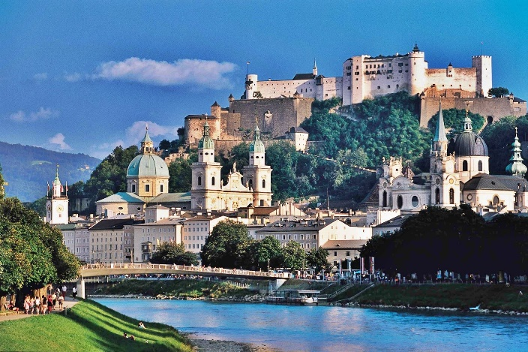
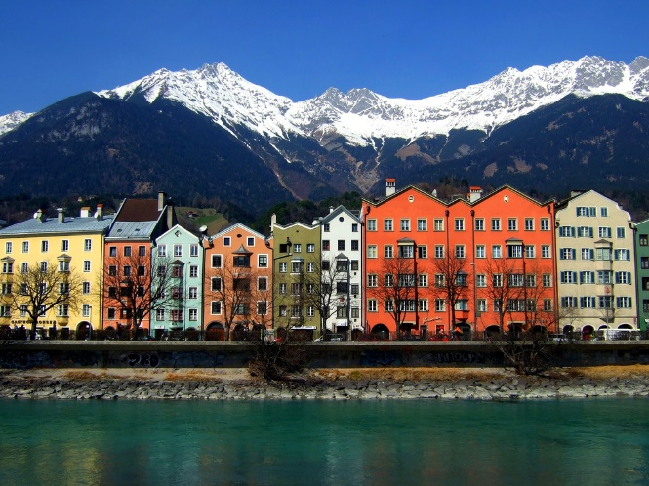
The Sights of Austria

Slide 8
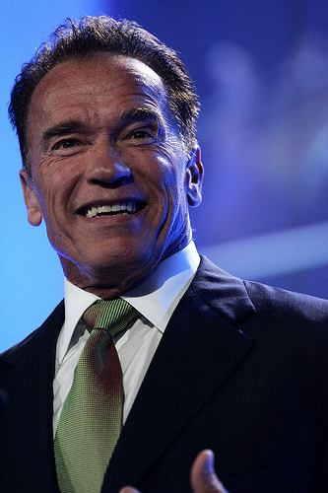
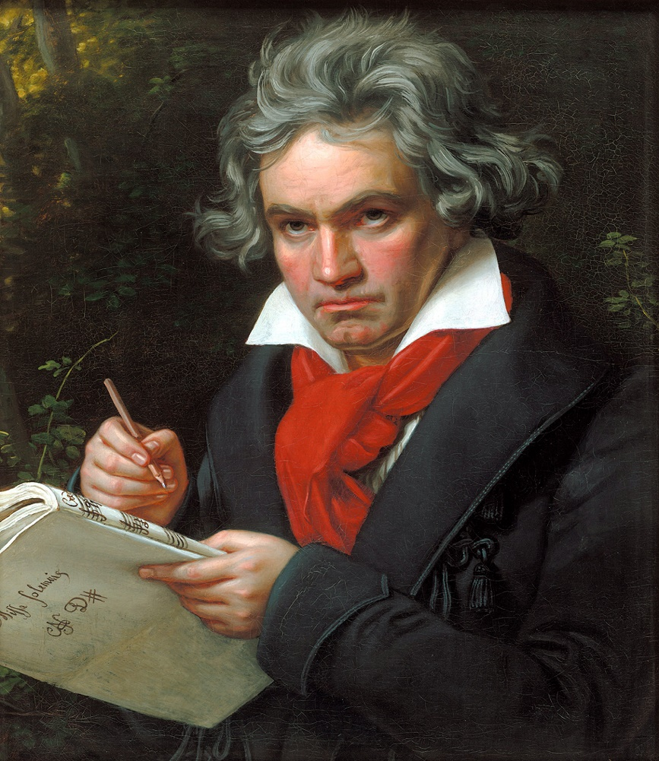
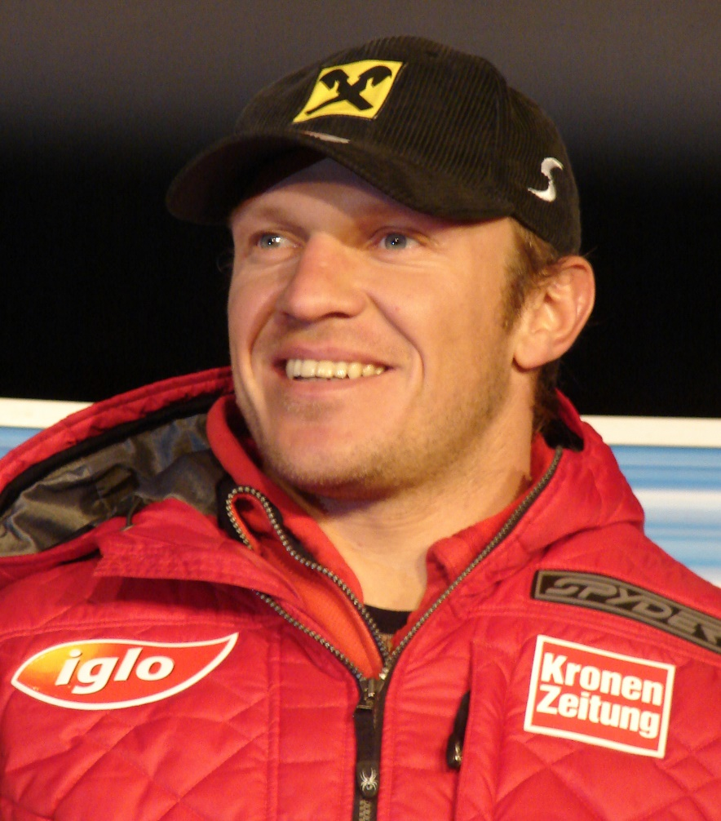
Austrians You May Know
Arnold Schwarzenegger
Ludwig von Beethoven
Hermann Maier

