Slide 1
Answers and discussion of our homework, Gantt charts, and work for next week.
Nov 7 Presentation
By Tom Coughlin

Slide 2
Schedule for rest of term:
Nov 7 Live Class.
Nov 14 Live Class.
Nov 21 Independent study week– Work on Assessment Plan part.
Nov 28 Live Class: Independent work review. Work session for Implementation plans.
Dec 6 Last Class: Implementation plan presentations.
Please note– next week is live class, following week is independent work.

Slide 3
K-12 Technology Implementations Showcase.
Valley Christian Schools– installs Crestron system: https://youtu.be/YIZii5r-YSw
Huntington School Ipad implementation:
https://youtu.be/f_C1kZKak5U
Integrating a smartboard into math demos:
https://youtu.be/Z_TiyDs-KmA

Slide 4
Adult Education
Implementations Showcase:
Military survival training. (Military training missions are considered “integration”– many hours of classroom and LMS training is brought together– also it’s an immersive simulation activity):
https://youtu.be/3Pqx0QruVhQ
Ohio State University modernizes a fragmented IT and teaching organization:
https://youtu.be/rNzgLOO8_9I

Slide 5
Adult Education
Implementations Showcase:
The Canada Science and Technology Museum, in Ottawa closed down for two years to completely revamp.
https://youtu.be/PtPD2c4iTeE
It’s re-opening on November 17, 2017,
https://ingeniumcanada.org/scitech/index.php

Slide 6
Last Week’s independent study
Question 1.1:
What revisions to the Technology Coordinator job description (TCM: pages 18-21) would you suggest to bring the requirements up to date?

Slide 7
Basic skills (p 11) haven’t changed:
Broad educational basis but must demonstrate that you are continually willing to learn.
Knowledge of the educational system (industry standards, teaching-admin standards, popular approaches to various institutional requirements).
Interpersonal Skills.
Technical skills (possibly demonstrated by coursework, certification holding, or experience.
As our book notices– three out of four are not technical in nature at all.

Slide 8
What may have changed:
Technical skill may be less important now than in the past. (finance, administrative, teaching, research may be more critical skill areas).
Use of vendors and SaaS has reduced the amount of server maintenance, network maintenance and hardware maintenance.
Programming skills may be more important than ever before.
Teaching and training may be more important.

Slide 9
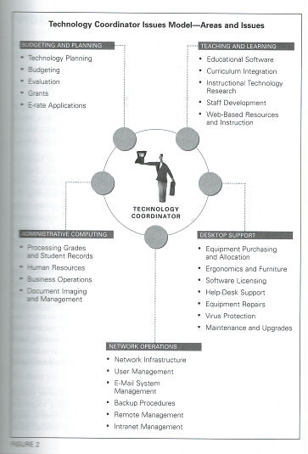

Slide 10
New skills:
Intimately familiar with major software packages used in the educational area (software apps are big, complicated and expensive today). This knowledge extends into the ability to train people.
Authority and experience to lead large purchases and projects.
Ability to gain grants, donations, and to market the technology program to new constituents.
Ability to conduct research and assessments.

Slide 11
Question 1.2:
--The ISTE standards and (k-12 instructional technology coordinator job description) were developed way before Learning Management Systems and on-line instruction had become popularized. Should additional skills be required of technology coordinators (and students and teachers) and added to the ISTE standards? Do you think the ISTE standards by themselves are sufficient to apply to online instructions?

Slide 12
Possible points
ISTE standards are fairly broad– part of their purpose is to unify state standards among states, and in some cases, chide states into creating standards. State standard for education usually go grade-by-grade, and discuss new skills required at each grade level. I believe it worked, and the main reason for the initial standards is no longer present.
ISTE standards apply to K-12 and mostly to classroom education. Should they apply to virtual academies, online education, homeschoolers?

Slide 13
Question 2.2
Assume that you are a University level instructional designer working to update an existing online course (Introductory Physics). Course is currently online and is working out well, but doesn’t have a lot of multimedia other than videos of lectures and still pictures. Your High School or University wants to incorporate concepts of “Universal Design” into the course. What changes would you make? How would you incorporate multimodal activities at the stages of representation, expression and engagement, and make the course more relevant for diverse cultures?

Slide 14
Universal Design
Universal design was first embraced by teachers wanting to make inclusive classrooms. In the end, people marveled that it was useful to way more people than those is was specifically designed for.
Intro to UDL:
https://youtu.be/MOUdmzaZrc8
Example of UDL in practice:
https://youtu.be/pGLTJw0GSxk

Slide 15
Question 3:
Can you spot some deficiencies with the SCORM standard? (For instance, it assumes that all courses are sequential, and do no have multiple branchings, or multiple paths to conclusion.)
If SCORM is universally recognized as a standard for learning management systems, why are alternatives and extensions important to it?

Slide 16
Scorm
Intro to Scorm:
https://youtu.be/FzxNwWvmwf4
-- SCORM is very good for keeping track of scores, and managing sequential instructional programs. Not good for multimedia, quizzes other than T/F and mult. choice. Good for integrating Captivate, Moodle, and Camtasia work.
Solving the deficiencies:
https://scorm.com/tincanoverview/the-letsi-scorm-2-0-white-papers/
collection of white papers discussing how to expand and improve.
Scorm authors: suggesting a new architecture.
https://youtu.be/y42MSS1DJqc

Slide 17
Moving on! Project management and use of associated software.
Syllabus mentions Microsoft Project, which is a PC only application. Also it requires a purchase to use at home. This video will explain the features:
https://youtu.be/iUqbhkJWt_4
Gantt Charts explained:
https://youtu.be/LrtLig0yYrs
OpenProj is a free application that you can use to make Gantt Charts (just like Project).
https://sourceforge.net/projects/openproj/?source=typ_redirect
Excel can be used too– but it’s a little cumbersome:
https://youtu.be/0hnAnwDABmU
https://youtu.be/QZd3iXcueaI

Slide 18
Homework for Next week—Developing Assessments.
Please read Chapter 10 of the Reiser and Dempsey Book (and also Chapter 11 if you missed it, it’s the ROI readings). Same chapters in both editions.
Please bring your computers and/or your project documents on disk next week.

