Slide 1
Balanced Scorecard
How it works—how to do the exercise

Slide 2
Balanced Scorecard—quick facts
It was developed to serve as an alternative to performing a purely financial valuation of an organizational project.
Financial evaluation is balanced with three other considerations of an organization value:
--Customer and stakeholder perspective (Customer value, satisfaction, retention).
--Internal process (excellency and efficiency).
--Organization capacity, or Learning and Growth (Human Capital, Technology, Culture)
“What is measured, gets done”– Peter Drucker.

Slide 3
How BSC views an organization (from BSC.org)
Financial: often renamed Stewardship or other more appropriate name in the public sector, this perspective views organizational financial performance and the use of financial resources.
Customer/Stakeholder: this perspective views organizational performance from the point of view the customer or other key stakeholders that the organization is designed to serve.
Internal Process: views organizational performance through the lenses of the quality and efficiency related to our product or services or other key business processes.
Organizational Capacity (originally called Learning and Growth): views organizational performance through the lenses of human capital, infrastructure, technology, culture and other capacities that are key to breakthrough performance.

Slide 4
Constructing the worksheet:
Financial, Customer, Internal, and Learning and Growth are along the vertical axis.
Across the horizontal axis are four columns:
Strategic Priorities
Measures
Targets
Initiatives

Slide 5
The horizontal axis has a general cause to effect relationship
Executives decide on the Strategic Priorities, and rank them from most important to least important.
With each Priority goal: measurements are determined that most effectively represent/signify the attainment of the goal.
With measurements established, target goals can be set. It may be as simple as reduction in errors, better test scores, etc. The goal and the measurements must be as closely related as possible.
When priorities, measurements and targets are in agreement, and are presenting a good representation of the company’s aspirations and internal processes, Initiatives are introduced to improve performance.

Slide 6
Through this process– new initiatives are inspired by Strategic goals, and the managers can adjust priorities as business conditions evolve.
Important Term: KPI (Key Performance Indicator)—
-Provides objective evidence of progressing toward achieving a desired result.
-Measures what is intended to measure.
-Offers a comparison that gauges the degree of performance over time.
-A good KPI can track: effectiveness, efficiency, quality, on-time performance, governance, compliance, behavior, economy, project performance, personnel performance, and resource utilization.
-Are balanced between leading and lagging indicators (measures inputs as well as post-production data).

Slide 7
Terms used:
Inputs.
Outputs.
Outcomes.
Process.
Project.

Slide 8
Strategic Priorities | Objectives | Measurements | Targets | Initiatives
Financial Reduce/control laptop program costs Cost effective software licensing Migrate textbook use to digital editions. | Reduce cost More properties available. More up-to-date materials | ROI per computer, mean time between failure. Cost over period of years. Cost, Convenience (look at varous ways of measuring adoption rate, or student ues of the resource) | Increase ROI by 20% Reduce Mean time between failure by 5% | Recruit students to volunteer to assist fixing computer. Keep better track of students who generate the most breakage reports
Customer Students/Parents— Best laptop program possible, Teachers— Increase efficiency by reducing administrative task load. Reduce software development obligations | Most up-to-date hardware possible, while controlling cost Reduce workload for teachers through better automtion, and less customization work. | Cost per student. CPS compared to CPS at other schools. Rate of available computers. Number of title available to students. Faculty– number of hours spent with prep. Number of hours spent doing administrative work. | Reduce CPS to $1,200 per year (22% reduction) | Look for better price when shopping for new computers, take advantage of bulk purchase deals.
Process (Internal) Clean repair fix computers quickly and cheaply. Reduce number of non-working student computers. | Reduce backlog of non-working student computer. | Rate of available computers. Cost of maintenance per computer. | Increase rate of available computers to 90% | Replace 20 of oldest computers. Encourage students to lease or purchase their own compatable computer.
Organization Capacity (Learning and Growth) Prepare for addition of grades 3, 4. | Prepare for 20-30 new student. | Number of new students compared to existing student body | All New teachers will need computers over summer. Will experiment with online training courses. | Move new teacher computer training to online courses,

Slide 9
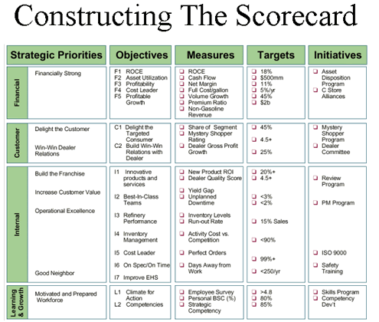
Example scorecard

Slide 10
After we develop (and redevelop) the worksheet–we do some conversions to create the final balanced scorecard.

Slide 11
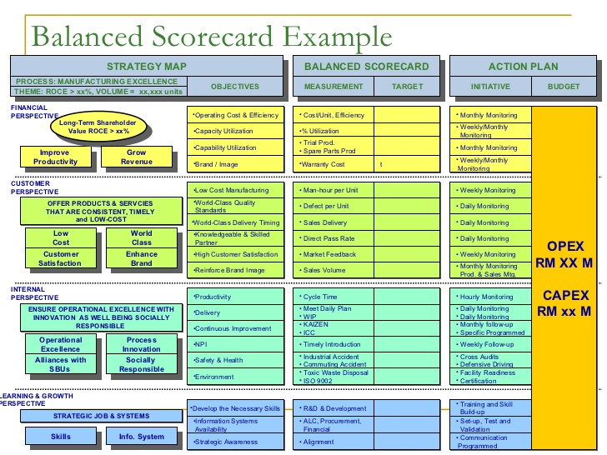
Example Balanced Scorecard
Your Balanced Scorecard might resemble the following image:

