Slide 1
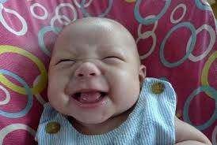
GIGGLE POETY
BY MATTHEW

Slide 2
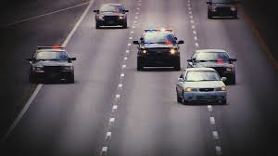
Bleep! Bleep! Bleep! Goes the alarm. Hurry! Hurry! Hurry! Says mom. Woof woof woof goes the dog. Burp burp burp goes my brother. Crunch crunch crunch goes my cereal. Fart fart fart goes the baby. Trickle trickle trickle goes the man in the rest room. Click is the sound as he gets in a car WEEEEEEEEEEEEEEOOOOOOOOOOOOOOOWEEEEEEEEEEEEEEEEEWOOOOOOOOOOOOOOOOOOOOOOOOOOOWEEEEEEEEEREEEEEEEEEWOOOOOOOOOOOOOOOOO goes the police sirens. Vrooooooooooooooooooooom vrooooooooooooooooooooooom goes his car. BLAP BLAP BLAP goes the officer’s gun. SCRECH………….BOOM. The car crashed. CACHING goes the handcuffs. WAW WAW WAW!!!!!!!!!!!!!!!!! Goes the Boby.

