Slide 1
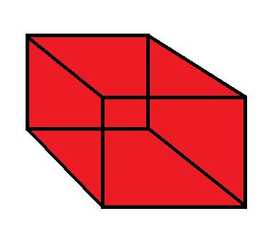
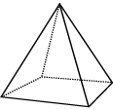
Volume of Rectangular Prisms

Slide 2
Right Prisms
A right prism is a geometric solid that has a polygon as its base and vertical sides perpendicular to the base. The base and top surface are the same shape and size.
Polygon – Many sided shape (octagon, hexagon…)
Click on the link to see some examples of different types of right prisms
  http://www.learner.org/interactives/geometry/3d_prisms.html

Slide 3
VOLUME
VOLUME is the amount of liquid or solid that will FILL a 3-Dimensional object!
*Always measured in units cubed (u³)

Slide 4
QUICK DEFINITION
3-Dimensional objects are NOT FLAT.
They have 3 measurements:
  Length
  Width
  Height

Slide 5
What Does Volume Mean?
Click on the link to explore the concept of volume
  http://www.learner.org/interactives/geometry/area_volume.html

Slide 6
Volume – the amount of space occupied by an object.
Example:
The VOLUME of this cube is all the space contained by the sides of the cube, measured in cube units (units³).
h
w
l

Slide 7
Volume – To calculate the volume of a prism, we first need to calculate the area of the BASE of the prism.
Example: The AREA of the base of this rectangular prism is l x w.
h
w
l

Slide 8
Volume – Once we know the area of the base, this is then multiplied by the height to determine the VOLUME of the prism.
We find that:
Volume = Area of Base x Height
Volume = (l x w) x h
h
w
l
*Pro tip: Don’t just multiply all the numbers together. Find the area of the base and multiply by the height. This will make finding the volume of other prisms much easier if you learn this way.

Slide 9
Volume (rectangular prism)
Formula:
V = B x h
V = l x w x h
h
w
l

Slide 10
Find the volume of this prism…
Formula:
V = B x h
V = l x w x h
7 cm
4 cm
5 cm

Slide 11
Find the volume of this prism…
Formula:
V = B x h
V = l x w x h
V = 5cm x 4cm x 7cm
7 cm
4 cm
5 cm

Slide 12
Find the volume of this prism…
Formula:
V = B x h
V = l x w x h
V = 5cm x 4cm x 7cm
V = 140cm³
7 cm
4 cm
5 cm

Slide 13
Does it matter which side is the base?
Formula:
V = B x h
V = l x w x h
V = 7cm x 4cm x 5cm
5 cm
4 cm
7 cm

Slide 14
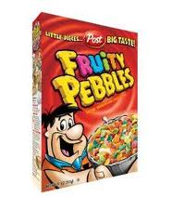
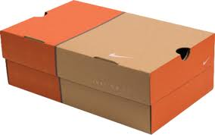

RECTANGULAR PRISM
A RECTANGULAR PRISM, is a solid figure that has six faces that are all rectangles. Opposite faces are congruent and parallel.

Slide 15
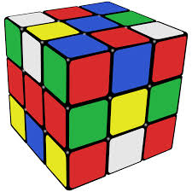
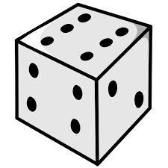
Cube
A CUBE, is a solid figure that has six faces that are all squares. All faces are congruent and parallel. This shape is classified as a rectangular prism because all squares are technically rectangles

Slide 16
FIND THE VOLUME OF THIS RECTANGULAR PRISM:
3 mm
2 mm
12 mm

Slide 17
FIND THE VOLUME OF THIS RECTANGULAR PRISM:
4 in
10 in
3 in

Slide 18
FIND THE VOLUME OF THIS RECTANGULAR PRISM:
11 in
40 in
9 in

Slide 19
FIND THE VOLUME OF THIS RECTANGULAR PRISM:
8 m
8 m
8 m

Slide 20
FIND THE VOLUME OF THIS RECTANGULAR PRISM:
5 cm
5 cm
5 cm

Slide 21
A cereal box has a length of 8 inches, a width of 1.75 inches, and a height of 12.125 inches? How much cereal will the box hold?

Slide 22
Wordtoon
b

Slide 23


Slide 24
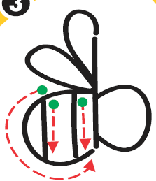

Slide 25


Slide 26
Alexia’s bathroom has a tub in the shape of a rectangular prism with a length of 1.5 meters, a width of
0.5 meter, and a height of 0.4 meter.
How many cubic meters of water can it hold?

Slide 27
Trailers that travel on the road behind trucks are rectangular prisms. A typical height for the inside of these trailers is 108 inches. If the trailer is 8 ft wide and 20 ft long, what is the volume of the trailer?
Hint: Make sure you are using the same units. 1ft = 12in

Slide 28
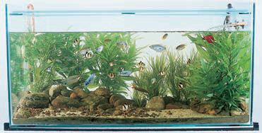
An aquarium shaped like a rectangular prism has a length of 120 centimeters, a width of
60 centimeters, and a height of
100 centimeters. How much water is needed to fill the aquarium?

Slide 29
A rectangular prism has a length of
2 inches, a height of 5 inches, and a width of 3 inches. What is the volume of this rectangular prism?

