Slide 1


State by: Phoenix

Slide 2
LARGEST CITIYS AND THE CAPITAL
Phoenix The capital is Phoenix
Tucson
Mesa
Glendale
Scottsdale

Slide 3
Bodies of water
Coolidge Dam
Theodore Roosevelt
Hoover Dam
Lake Powell
Lake mead
Lake Mohave

Slide 4
FAST FACTS
ARIZONA joined the union in February 14, 1912
6 largest state
Located in the south
It’s apart of the four corner states

Slide 5
GEROGRPHY
The states that border Arizona are CALIFORNIA,UTAH,COLORADO,NEW MEXICO, and NEVADA.
The Theodor Roosevelt dam was built in 1911

Slide 6
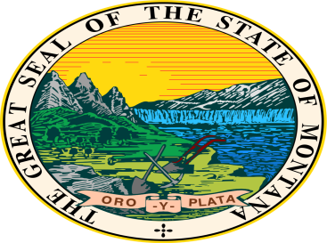
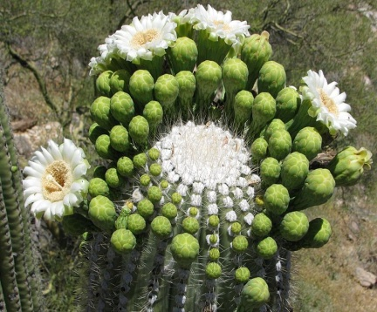
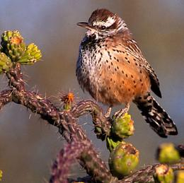

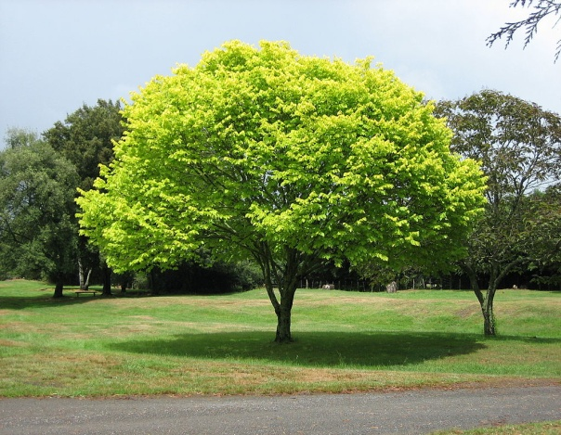
STATE SYMBOLS

Slide 7
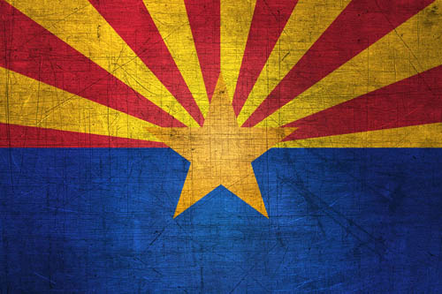
State flag and motto
“Ditat Deus”-Latin for “GOD Enriches”
State flag

Slide 8
FAMOUS PEOPLE
Raul Castro Arizona governor
Barry Goldwater a U.S. senator
Cesar Chavez a Labor organizer

Slide 9

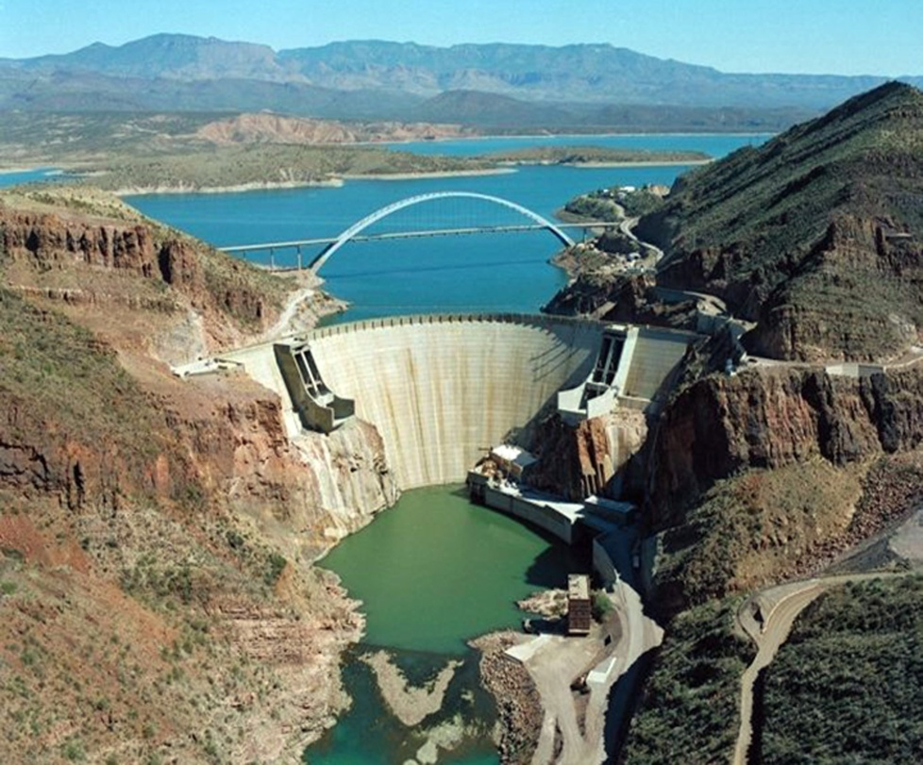
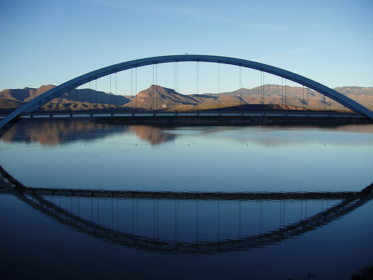
History
15 Native American tribes lived in Arizona
Arizona fount in world war 1
In 1911 the Theodore Roosevelt Dam

Slide 10
FUN EVENTS
Festival of the Arts
Fortier days
American Indian Exposition
Easter Sunrise Service
Arizona National Stock show

Slide 11
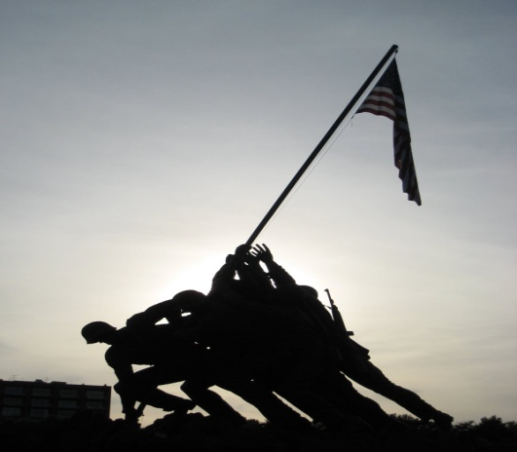
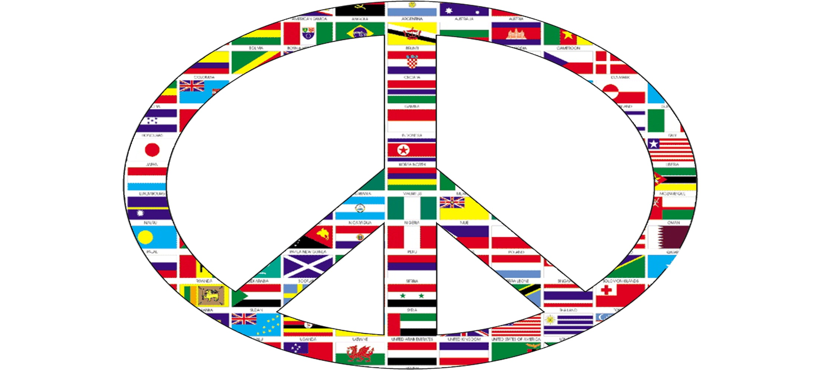
WAR
WOLD WAR I
WORD WAR II
Navajo war

Slide 12



You’re smarter now

