Slide 1
Science Specific
Language Development
Workshop Three
January 21, 2016

Slide 2
2016 NYSESLAT Update
www.esboces.org/Page/1461
  Overall structure of the 2016 NYSESLAT grades 1-12
  Revision of Test Design of 2016 NYSESLAT @ Kindergarten level
  2016 Speaking Rubrics for grades K-12
  DRAFT Rubrics for Listening, Reading, Writing for K; 1-2; 3-4; 5-6; 7-8; 9-12
  Targets of Measurement (ToMs) for Speaking, Listening, Reading & Writing for all grade bands.
  From December 28th email/Terri Brady-Mendez

Slide 3
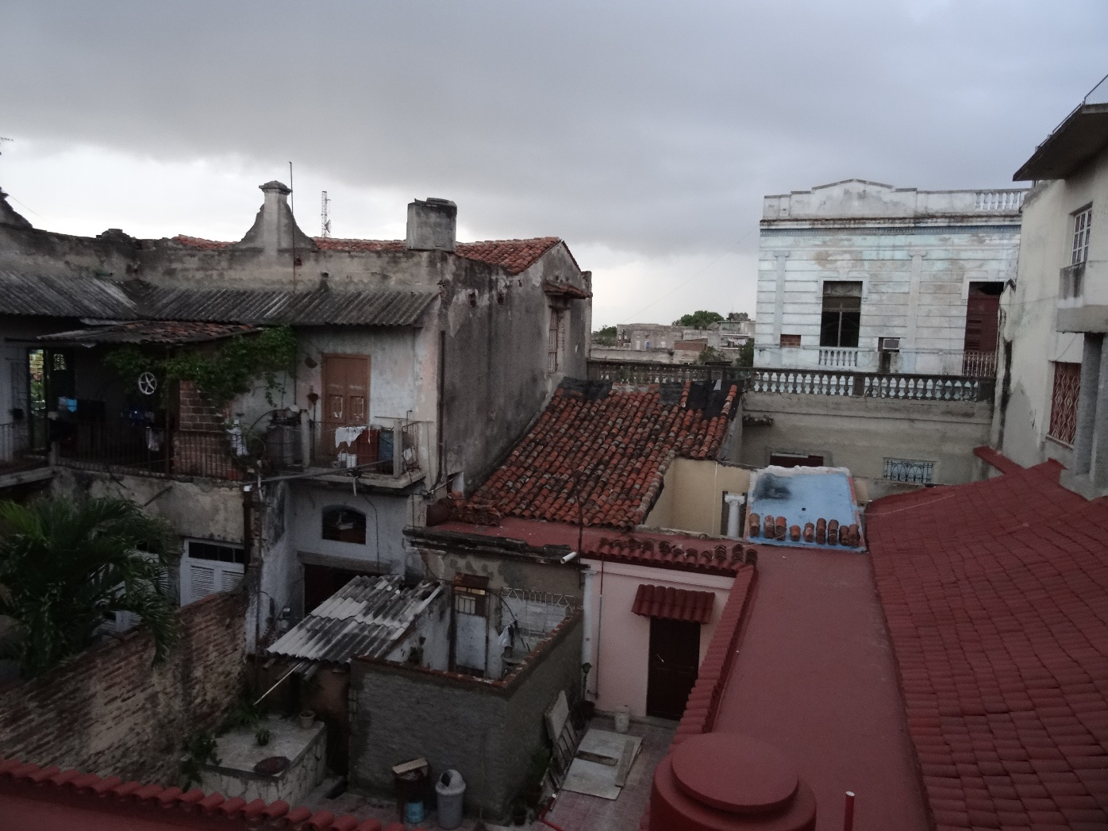
Cameguey, Cuba

Slide 4
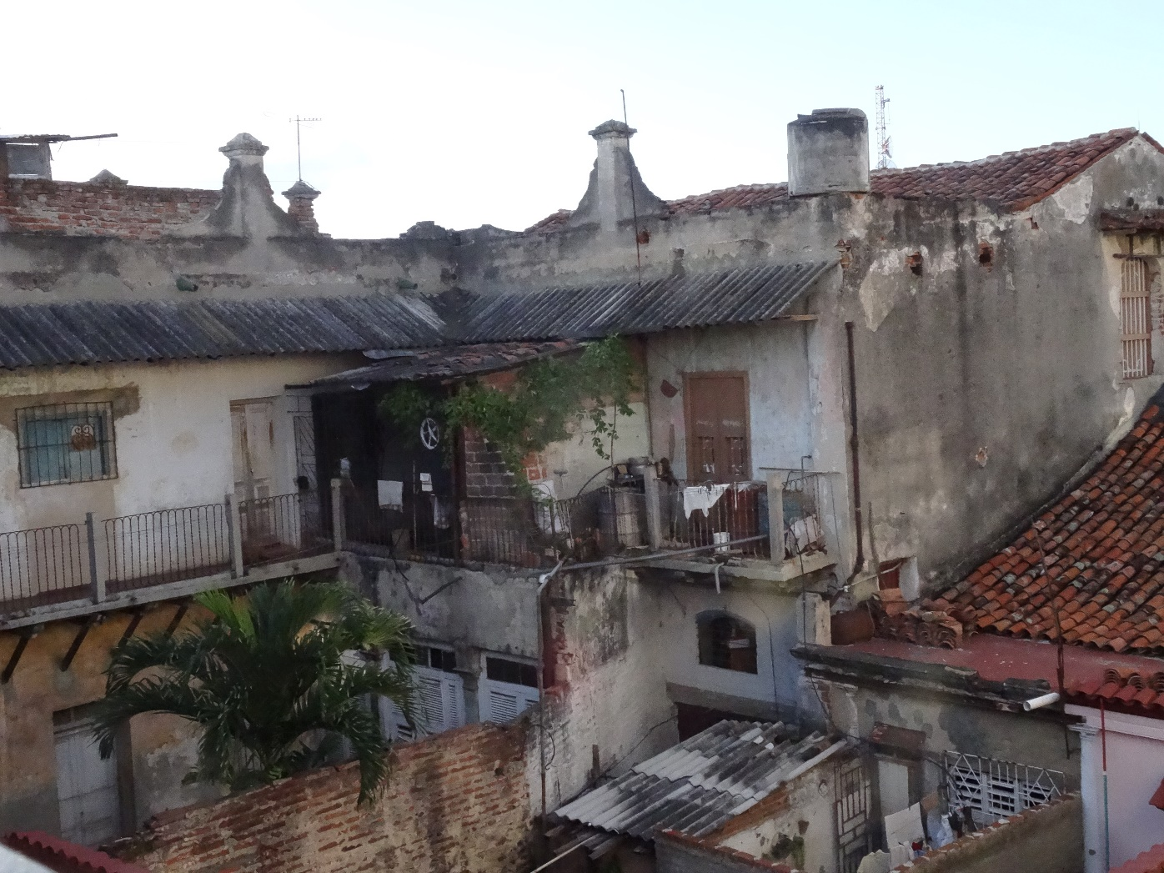
Camaguey, Cuba

Slide 5
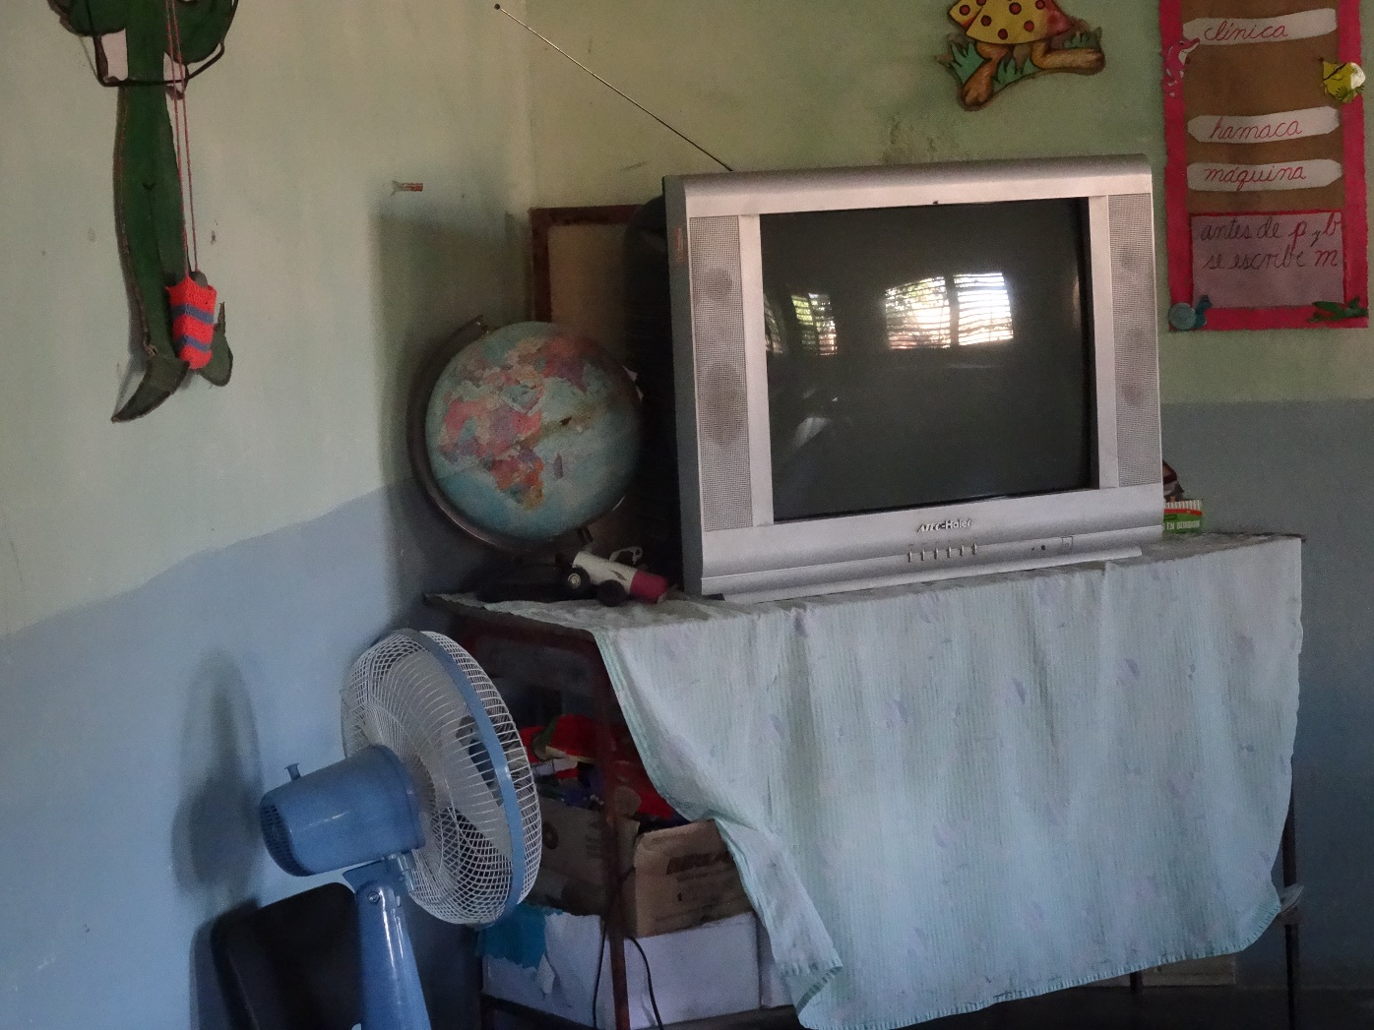
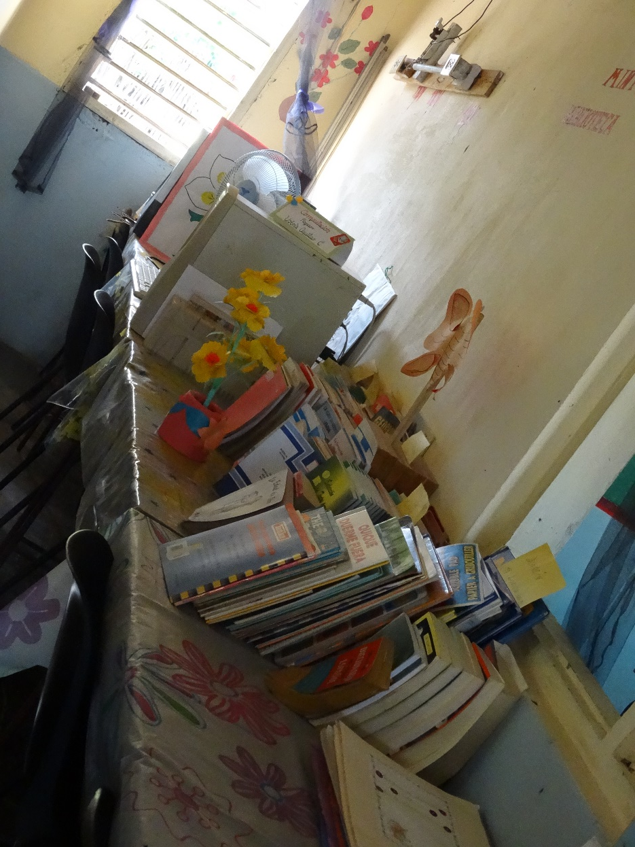
King Ranch, Cuba

Slide 6
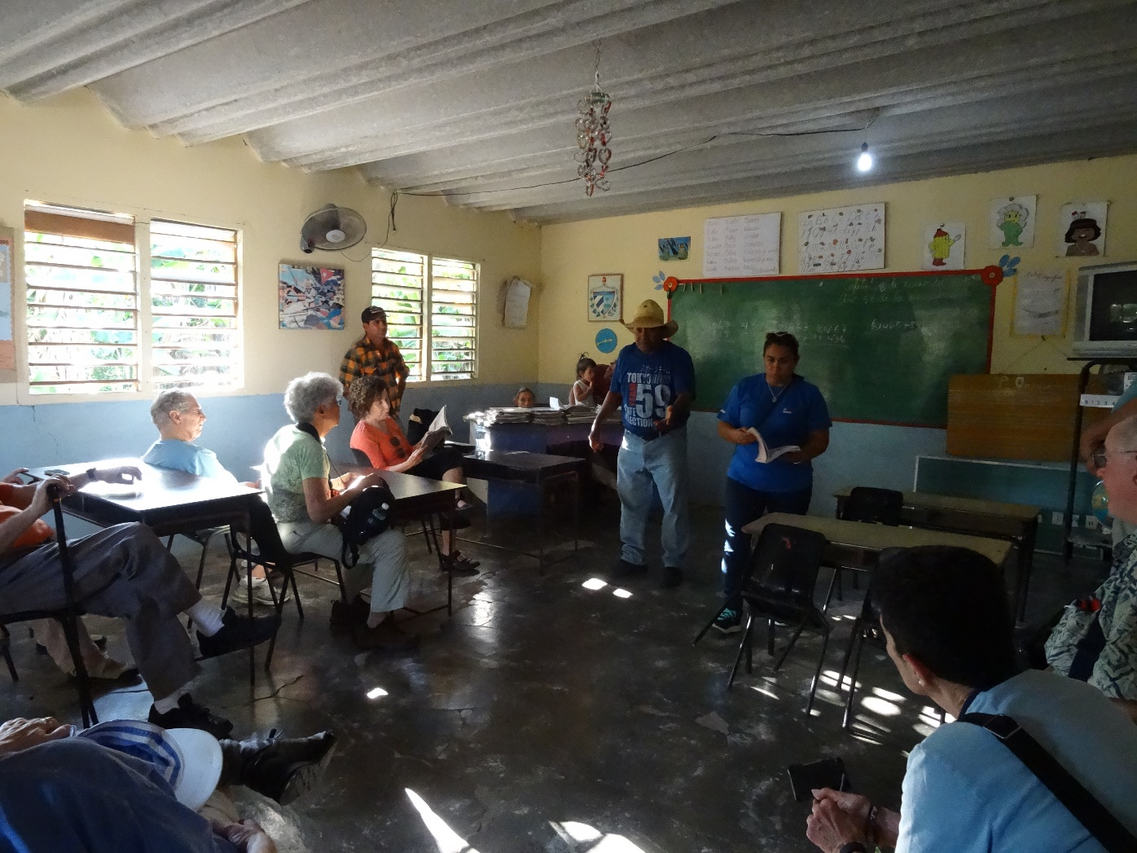
King Ranch, Cuba

Slide 7
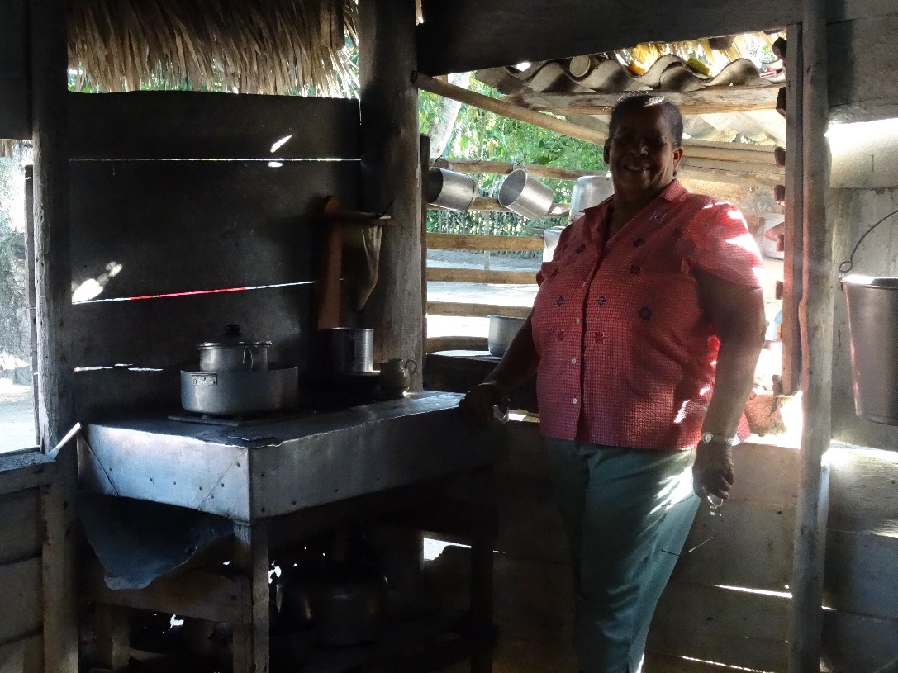
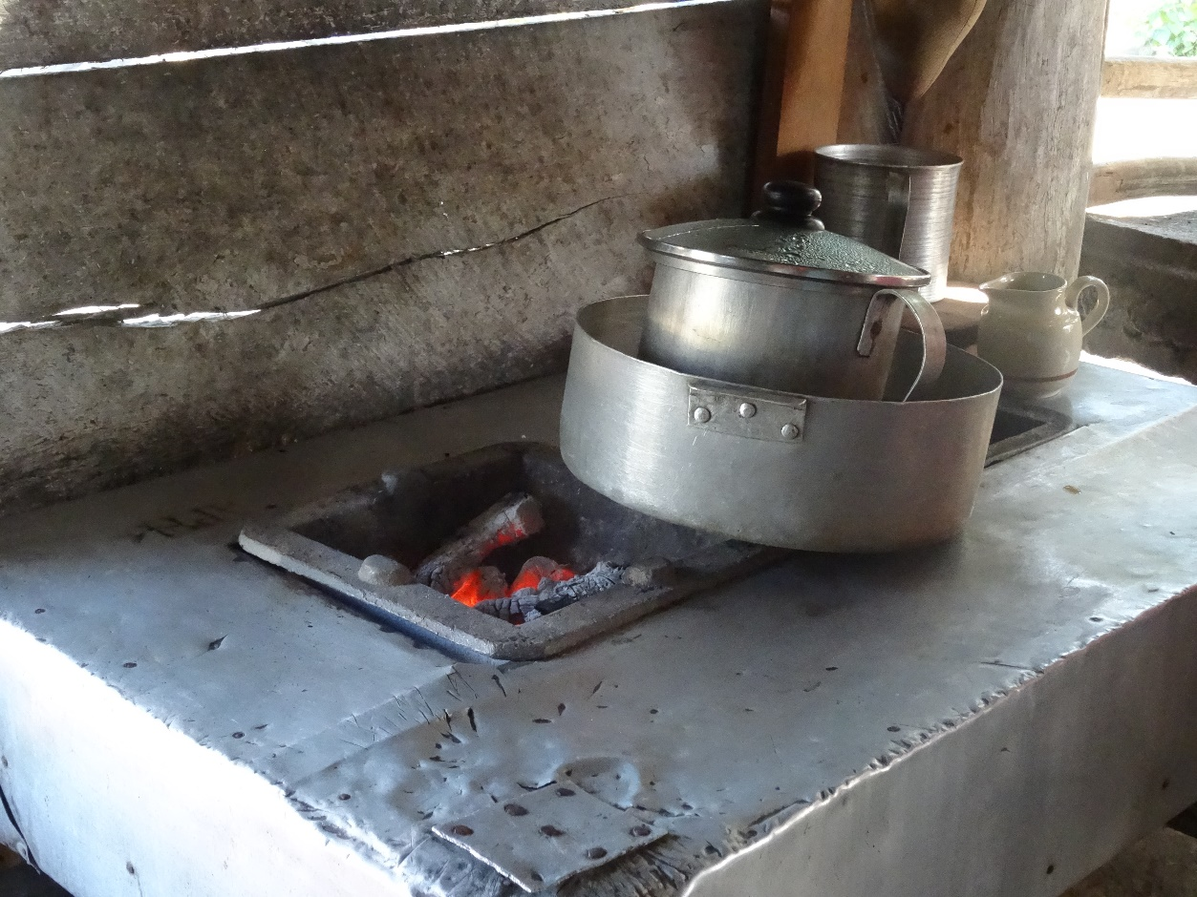
King Ranch, Cuba

Slide 8
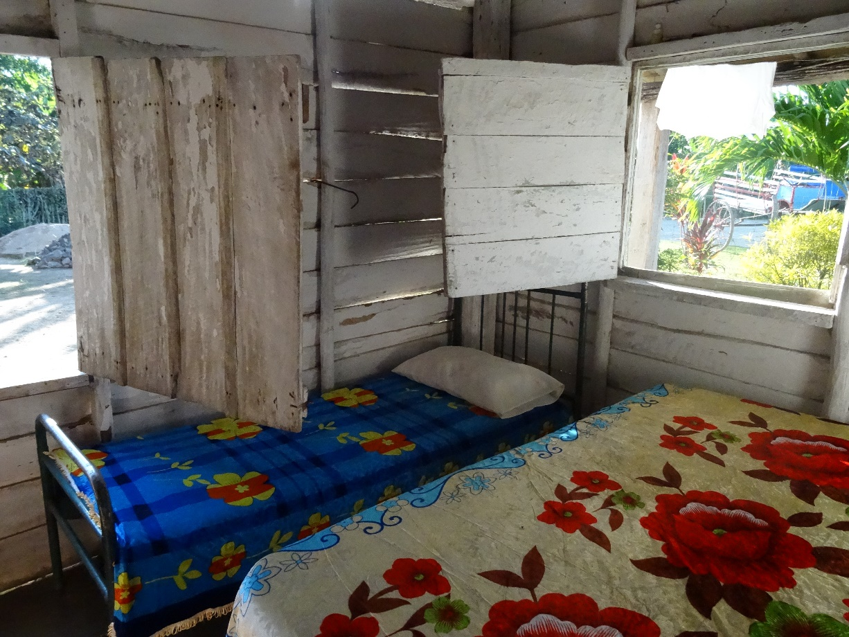
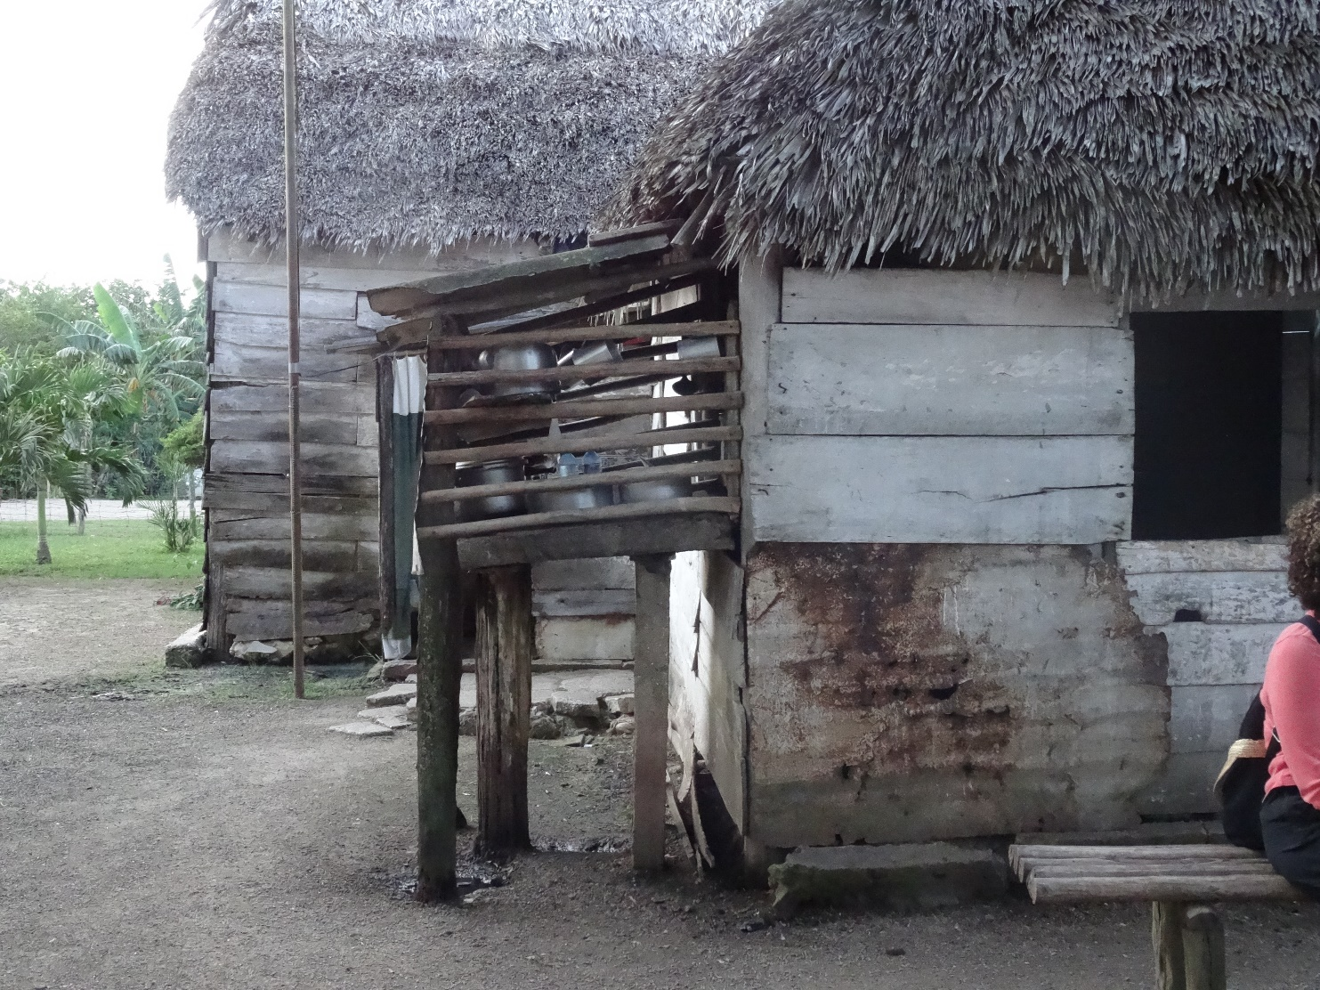
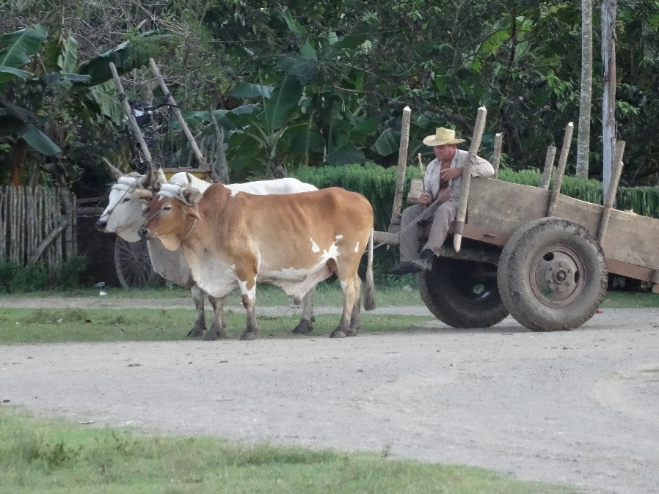
King Ranch, Cuba

Slide 9
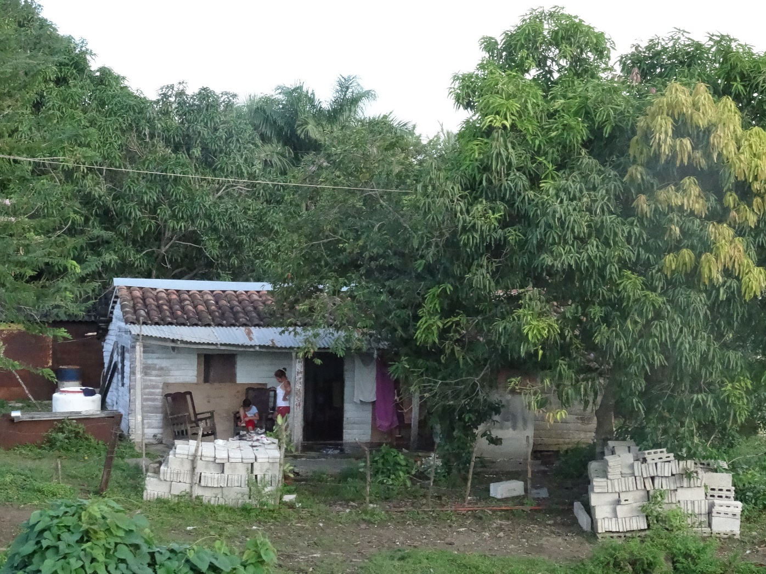
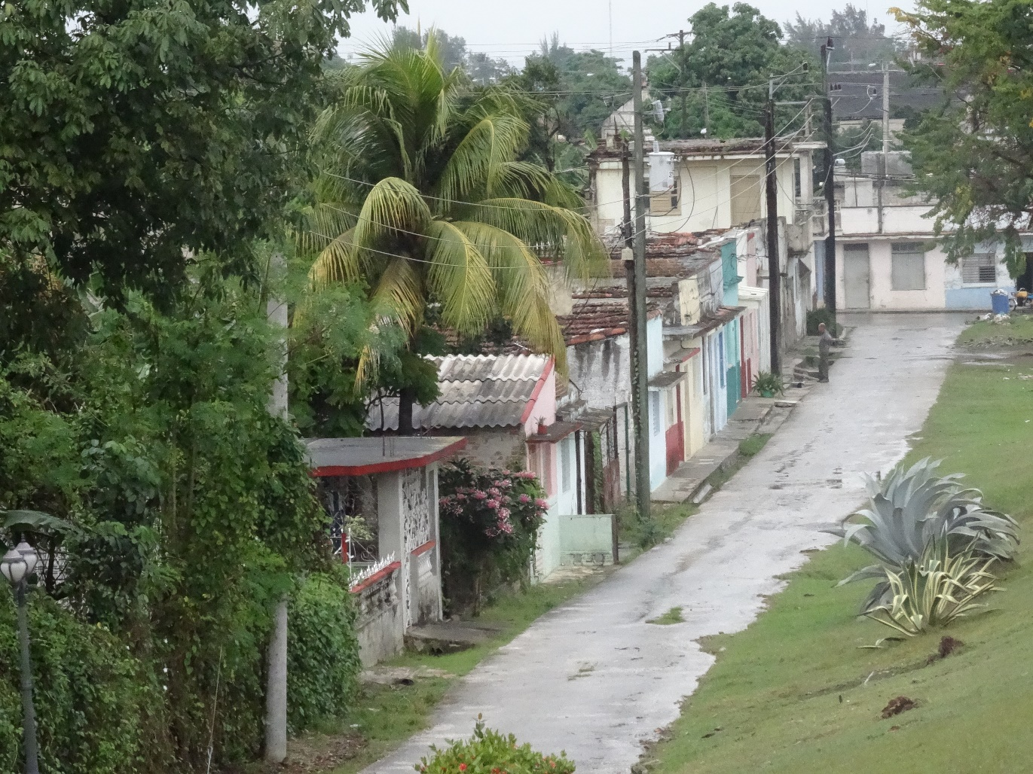
Remedios, Cuba

Slide 10

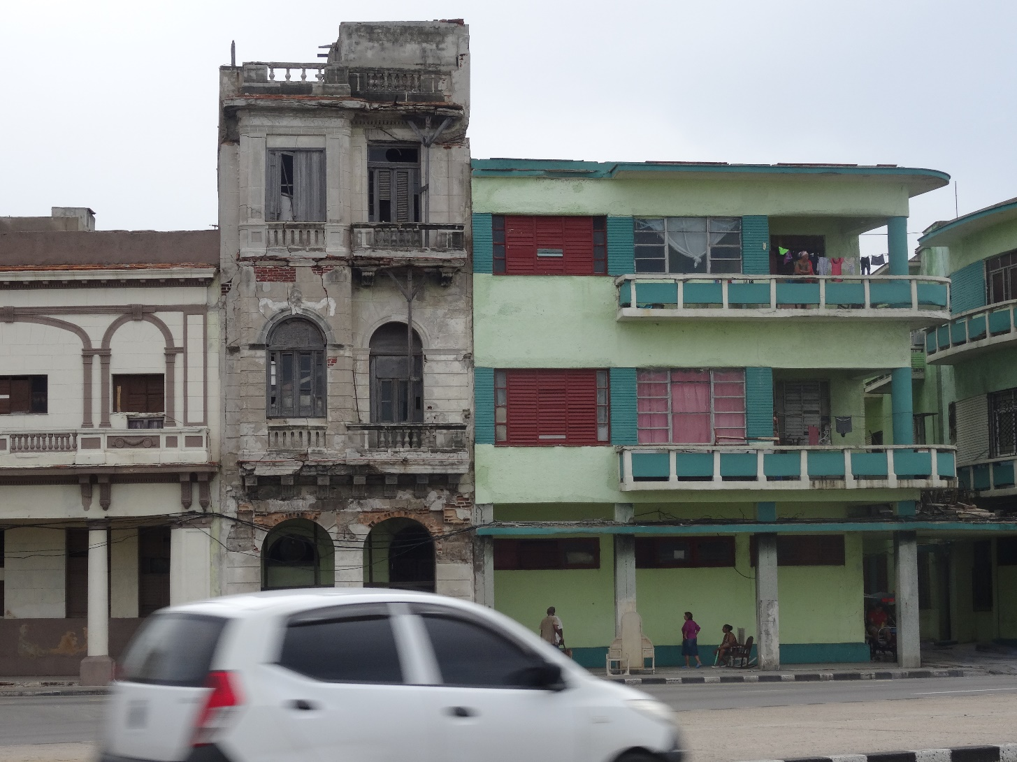
Havana, Cuba

Slide 11
SIOP
Challenges for ELLs with Science
http://siop.pearson.com/
About SIOP : Watch video on each of the 8 major components
Tools and Resources…Activities …Recorded Webinars….
Books and Resources…Trial version of PD Toolkit for
Words Their Way
http://pdtoolkit.pearson.com
Notes:
Go to ‘About SIOP’ > scroll down to ‘Building Background’ > play video – three different levels of building background

Slide 12
Changes…
call,
blame,
punish,
teach
Notes:
Changes in the classroom (present perfect passive)
Ask a student or students to leave the room. Make some changes in the classroom, e.g. knock some books onto the floor, turn the lights out, erase the board etc. Ask the students to come back into the room and guess what has been changed.
Changes in your life (past passive or passive with used to)
Write the following words up on the board: call, blame, punish, teach. Ask the students to think about when they were children. They should write sentences in the past passive, or used to passive with these verbs. For example:
When I was eight years old…
I was called Chuckie.
I was taught to listen in class and never question the teacher.
I always used to be blamed for hitting my little brother.

Slide 13
Academic Language
“Educators have begun to realize the mastery of academic subjects is the mastery of their specialized patterns of language use, and that language is the dominant medium through which these subjects are taught and the students’ mastery of them tested”
(Lemke, 1988, p.81)
  Scientific language has a preference in its grammar for using the passive voice!
The passive voice is especially helpful (and even regarded as mandatory) in scientific or technical writing or lab reports, where the actor is not really important but the process or principle being described is of ultimate importance. Instead of writing "I poured 20 cc of acid into the beaker," we would write "Twenty ccs of acid was poured into the beaker." The passive voice is also useful when describing, say, a mechanical process in which the details of process are much more important than anyone's taking responsibility for the action: "The first coat of primer paint is applied immediately after the acid rinse."

Slide 14
Learning Processes
There are similarities in both science and language learning processes. Learning science and learning a language are cognitive processes that support each other. The science process skills-including observing, predicting, communicating, classifying, and analyzing- are almost the same as language learning skills - seeking information, comparing, ordering, synthesizing and evaluating. In the classroom, science and language are interdependent, in part because each is based on process skills that are mirrored in each other.
Both science and English instruction focus on skills such as noting details, predicting, distinguishing fact from opinion, and linking words with precise meaning.
Science Process Skills | English Learning Skills
Observing | Seeking Information
Predicting | Comparing
Communicating | Ordering
Classifying | Synthesizing
Analyzing | Evaluating

Slide 15
Guided Scientific Inquiry
The process skills of science inquiry that students use to carry out hands on and minds on investigations in many cases are the same skills used by students that are learning a second language.
Basic Science Process Skills of Inquiry for Primary Grades
Observing - the use of the five senses to gather data about objects and events
Communicating - the use of the spoken and written words, graphs, drawings, and diagrams to share information and ideas with others
Classifying – the use of observations to determine similarities and differences in objects and events to group or order objects or events into categories based on properties or criteria
Measuring – using both standard and nonstandard measures or estimates to describe the dimensions of an object or event
Predicting – stating the outcome of a future event based on a pattern of evidence
Inferring – the use of a logical thought process to show a relationship between observations or provide an explanation of an observation

Slide 16
Next Generation Science Standards
Next Generation Science Standards are built on the notion of learning as a developmental progression. It is designed to help children continually build on and revise their knowledge and abilities, starting from their curiosity about how the world works.
The framework focuses on a limited number of core ideas in science and engineering . A reduction of the number of sheer details is intended to give time for students to engage in scientific investigations and achieve a deeper
understanding for the core ideas presented.
http://www.nextgenscience.org/next-generation-science-standards
This website connects the science standards by grade level with the
corresponding ELA standards !
Notes:
Next Generation Science
http://www.nextgenscience.org/
Next Generation Science Standards Tab / View NGSS by Topic Arrangements / Click on 4 Earth Systems….click on the link How to read the Standards and play the video …. arrow over bold information to read in more detail (Identify Evidence note this scaffolds upon information learned in earlier grades ( siop building knowledge based upon past learning experiences…..CCSS related to ELA

Slide 17
Next Generation Science
Supports an Inquiry Approach to Learning
Show a video / Present an Experience
Teach using informal speech
Teach the vocabulary
Teach using technical vocabulary and sentence structure
Great Interactive Experiments Under Science Tile (Sink and Float)
http://interactivesites.weebly.com/
Science Vocabulary un:dgerken@esboces.org pw: courtney
http://www.spellingcity.com/ (also an app)
Great High School Science Information (nice vocab. Piece) un:dgerken pw Courtney87
www.visionlearning.com/en/library
Science Glossaries
http://www.p12.nysed.gov/biling/bilinged/bilingual_glossaries.htm
Notes:
The more interactive; the more visual – the better our students will remember.

Slide 18
Academic Vocabulary
Process/function words -- general academic words; often the tasks students must accomplish; explain the effect, state in your own words, identify, create, etc.
Common Scientific Language Functions
Analyze | Calculate | Classify | Confirm | Contrast
Defend a Position | Describe | Discuss | Distinguish Fact from Opinion | Estimate
Identify | Interpret | Justify | Observe | Persuade
Predict | Provide Evidence | Question | Reflect Upon | Report
Words/word parts that teach English structure – suffixes, prefixes, formation of passive voice, formation of past tense, irregular verbs…

Slide 19
Activities to Build Background
Magic Curtain of Science
Quickwrite
Oh Yesterday!
Signal Words
Frayer Model
Vocabulary Key Rings
Vocabulary Matching Activities
Notes:
Brief review of activities demonstrated last year…

Slide 20
Magic Curtain of Science
Place 8-10 items in front of class on a table underneath a piece of fabric called the “Magic Curtain of Science”
Tell students you will be lifting the ‘curtain’ for 10 seconds and they are to look at the items and try to remember as many of them as possible
Lift the ‘curtain’ for 10 seconds and then replace it. Have students make a list of what they remembered. Call on students to make a list of what they remembered on the board. (Be sure to add what the students may not have remembered)
Have students predict what they think the lesson might be about.
Notes:
ELA skill being practiced is finding main idea

Slide 21
Quickwrite
Students write what they know about a topic for 2-3 minutes.
  No right or wrong answer
  Spelling/grammar do not matter
  Students must write for the entire time
After writing, students share out
This technique is particularly valuable to provide insights into students’ misconceptions…
Notes:
ELL students may need more time – like 5 min.

Slide 22
Sample Quickwrite
Lesson Concept: static electricity
Content Objective: students will be able to connect what they already know to the lesson topic of static electricity
Language Objective: students will be able to write sentences using background knowledge about static electricity and sentence frames…
  1. One thing I already know about ___ is ____
  2. I remember learning ____ in ____
  3. ____ reminds me of ____ because ____
  Manipulatives that teach science concepts; view static electricity
https://phet.colorado.edu/sims/html/balloons-and-static-electricity/latest/balloons-and-static-electricity_en.html
  –
Notes:
Put teachers into grade band groups; spend 20 min identifying grade appropriate manipulatives – report out to group
Remember differentiation: newcomers might be allowed to draw pictures or list words related to the Quickwrite or more advanced student might engage in Think-Pair-Share and write comments for Beginner.

Slide 23
Oh Yesterday!
Builds background by having students recall & relate info they learned in a prior lesson. Students are encourages to whisper, use a funny voice, using a theatrical manner, etc.
  Oh Yesterday! I learned that…
  Oh Yesterday! We studied…
  Oh Yesterday! I discovered that…
  Oh Yesterday! Our class…
Done quickly. First student may select next student who then selects next student. Usually 4-6 students in a given day

Slide 24
Sample Oh Yesterday!
Lesson Concept: Velocity and Vectors
Content Objective: Students will be able to review facts about Velocity and Vectors
Language Objective: Students will be able to state facts they have learned with inflection and emotion
Understanding Physics with Manipulatives
http://www.physicsclassroom.com/Physics-Interactives
Vectors & Projectiles / The Monkey & the Zookeeper
Notes:
Put teachers into grade band groups; spend 20 min identifying grade appropriate manipulatives. Report out to group
Differentiation thoughts: provide rehearsal time for newcomers; advanced students might be challenged to draw a conclusion or make an analytical statement
The Monkey and the Zookeeper ( Target L 4/5 R 2 / Speed 54 / Degrees 45 first hide / Trace Path / Show Velocity / Show Acceleration )

Slide 25
Sample Signal Words
Lesson Concept: Transpiration (Transpiration is the process by which moisture is carried through plants from roots to small pores on the underside of leaves, where it changes to vapor and is released to the atmosphere. Transpiration is essentially evaporation of water from plant leaves. Transpiration also includes a process called guttation, which is the loss of water in liquid form from the uninjured leaf or stem of the plant, principally through water stomata.)
Content Objective: students will be able to explain the steps of transpiration
Language objective: students will use key vocabulary to write a paragraph describing transpiration
Great Site for short explanations of signal words and examples
http://web.clark.edu/martpe/signal%20words.htm

Slide 26
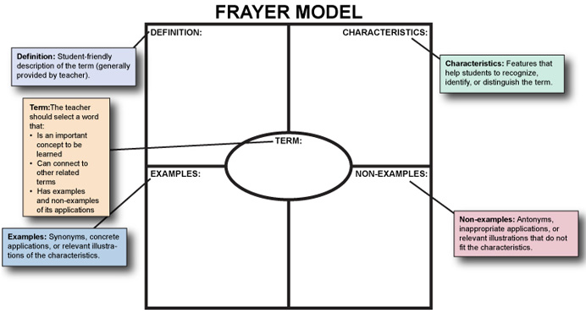
Frayer Model…Vocabulary
Learn a vocabulary word from different perspectives

Slide 27
Frayer Model Vocabulary
Learn a vocabulary word from different perspectives (use SmartArt)
scar
a mark on the skin
scar
blemish
He has a scar on his arm.

Slide 28
Make use of Graph Organizers
Learn a vocabulary word from different perspectives
desert
has very little precipitation
less plant and animal life
lighthouse
help sea navigation
a complex system od lenses
penguins
flightless birds
slide on their bellies
Science: Graphic Organizers assist in understanding !
http://eduplace.com/science/hmsc/content/organizer/index.html

Slide 29
Key Rings
Introduce students to key vocabulary for the unit. Include student-friendly definitions, graphics, other comprehensible input.
Students given note-cards (one per word based on the Frayer Model)
  On the back the student can write a sentence
After checking for accuracy, the teacher punches a hole in the card and adds card to an actual key ring…

Slide 30
Interaction/Practice
Interview – divide students into groups of 3-4; each group is assigned an event to research; when the research is completed students present the information through an interview activity
  One student is the interviewer
  One student takes the role of the character, people or animals that were present when the event took place (a cat that was under the porch when the tornedo hit or the homeowner that couldn’t find the cat)
  The interviewer prepares questions using key vocabulary and interviewee prepares answers using sentence starters & key vocab
  These interviews can be documented using the iMovie App.

Slide 31
Sample Interview Activity
Lesson Concept: Natural Hazards
Content Objectives: students will be able to conduct research on natural hazards
Language Objective: Students will be able to write interview questions and response sentences in order to communicate essential facts
Sandstorms
Question: | Response:
Hurricanes
Question: | Response:
BrainPop – www.brainpop.com
(science based videos)
Notes:
Science / Scientific Inquiry / Scientific Method / Activity /Graphic Organizer / Vocabulary/ Make a Map (Beta) / Q & A (click on questions to read answers. This could be a great way to learn extra vocabulary. The information can be copied and pasted into Rewordify !!!I ) FYI /Quiz /

Slide 32
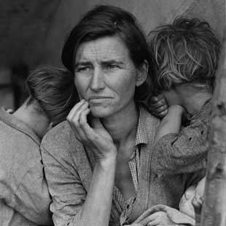

Social Studies --
Notes:
Divide room in half – distribute ‘Image Analysis Worksheet’ > analyze one or other pic using worksheet > evaluate
Destitute pea pickers in California. Mother of seven children. Age thirty-two. Nipomo, California -- http://www.loc.gov/item/fsa1998021539/PP/
http://www.newsday.com/news/nation/senate-to-take-up-bill-for-more-scrutiny-of-syrian-refugees-1.11331797 – Syrian refugees inside border of Jordan.

Slide 33
Teaching Organizational Skills to Help Learn Social Studies Content
Read a text or /website by focusing on:
  Preface
  Introduction
  Table of Contents
  Headers
  Side Bars
  New Vocabulary
  Create an Outline / Graphic Organizer of the Text
Look at Pictures - Read Captions
Read Small Chunks of Information -Take Breaks
Read Out Loud
  Read Again and Highlight
  Write Notes in the Margins
Notes:
Distribute the Odell – ‘Analyzing Details’ worksheet

Slide 34
ELA Skills in Social Studies - Basic Content Area
Adjusting rate of reading
Understanding that the narrative writing style can supply information
Understanding author's prejudices
Using illustrations and charts
Using encyclopedia type entries
Using secondary sources to validate information
Understanding symbols
Map reading
Understanding slogans
Vocabulary
Forming judgments
From Handout by Louisa Kramer Vida, Ed. D., February, 2010
Cause and effect
Developing topics and sub-topics
Locating supporting information
Classifying ideas
Outlining
Summarizing
Using a time line
Using newspapers and magazines for information
Fact vs. Opinion
Skim
Identify propaganda and bias.

Slide 35
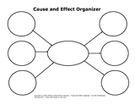
Activity - Create a Graphic Organizer Using
SmartArt
Open MS Word or PowerPoint > Insert > SmartArt > choose a Graphic Organizer or Create a graphic organizer using SmartArt by adding 5 facts about today’s date or another date of your choice – or – use Educreations app to draw a graphic organizer
Open the This Day app, and click on topic of the day that interests you.
Use the website, www.snappywords.com , to find definitions, if needed.

Slide 36
New York State Social Studies Resources from EngageNY
New York State K-12 Social Studies Field Guide
New York State K-12 Social Studies Resource Toolkit
New York State K-12 Social Studies Framework

Slide 37
New York State K-12 Social Studies Framework Guide
New York State K-12 Social Studies Framework – Introduction
  New York State Learning Standards for Social Studies (p. 3)
  New York State Common Core Learning Standards for English Language Arts and Literacy
  in History/Social Studies, Science, and Technical Subjects
    Reading, Writing, and Speaking & Listening (p. 4-6)
    Social Studies Practices (p. 9)
    Unifying Social Studies Themes (p. 10-12)
    K-12 Content Sequence
    Reading the Social Studies Framework (p. 13)
    Progression of Social Studies Practices (p. 14-21)
    Reading and Writing Standards for Literacy in History/Social Studies 5-12 (p. 22-27)

