Slide 1
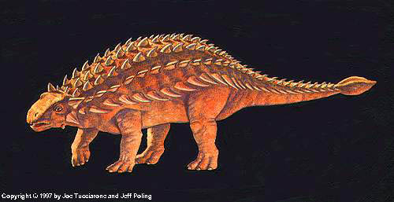
Ankylosaurus
By Zoe Evette McFadden

Slide 2
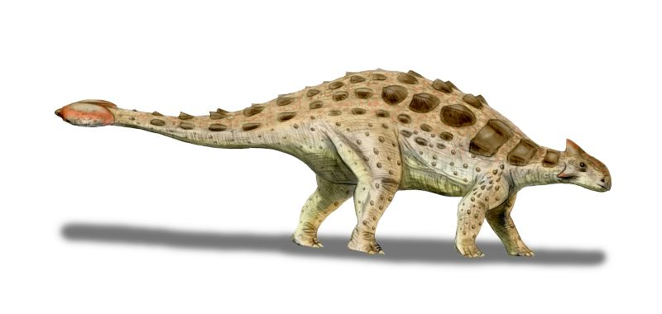
Ankylosaurus
His name means fused, stiff, or bent lizard.

Slide 3
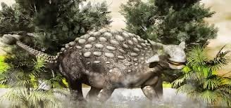
Ankylosaurus
It ate plants.

Slide 4

Ankylosaurus
Length: 25-35 ft.
Height: 4ft.
Weight: 3 – 4 tons

Slide 5
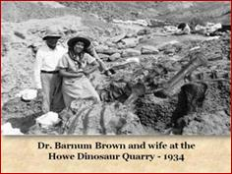
Ankylosaurus
Barnum Brown named the dinosaur in 1908.

Slide 6
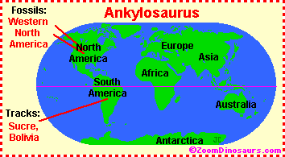
Ankylosaurus
My dinosaur lived in the U.S.A. and Canada.

Slide 7
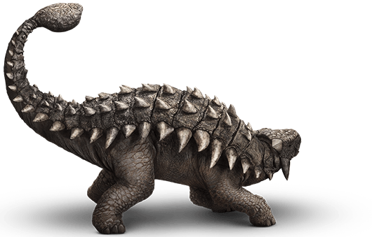
Ankylosaurus
It lived during the Cretaceous Period.

Slide 8
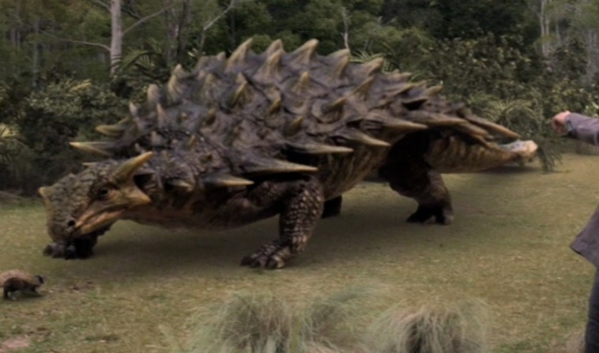
Ankylosaurus
Its intelligence was low.

Slide 9
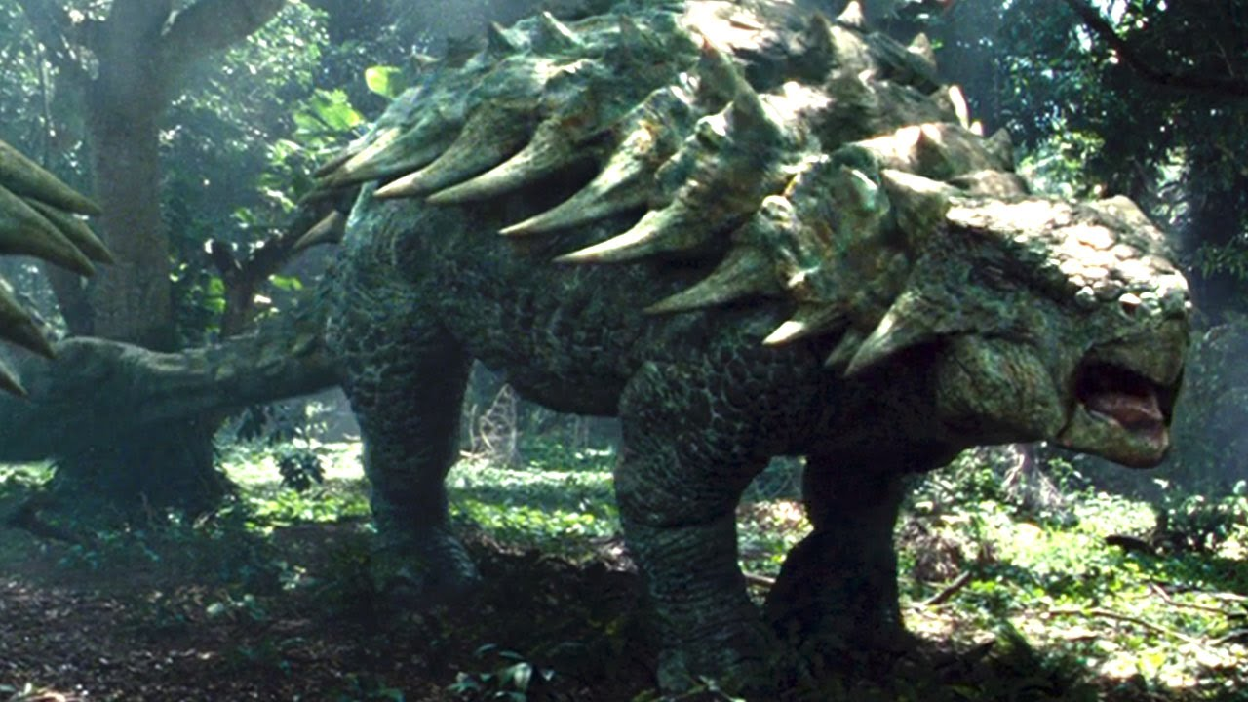
Ankylosaurus
It had a lot of gas from the plants it ate.

Slide 10
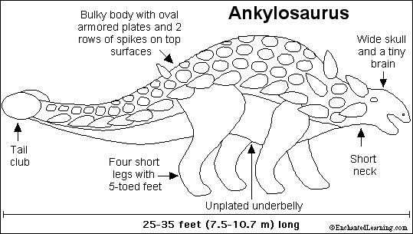
Ankylosaurus
It was an armored dinosaur. Even its eyelids were plated.

Slide 11
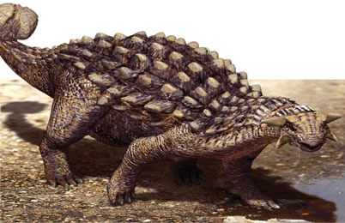
Ankylosaurus
It was a slow moving dinosaur.

Slide 12
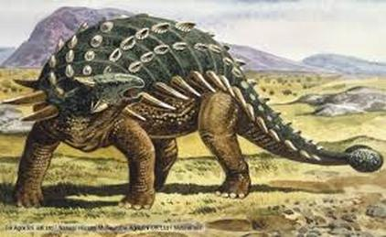
Ankylosaurus
Save the Ankylosaurus!

