Slide 1
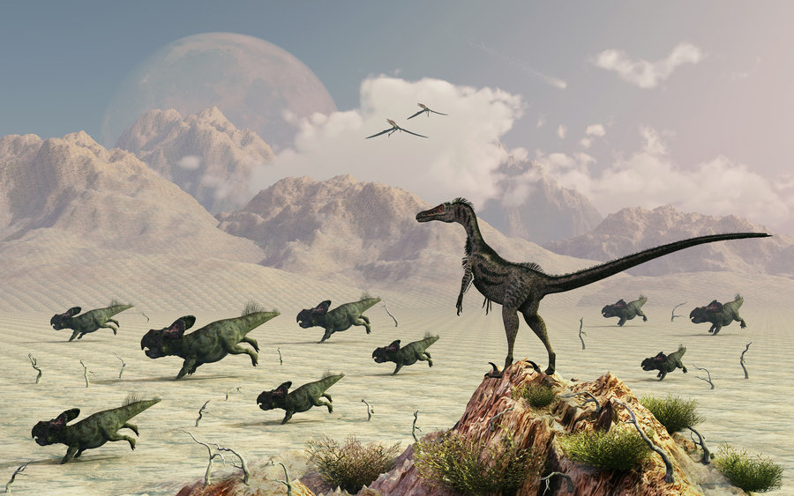
Protoceratops
By Weiler Feldman

Slide 2
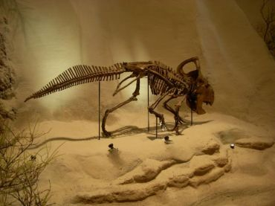
Protoceratops
His name means Five Horned Face.

Slide 3
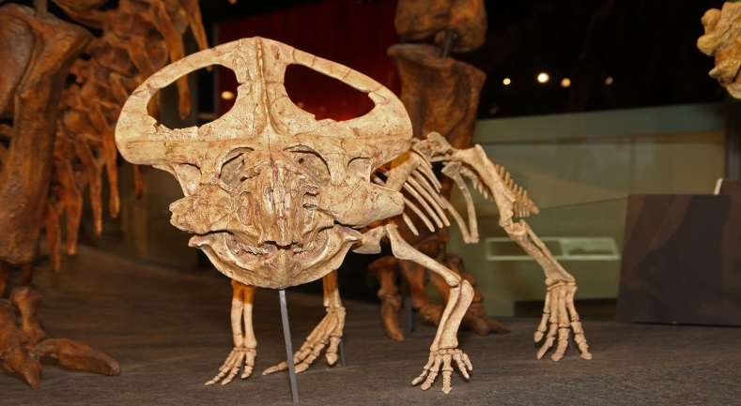
Protoceratops
It was a plant eater.

Slide 4
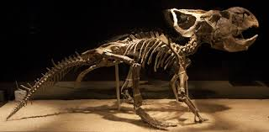
Protoceratops
Length: 6 – 8 ft.
Height: 3 feet
Weight: 900 pounds

Slide 5
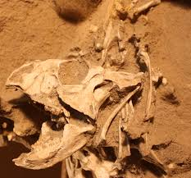
Protoceratops
Walter Granger and W. K. Gregory named it in the 1920’s.

Slide 6
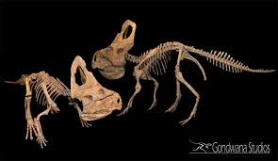
Protoceratops
It lived in Mongolia.

Slide 7
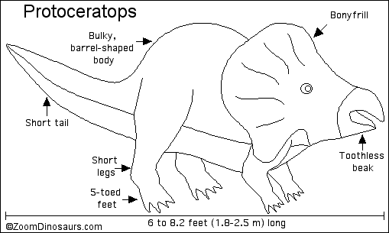
Protoceratops
It lived during the Cretaceous Period.

Slide 8
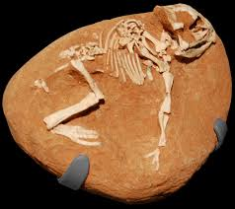
Protoceratops
It walked on four legs.

Slide 9

Protoceratops
It was in the middle range of intelligence.

Slide 10

Protoceratops
The male frills were larger than the female frills.

Slide 11
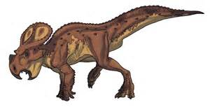
Protoceratops
It had a toothless beak.

Slide 12
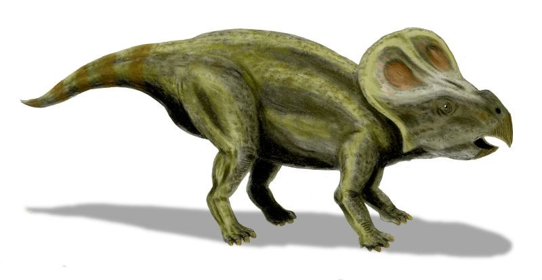
Protoceratops
Please save my dinosaur!

