Slide 1
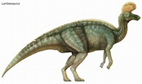
Lambeosaurus
By Maya Johnson

Slide 2
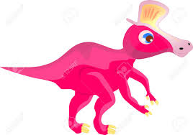
Lambeosaurus
His name means Lambe’s Lizard.

Slide 3
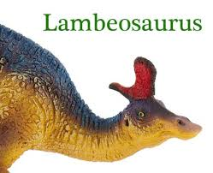
Lambeosaurus
It was a plant eater.

Slide 4
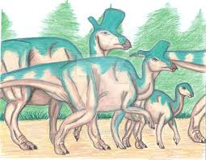
Lambeosaurus
Height: 7 ft.
Weight: 5.6 Tons
Length: 30-50 ft.

Slide 5
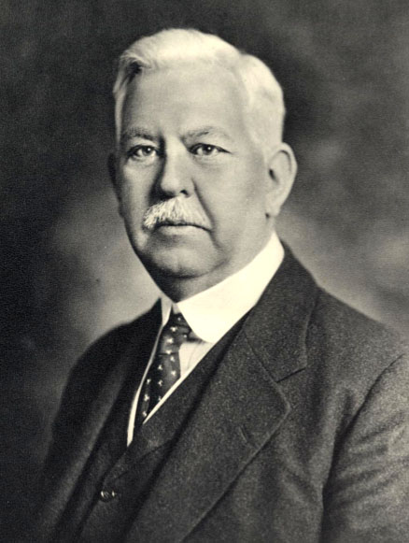
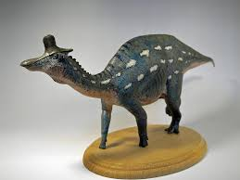
Lambeosaurus
Dr. William A. Parks named the dinosaur in 1923.

Slide 6
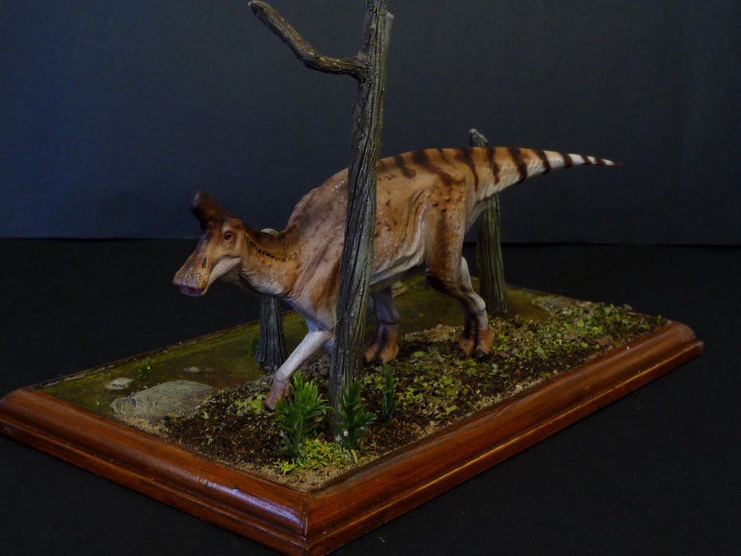
Lambeosaurus
It lived in North America.

Slide 7
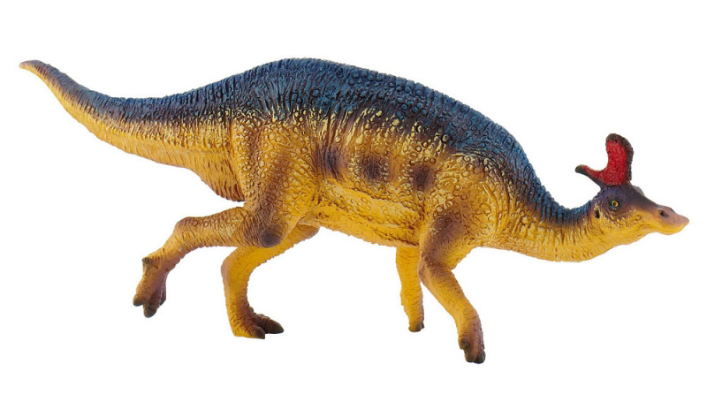
Lambeosaurus
It lived during the Cretaceous Period about 83-65 million years ago.

Slide 8
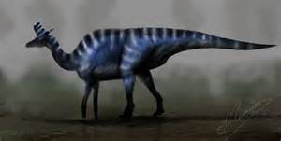
Lambeosaurus
It had a wide toothless bill and many cheek teeth.

Slide 9
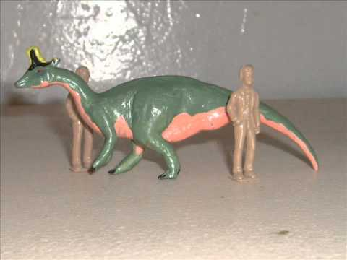
Lambeosaurus
Its hind legs were much larger than its front legs.

Slide 10
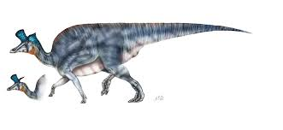
Lambeosaurus
It had a bulky body.

Slide 11

Lambeosaurus
It had a long stiff tail.

Slide 12
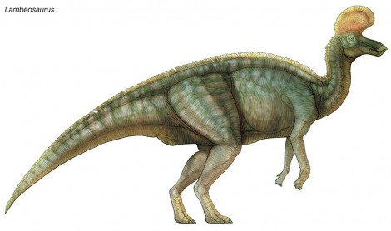
Lambeosaurus
Please save this dinosaur!

