Slide 1
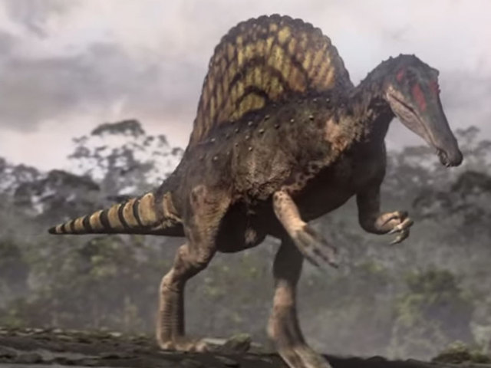
Spinosaurus
By Kendall Curtis

Slide 2
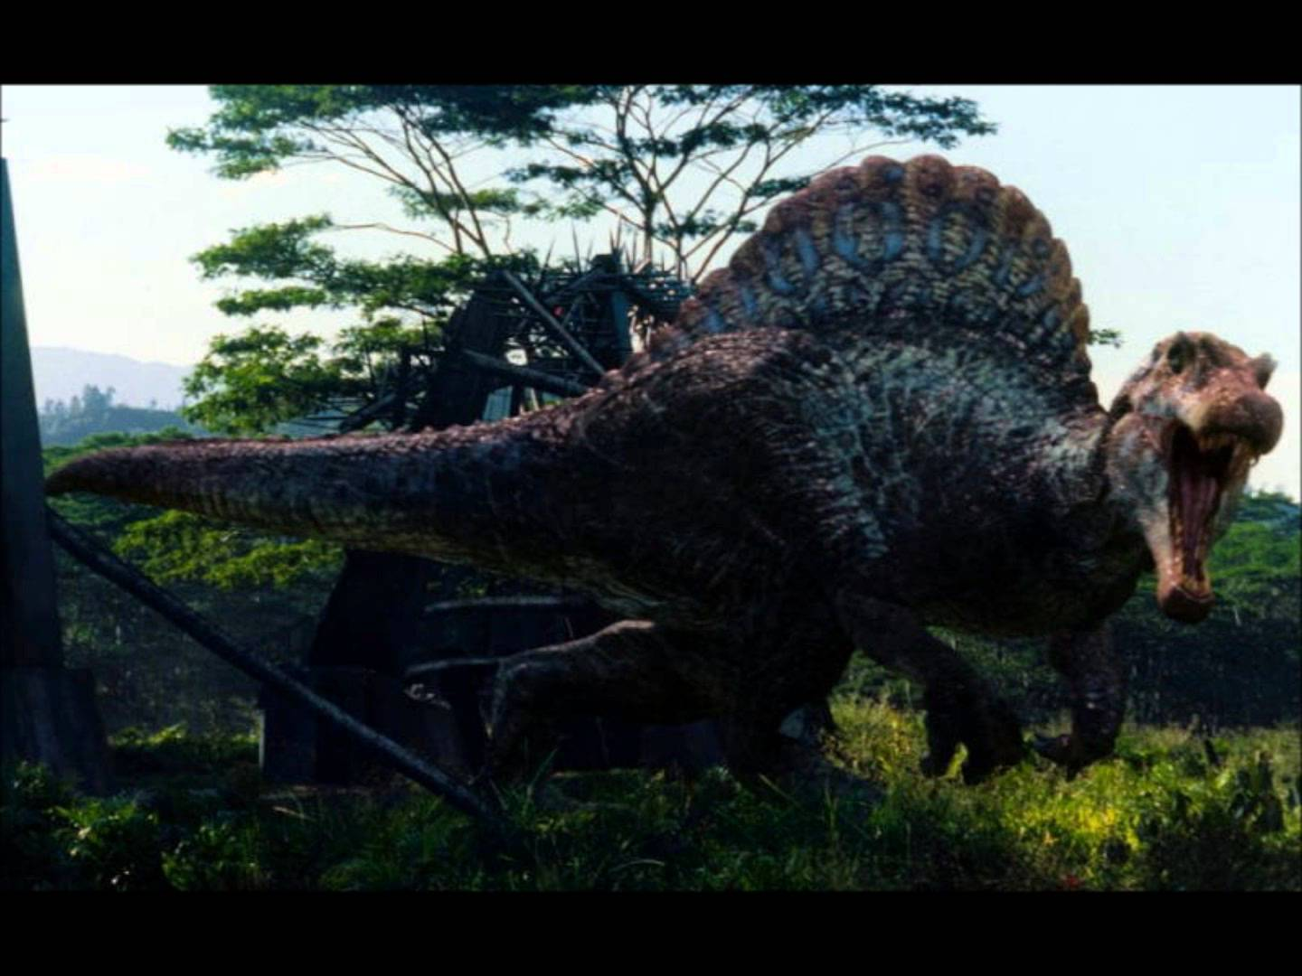
Spinosaurus
His name means Spiny Lizard.

Slide 3
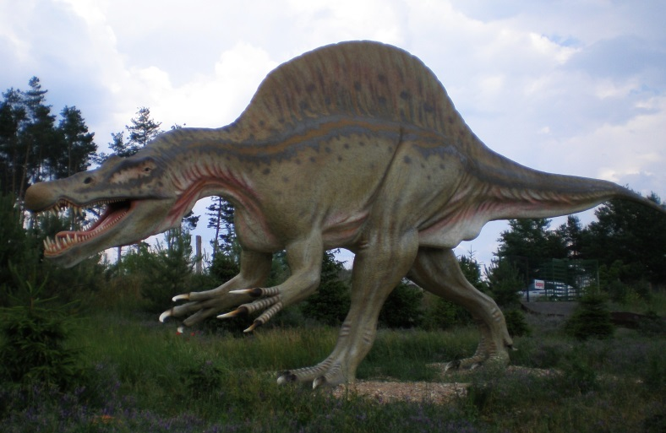
Spinosaurus
It eats fish and plants.

Slide 4
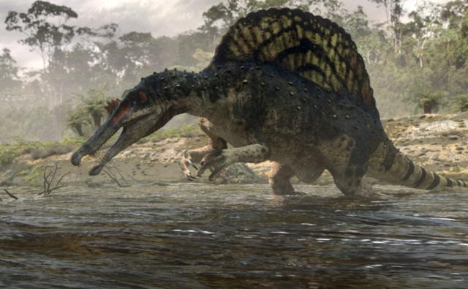
Spinosaurus
Length - 40-50 ft.
Height – 14 ft.
Weight – 4 tons

Slide 5
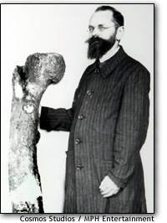
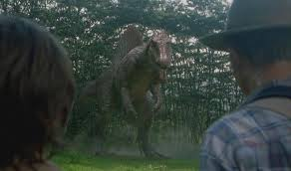
Spinosaurus
It was named by
Ernst Stromer von Reichenbach in 1915.

Slide 6
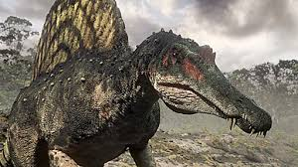
Spinosaurus
It lived in Africa.

Slide 7
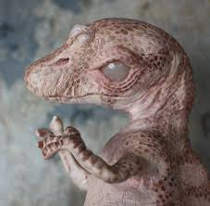
Spinosaurus
It lived 98 to 95 million years ago.

Slide 8
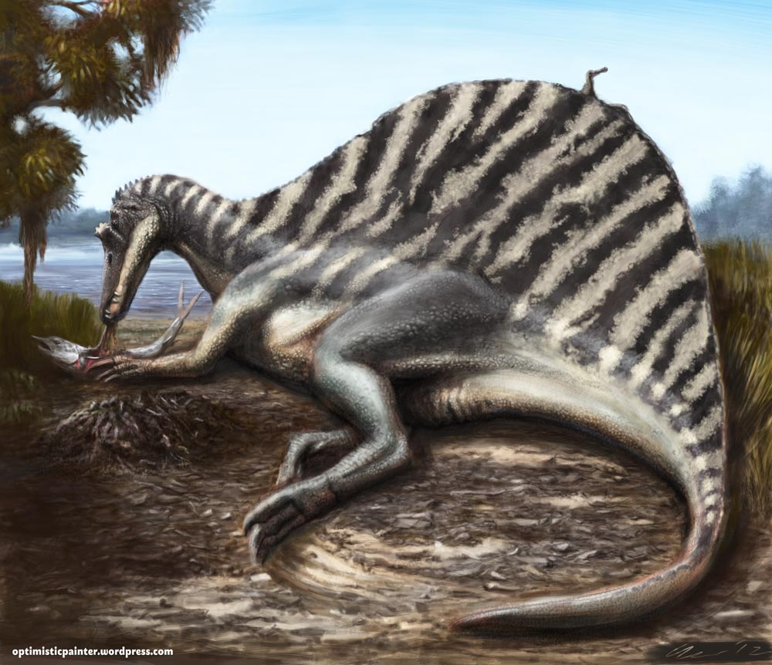
Spinosaurus
It was very smart.
.

Slide 9
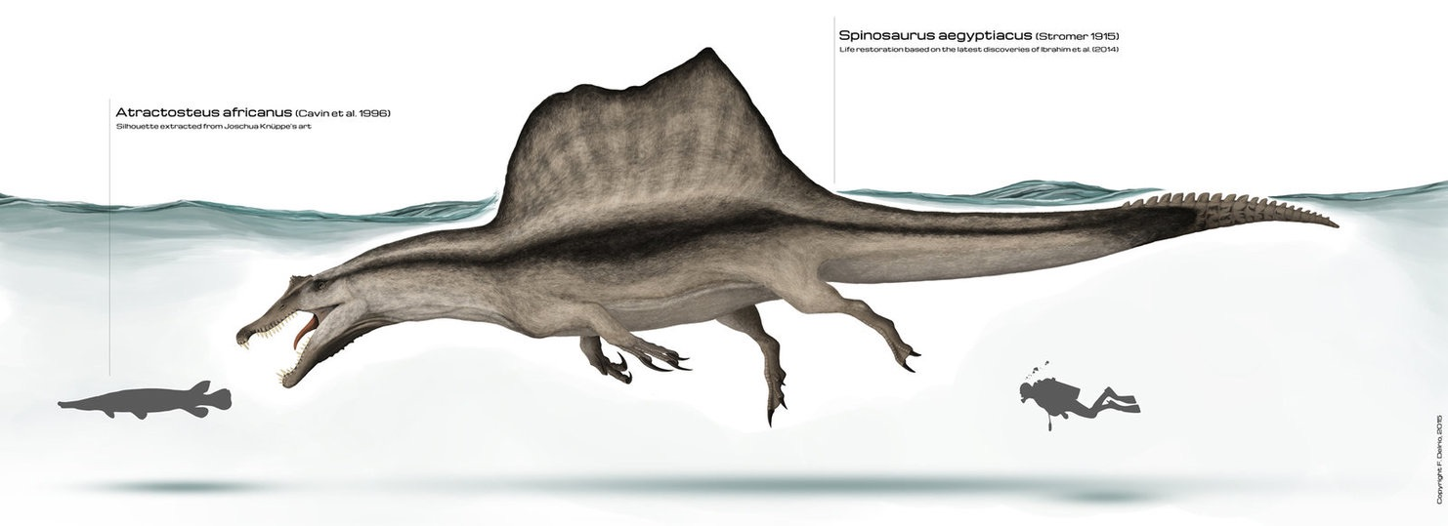
Spinosaurus
It was huge.

Slide 10
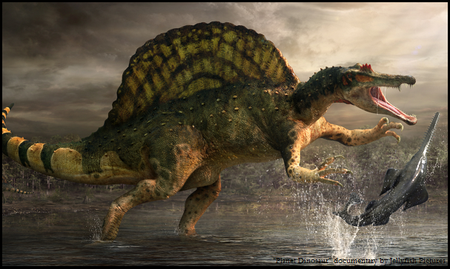
Spinosaurus
It had large bony spines on its back.

Slide 11
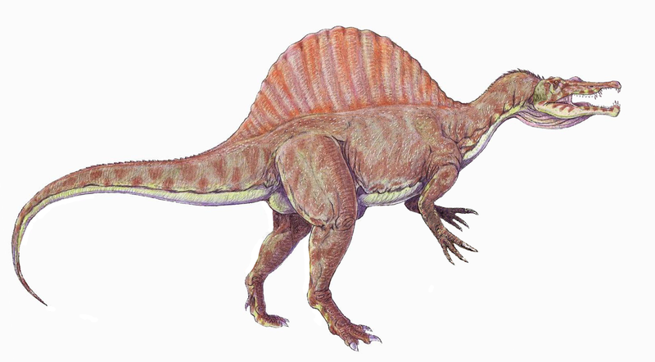
Spinosaurus
Its huge sail may have been used to regulate its temperature.

Slide 12

Spinosaurus

Slide 13

Spinosaurus
Please save this dinosaur!

