Slide 1
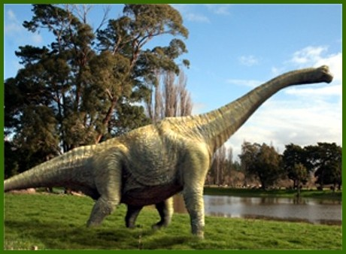
Brachiosaurus
By Emily Smith

Slide 2
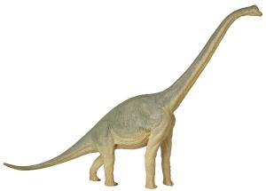
Brachiosaurus
His name means Arm Lizard.

Slide 3
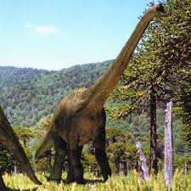
Brachiosaurus
It was a plant eater.
It ate from the top of trees.

Slide 4
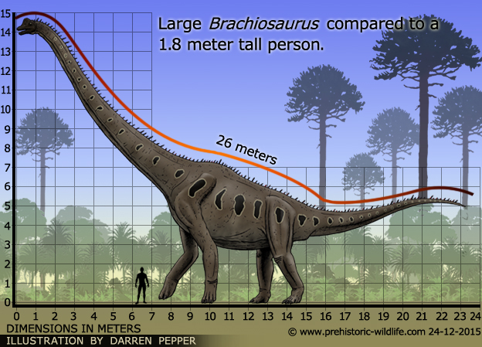
Brachiosaurus
Length: 85 ft.
Height: 50 ft.
Weight: 33-38 tons

Slide 5
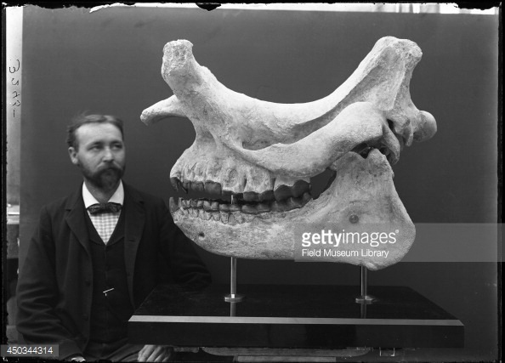
Brachiosaurus
Elmer S. Riggs named
my dinosaur in
1903.

Slide 6
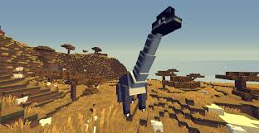
Brachiosaurus
My dinosaur lived in
North America
and Africa.

Slide 7
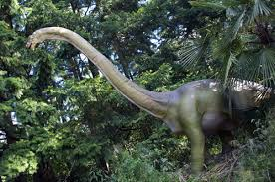
Brachiosaurus
It lived during the
Jurassic Period.

Slide 8
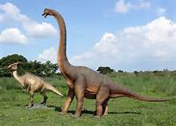
Brachiosaurus
It swallowed food whole without
chewing.

Slide 9
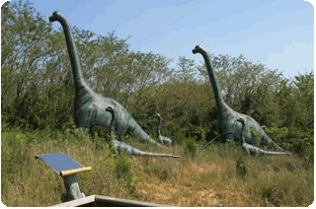
Brachiosaurus
They lived up to
100 years old.

Slide 10
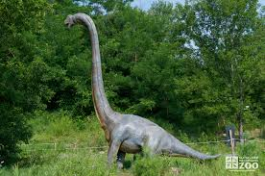
Brachiosaurus
It had very high blood pressure.

Slide 11
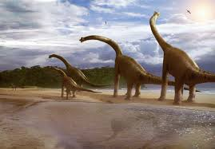
Brachiosaurus
It had a good sense of smell and a total of 52 teeth.

Slide 12
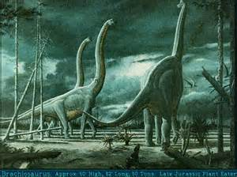
Brachiosaurus
Save my dinosaur!

