Slide 1
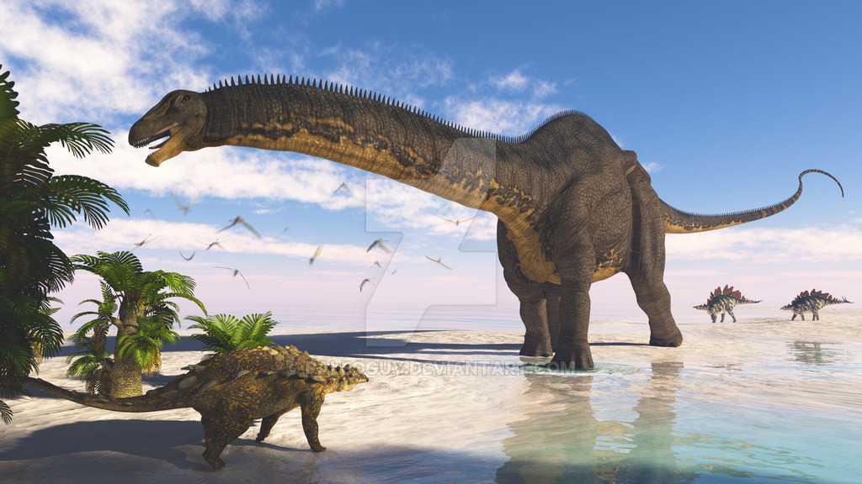
Apatosaurus
By Ellianna Cerrato

Slide 2
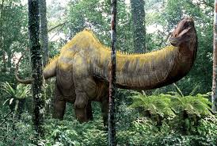
Apatosaurus
Its name means the deceptive lizard.

Slide 3
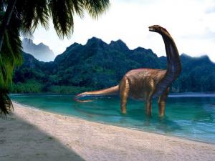
Apatosaurus
It was a plant eater.

Slide 4
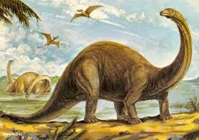
Apatosaurus
Length: 70- 90 feet
Height: 15 feet
Weight: 33-38 tons

Slide 5
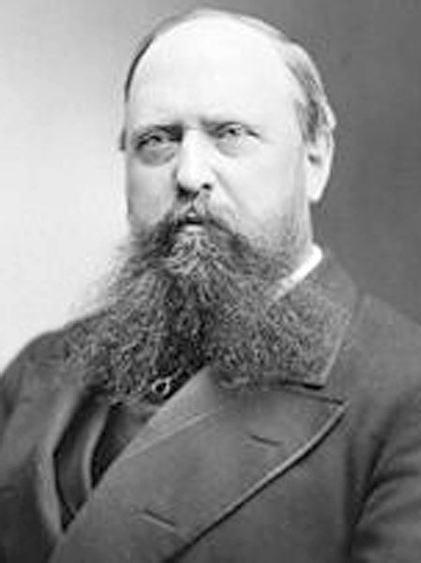
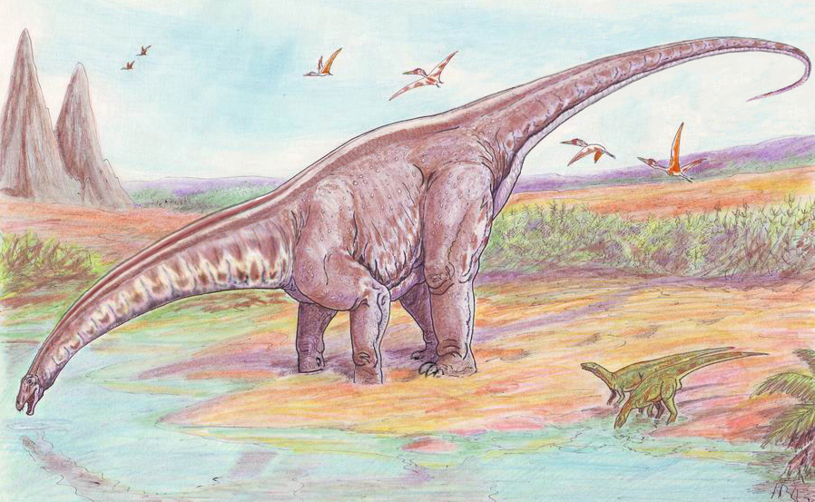
Apatosaurus
Othniel Marsh
named the dinosaur in 1877.

Slide 6
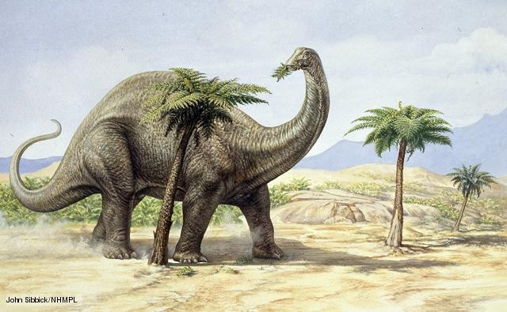
Apatosaurus
It was found in Western North America.

Slide 7
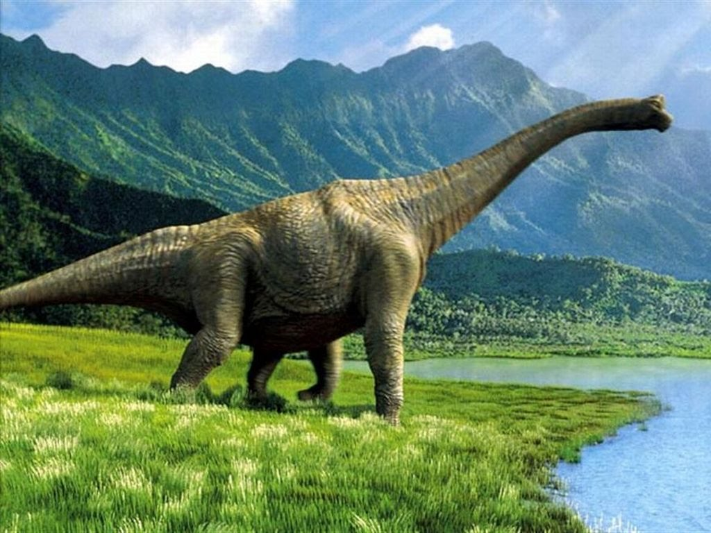
Apatosaurus
It lived 157-146 million years ago.

Slide 8
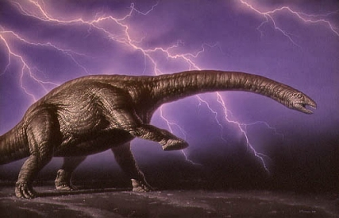
Apatosaurus
It swallowed stones to help it grind up food.

Slide 9
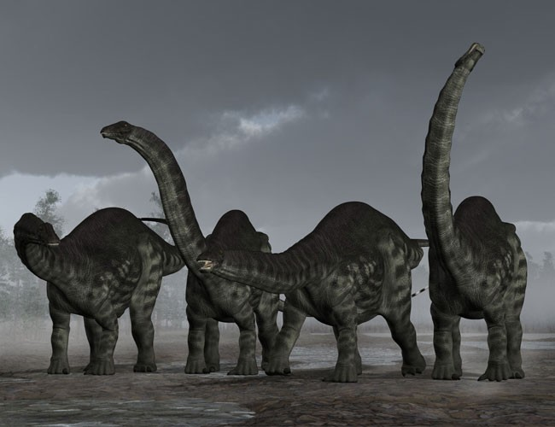
Apatosaurus
It had a small mouth and peg-like teeth.

Slide 10
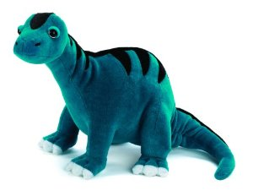
Apatosaurus
It had a long small skull with nostrils
toward the top of its head.

Slide 11
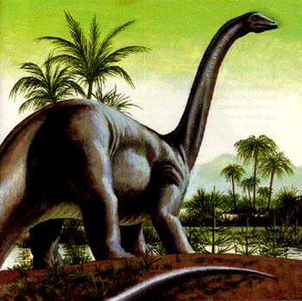
Apatosaurus
It had a long whip-like tail.

Slide 12
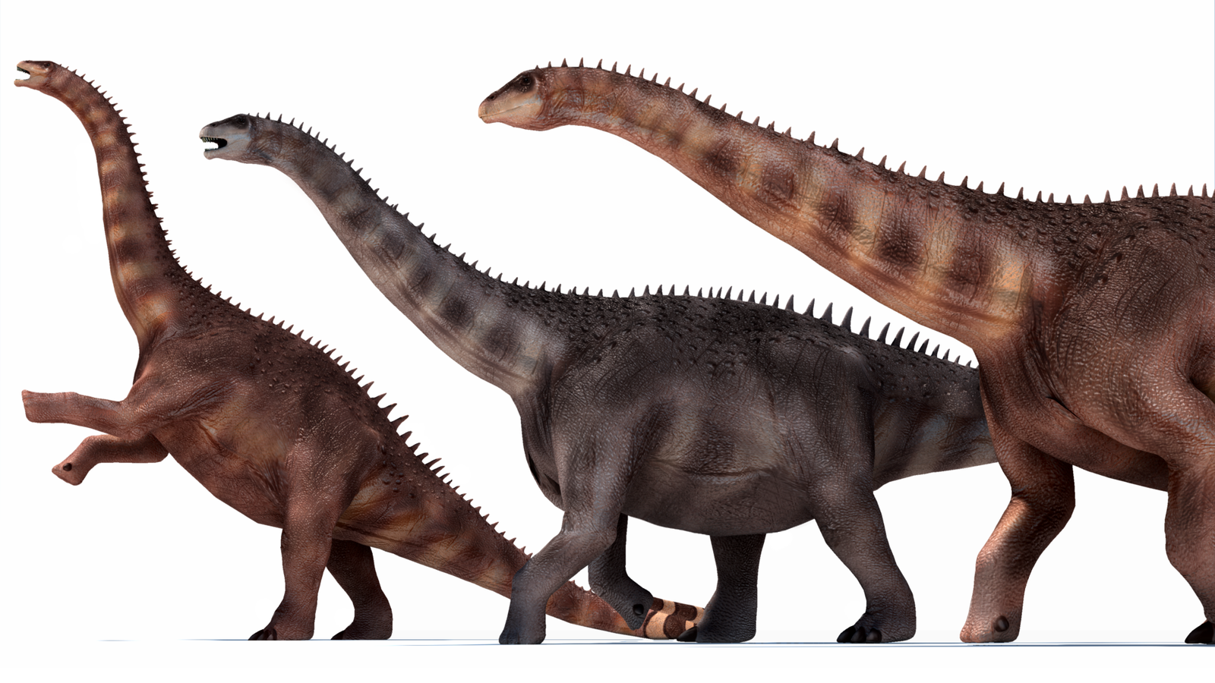
Apatosaurus
Save the Apatosaurus!

