Slide 1
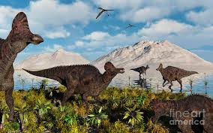
Corythosaurus
By Concetta Charleston

Slide 2
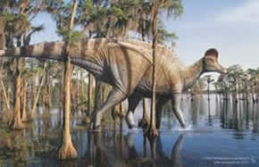
Corythosaurus
His name means” Helmet Lizard.”

Slide 3
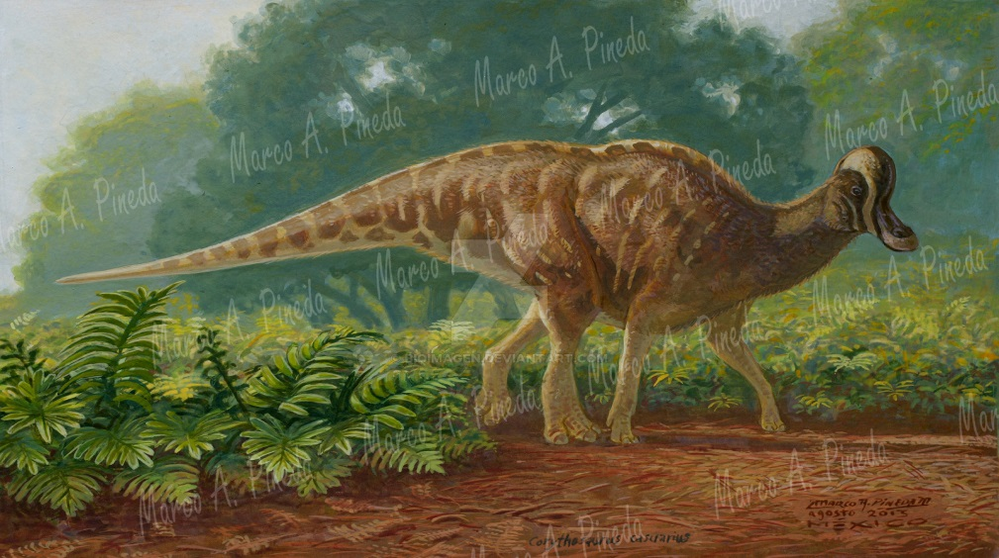
Corythosaurus
He ate pine needles, ginkgos, seeds, cycods, twigs, and mango leaves.

Slide 4
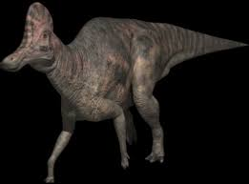
Corythosaurus
Length: 33 ft.
Height: 6.6 ft.
Weight: 5 tons

Slide 5
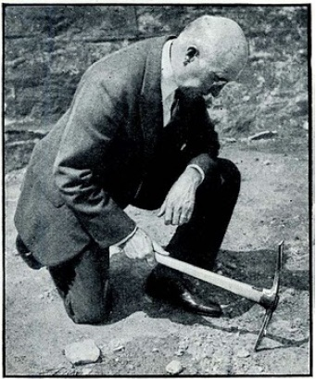
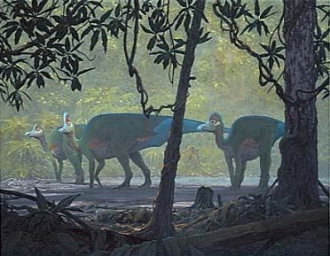
Corythosaurus
The person who named my dinosaur was Barnum Brown in 1914.

Slide 6
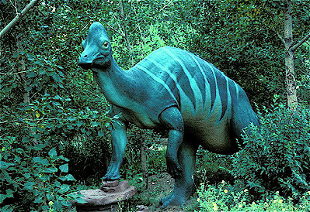
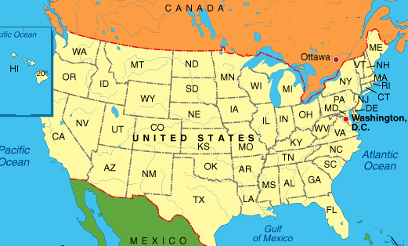
Corythosaurus
It lived in North America,
mainly in Montana.

Slide 7
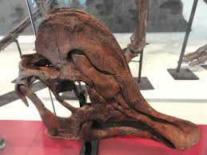
Corythosaurus
It lived in the Late Cretaceous Period
about 70 million years ago.

Slide 8
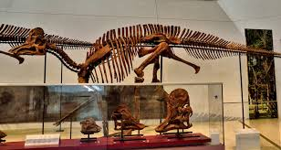
Corythosaurus
It was a herding animal.

Slide 9
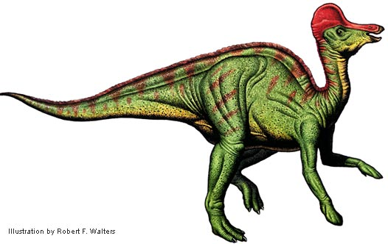
Corythosaurus
Corythosaurus was an ornithopod ,
whose intelligence was midway among the dinosaurs.

Slide 10
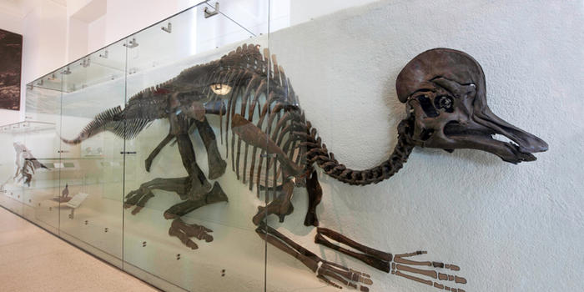
Corythosaurus
Corythosaurus walked and ran on two legs and was a pretty fast dinosaur.
.

Slide 11
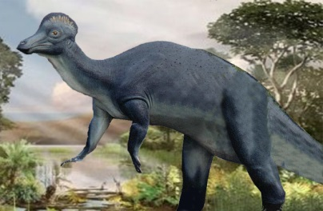
Corythosaurus
Males had a larger crest
than females.

Slide 12
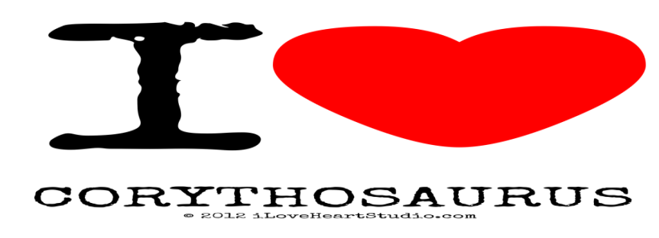

Corythosaurus
Save my dinosaur! It ate plants so
it’s not harmful to us.

