Slide 1
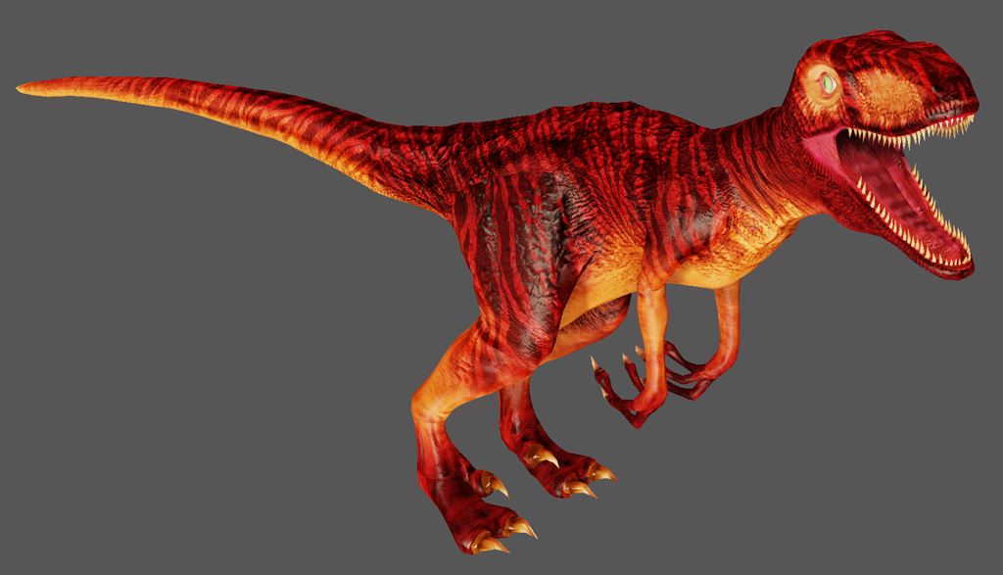
Velociraptor
By Chris Bellamy

Slide 2
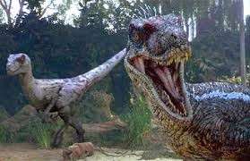
Velociraptor
His name means Speedy Thief.

Slide 3
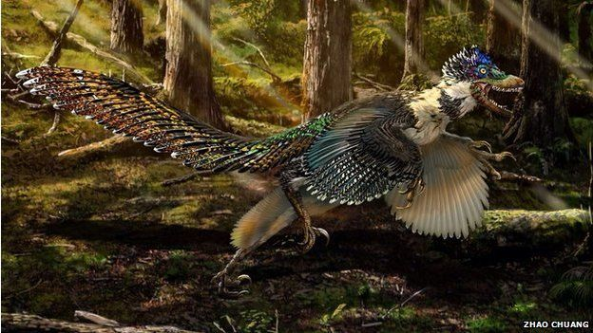
Velociraptor
It was a meat eater.

Slide 4
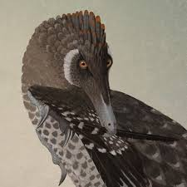
Velociraptor
Length: 5 – 6 ft.
Height: 3 ft.
Weight: 15 -33 pounds

Slide 5
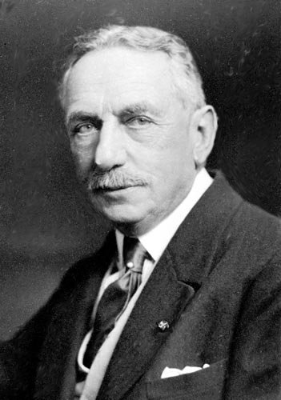
Velociraptor
H.F. Osborn named
my dinosaur in 1924.

Slide 6
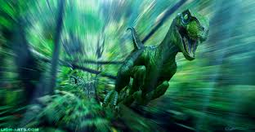
Velociraptor
It lived in North America.

Slide 7
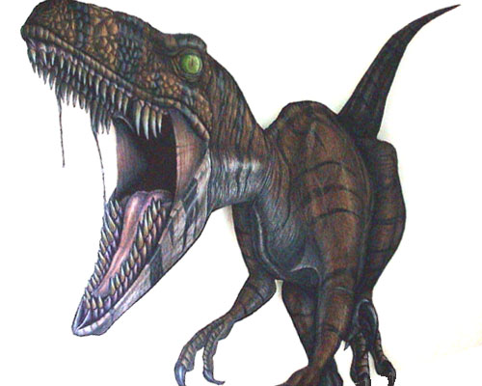
Velociraptor
It lived in the late Cretaceous period.

Slide 8
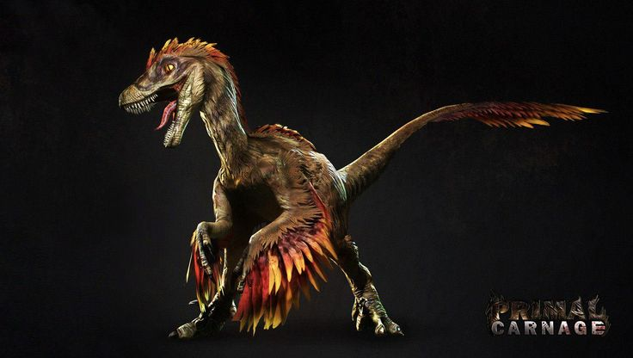
Velociraptor
It was a fast runner.
It could run up to
40 miles per hour.

Slide 9
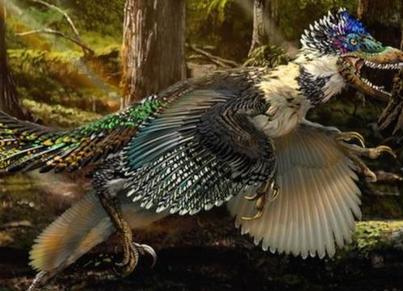
Velociraptor
It had over 80 very sharp teeth.

Slide 10
Velociraptor
It was among the smartest of the dinosaurs.

Slide 11
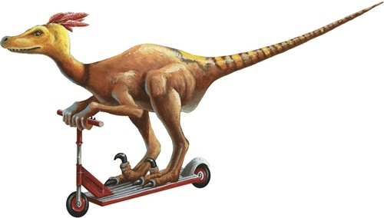
Velociraptor
It used its tail for balance.

Slide 12
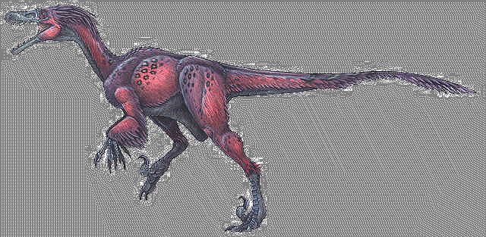
Velociraptor
Save my dinosaur!

