Slide 1
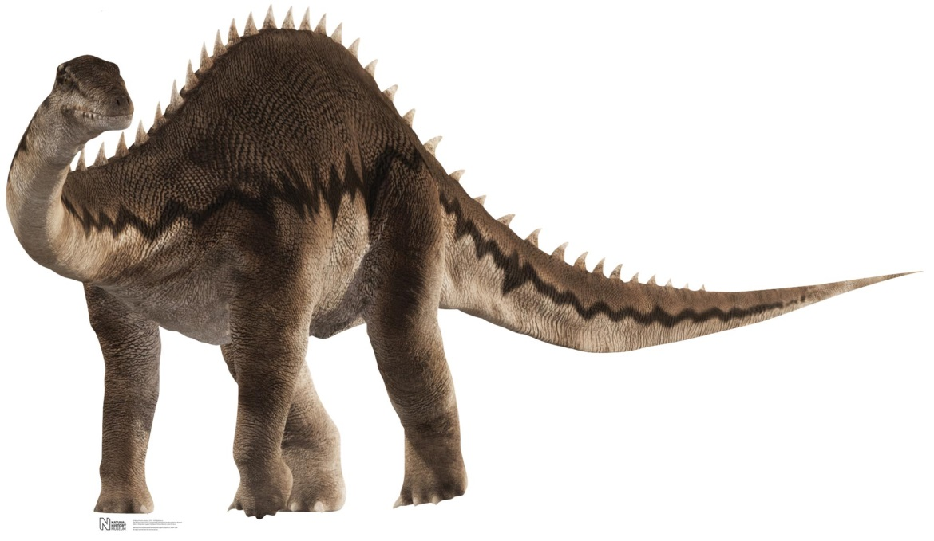
Diplodocus
By Angelina Cerrato

Slide 2
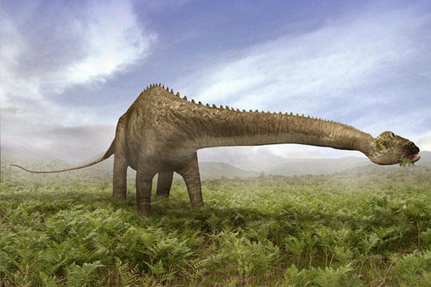
Diplodocus
Its name means Doubled Beam.

Slide 3
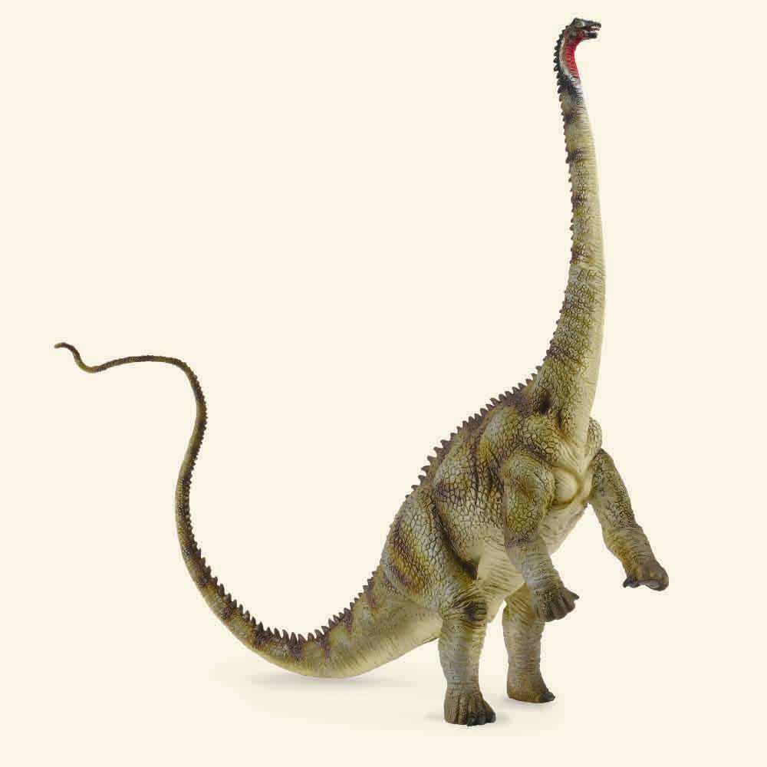
Diplodocus
Length: 90 ft.
Height: 30 ft.
Weight: 10-20 tons

Slide 4
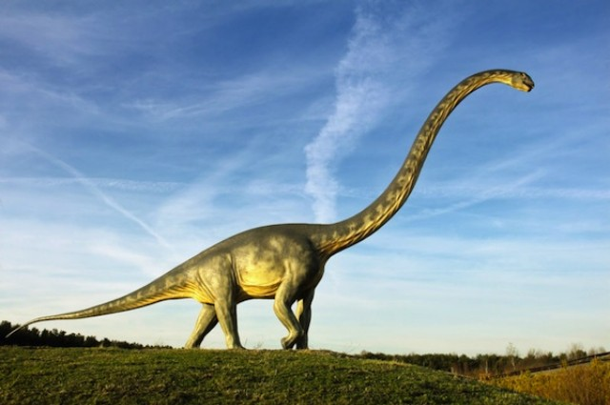
Diplodocus
It was a plant eater.

Slide 5
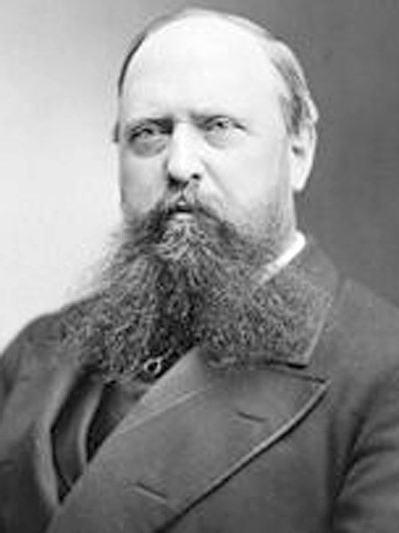
Diplodocus
Othniel Marsh named the dinosaur in 1878.

Slide 6
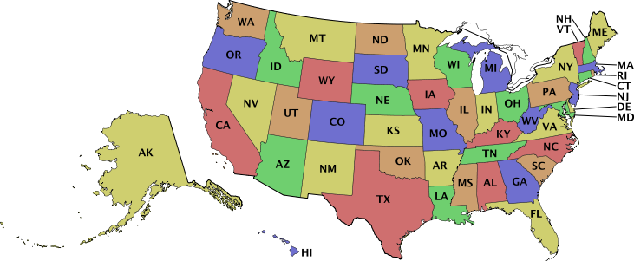
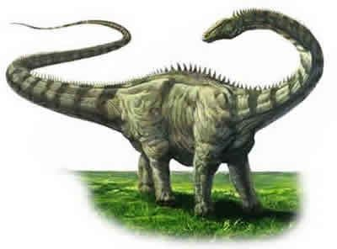
Diplodocus
It lived in Western USA.

Slide 7
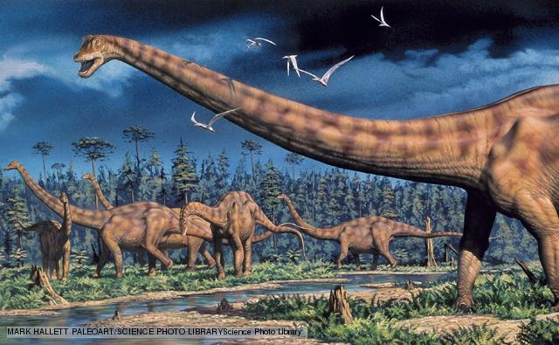
Diplodocus
It lived in the Jurassic Period, 155 – 145 million years ago.

Slide 8
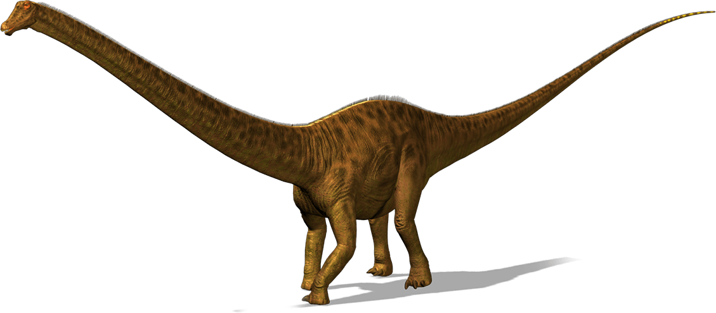
Diplodocus
It needed a lot of food to keep it alive.

Slide 9
Diplodocus
Its tail was 45 feet long.

Slide 10
Diplodocus
His nostrils were on the top of his forehead.

Slide 11
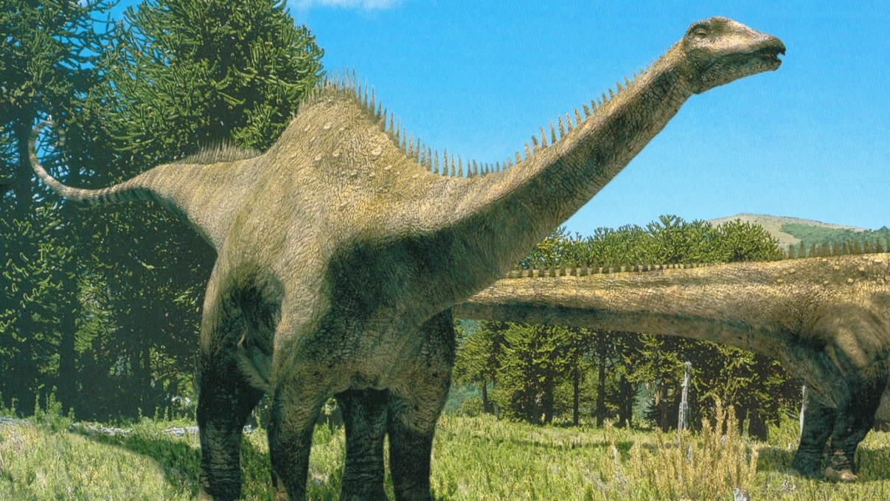
Diplodocus
People thought it had a second brain, but it was really an enlargement on its spinal cord.

Slide 12
Diplodocus
Please save this dinosaur!
Save the diplodocus!

