Slide 1
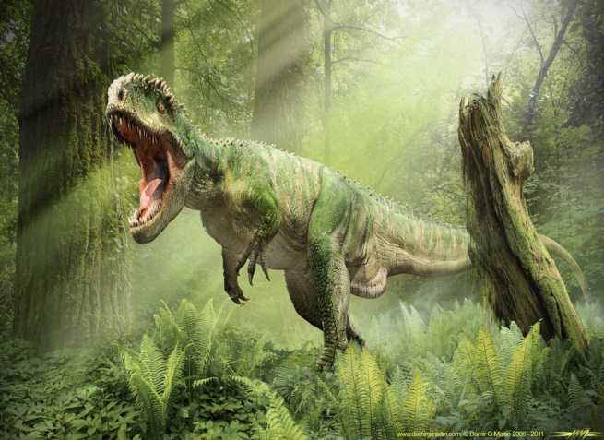
Giganotosaurus
By Alexis Morgan

Slide 2
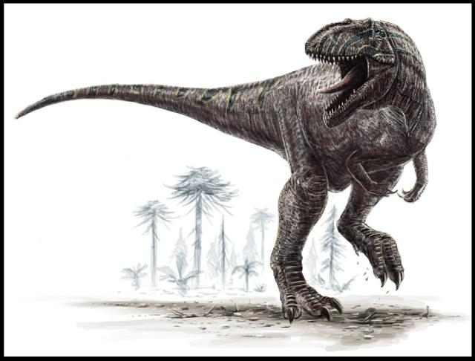
Giganotosaurus
His name means Giant Southern.

Slide 3
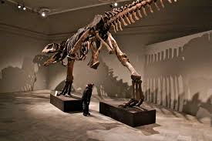
Giganotosaurus
It was a carnivore. It ate large plant-eating dinosaurs.

Slide 4
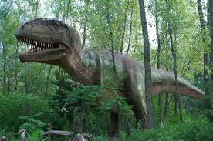
Giganotosaurus
Rodolfo Coria named the Giganotosaurus in 1995.

Slide 5
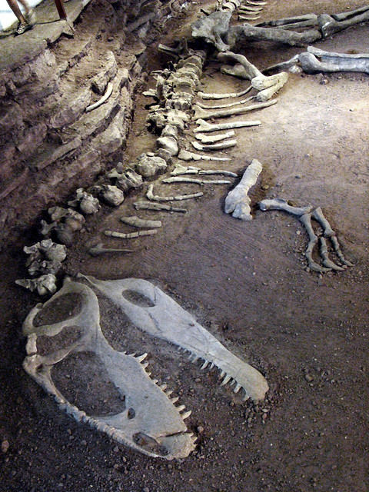
Giganotosaurus
Length: 44-46 ft.
Height: 13 ft. at the hips
Weight: 8 tons

Slide 6
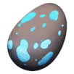
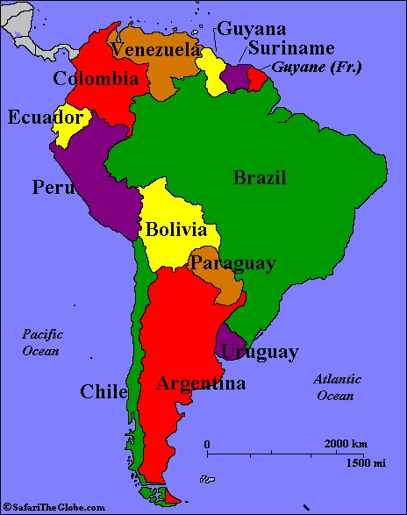
Giganotosaurus
It lived in South America.

Slide 7
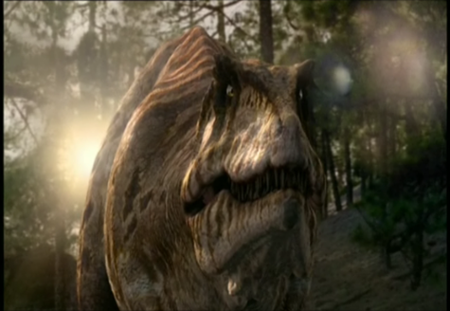
Giganotosaurus
It lived about 110-95 million years ago.

Slide 8
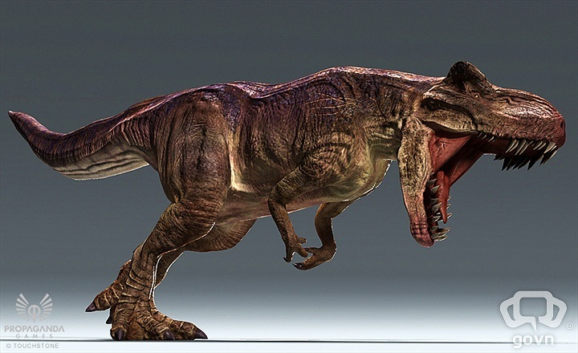
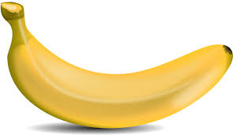
Giganotosaurus
It had a brain the size of a banana.

Slide 9
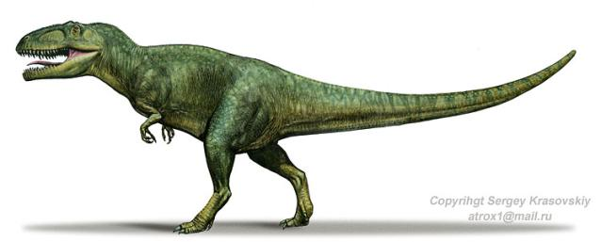
Giganotosaurus
It was longer than the T-Rex.

Slide 10
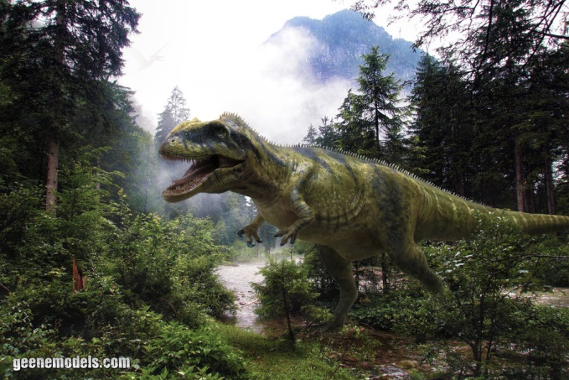
Giganotosaurus
It had enormous jaws with 8-inches long serrated teeth.

Slide 11
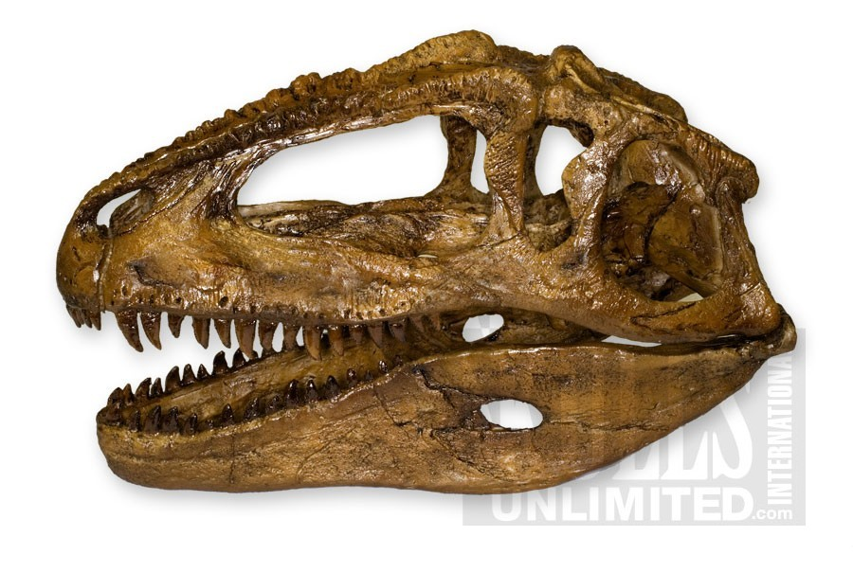
Giganotosaurus
It had a 6-foot long skull.

Slide 12
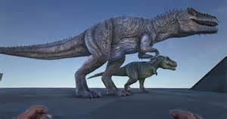
Giganotosaurus
SAVE MY DINOSAUR!

