Slide 1
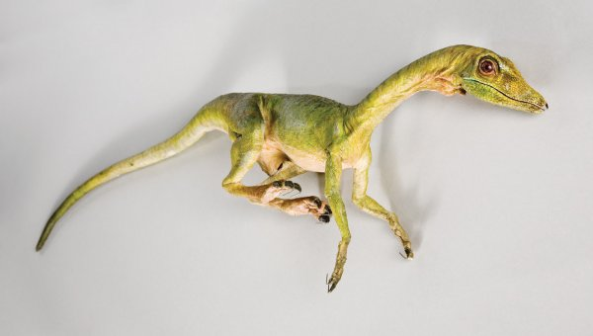
Compsognathus
By Davey Coleman

Slide 2
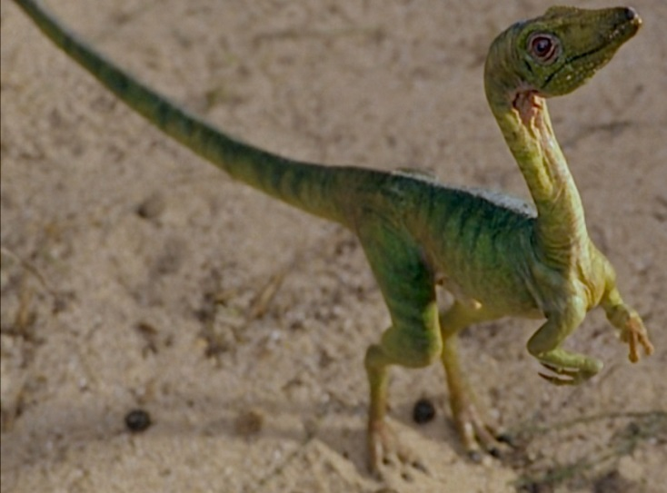
Compsognathus
His name
means
pretty jaw.

Slide 3
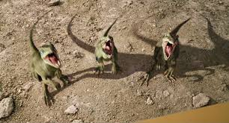
Compsognathus
He was a meat eater.

Slide 4
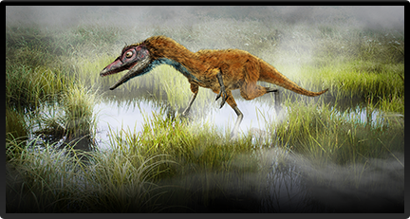
Compsognathus
Length: 28 in.-4 ft.
Height: 10 in.
Weight: 6.5 lbs.

Slide 5
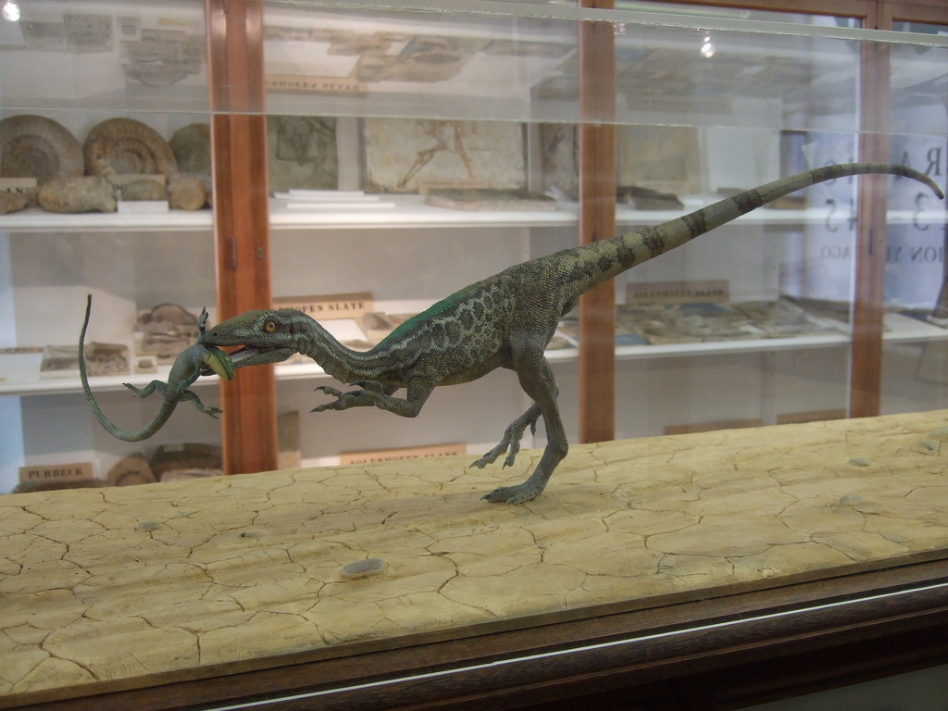
Compsognathus
It was named by
Johann A. Wagner in 1859.

Slide 6
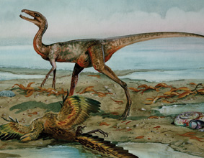
Compsognathus
It lived in southern
Germany and France.

Slide 7
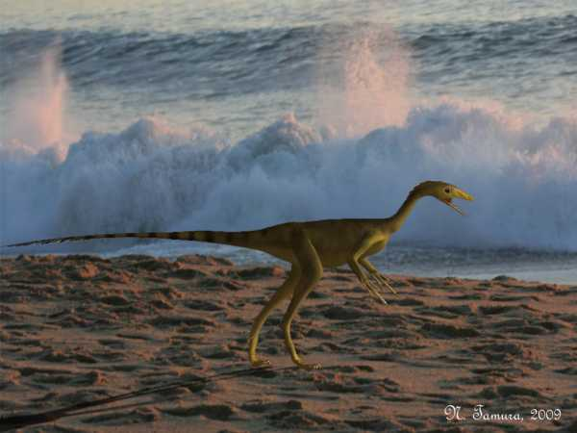
Compsognathus
It lived 155 to 145 million
years ago.

Slide 8
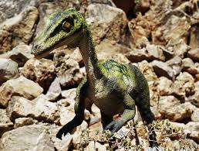
Compsognathus
It was about the size
of a chicken.

Slide 9
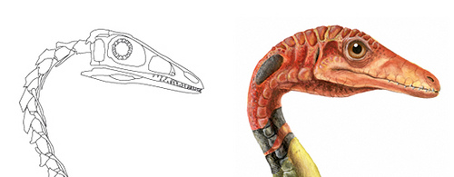
Compsognathus
It is one of the smallest known
dinosaurs.

Slide 10
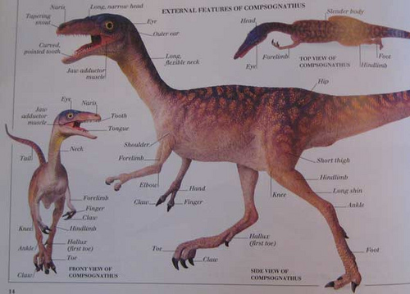
Compsognathus
It had hollow bones.

Slide 11
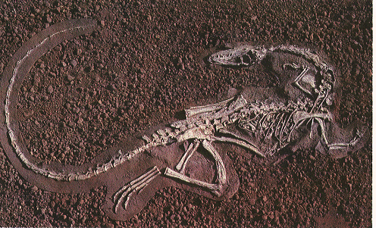
Compsognathus
It had a long flexible neck.

Slide 12

Compsognathus!
SAVE

