Slide 1
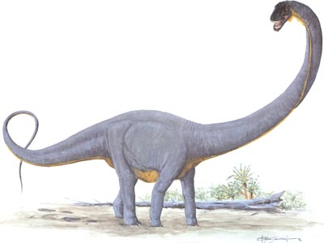
Ultrasaurus
By Amaya Dorsey

Slide 2
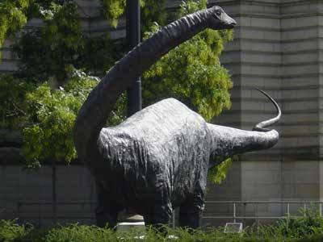
Ultrasaurus
His name means Ultralizard.

Slide 3
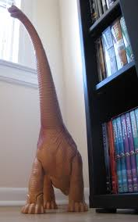
Ultrasaurus
It was a plant eater.

Slide 4
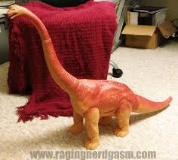
Ultrasaurus
Length: 15 Ft.
Height: 50 Ft. tall at the hips
Weight: 55 to 130 tons

Slide 5
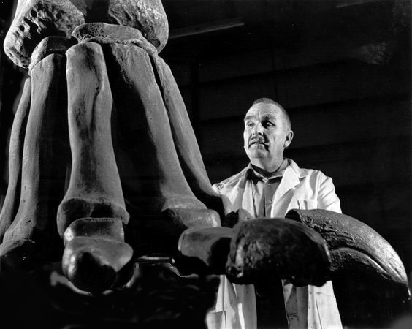
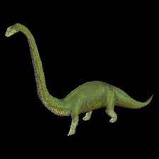
Ultrasaurus
James A. Jenson named my dinosaur in 1979.
.

Slide 6
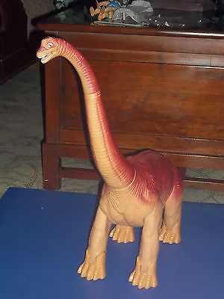
Ultrasaurus
It lived in the
late Jurassic period.

Slide 7
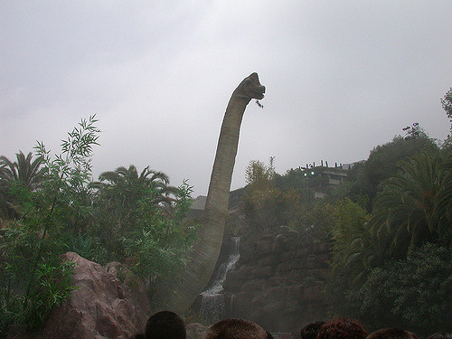
Ultrasaurus
It lived in
North America.

Slide 8
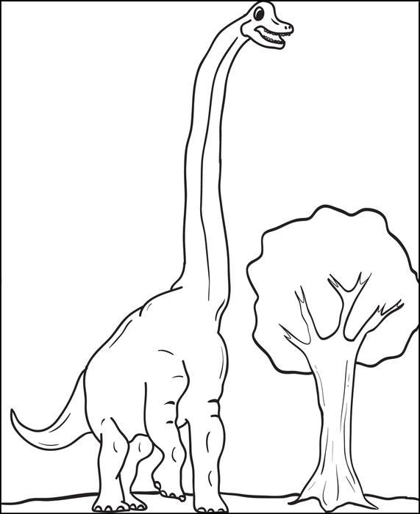
Ultrasaurus
Its intelligence was in the lowest of the dinosaurs.

Slide 9
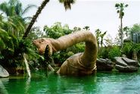
Ultrasaurus
It was hatched from eggs.

Slide 10
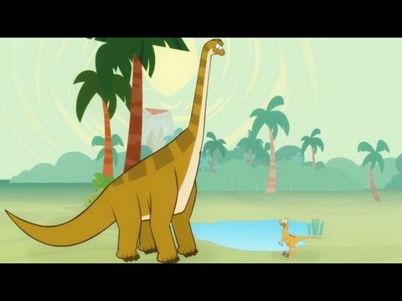
Ultrasaurus
It walked very slowly on four long legs.

Slide 11
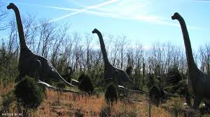
Ultrasaurus
It swallowed its food whole, without chewing it, digesting the plants in its gut.

Slide 12
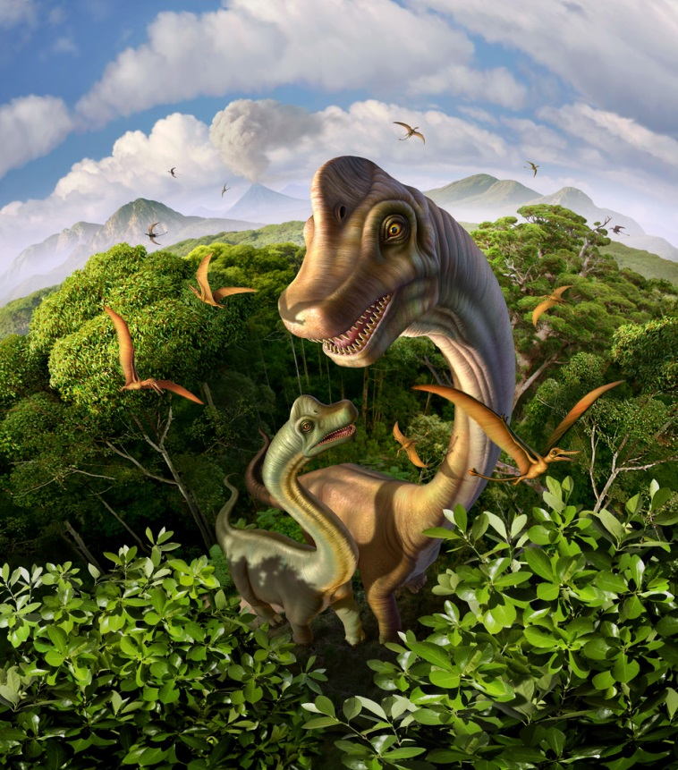
Ultrasaurus
Save this dinosaur !
Save the Ultrasaurus!

