Slide 1
Dinosaur Challenge
Webquest
Created by Ms. Smith
Introduction | Task | Process | Resources | Evaluation | Conclusion

Slide 2
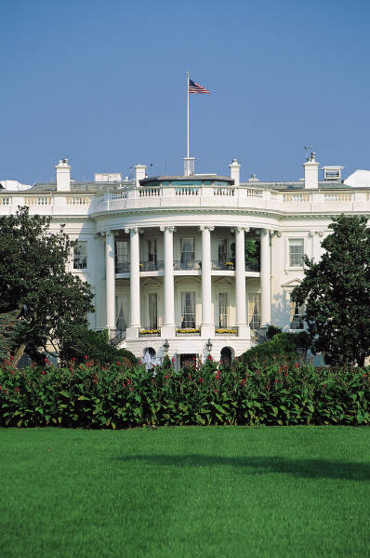

Introduction
Introduction | Task | Process | Resources | Evaluation | Conclusion
My Fellow Americans,
I’ve called you here to the White House because I need your help. Scientists have discovered a way to bring dinosaurs back to life! However, our country doesn’t have enough money to pay for every dinosaur. As famous paleontologists, I challenge each of you to prepare a report on a specific dinosaur. Since I can only bring back one dinosaur, I want you to convince me to bring back yours.
President T. Rex Saurus

Slide 3
Your Task
Introduction | Task | Process | Resources | Evaluation | Conclusion
Your challenge is to collect facts about your chosen dinosaur. You will become an expert on that dinosaur. After you have collected your data, you will complete a dinosaur data chart, a model of your dinosaur, and a presentation to persuade President Saurus. Good luck!

Slide 4
Your Process
Introduction | Task | Process | Resources | Evaluation | Conclusion
Job #1
Choose an envelope which will give you the name of your dinosaur and a dinosaur data chart for this challenge.

Slide 5
Your Process
Introduction | Task | Process | Resources | Evaluation | Conclusion
Job #2
View two videos on dinosaur fossils and dinosaur extinction as an introduction to your challenge. Click on the web links below:
Dinosaur Fossils
Dinosaur Extinction

Slide 6
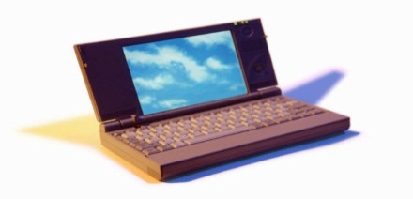
Your Process
Introduction | Task | Process | Resources | Evaluation | Conclusion
Job #3
Click on your dinosaur’s name in the table below. This will take you to web sites with information about your dinosaur. Using this information, fill in the dinosaur data chart which was in your envelope.
Ankylosaurus | Apatosaurus | Brachiosaurus | Compsognathus
Diplodocus | Iguandon | Lambeosaurus | Oviraptor
Stegosaurus | Triceratop | Ultrasuarus | Velociraptor

Slide 7
Your Process
Introduction | Task | Process | Resources | Evaluation | Conclusion
Job #3
Click on your dinosaur’s name in the table below. This will take you to web sites with information about your dinosaur. Using this information, fill in the dinosaur data chart which was in your envelope.
Corythosaurus | Protoceratops | Ornithomimus | Giganotosaurus
Plateosaurus | Coelophysis | Spinosaurus | Camptosaurus

Slide 8
Your Process
Introduction | Task | Process | Resources | Evaluation | Conclusion
Job #4
Create a clay model of your dinosaur. Place your dinosaur in a diorama showing your dinosaur’s habitat. Click on the picture below to get directions on how to do this.

Slide 9
Your Process
Introduction | Task | Process | Resources | Evaluation | Conclusion
Job #5
Prepare a storyboard which can be used for a power point presentation for the President. Click on the picture below to get the storyboard directions.

Slide 10

Your Process
Introduction | Task | Process | Resources | Evaluation | Conclusion
Job #6
Working with your IT person, create a power point presentation with at least 4 slides which will convince President T. Rex Saurus to choose your dinosaur.

Slide 11
Resources
Introduction | Task | Process | Resources | Evaluation | Conclusion
Dinosaur Data Chart
Teacher’s Notes
http://www.sheppardsoftware.com/scienceforkids/dinosaurs/games.htm
http://www.enchantedlearning.com/Home.html
http://www.kidsdinos.com/
http://www.dinofun.com/dinomatch/dinomatch.htm
http://www.abc.net.au/dinosaurs/dino_playground/default.htm
http://www.amnh.org/explore/ology/paleontology
http://www.sheppardsoftware.com/scienceforkids/dinosaurs/games.htm
http://www.nhm.ac.uk/kids-only/

Slide 12
Evaluation
Introduction | Task | Process | Resources | Evaluation | Conclusion
 | Beginning 1 | Developing 2 | Accomplished 3 | Exemplary 4 | Score
Dinosaur Data Chart | Answers less than 3 questions in chart. Has more than five errors. | Answers some questions in the chart. Has between 3 and 5 errors. | Answers all questions in the chart. Has one or two errors. (spelling/ grammar) | Answers all questions. Chart is completed neatly and without errors.
Model | Makes an attempt to create a model | Follows some directions for creating a model | Follows all directions in creating a model | Follows all directions. Model resembles their dinosaur.
Diorama | Makes an attempt to create a diorama. | Follows some diorama directions. | Follows all directions in making a diorama. | Follows all directions reflecting the highest level of performance.

Slide 13
Evaluation
Introduction | Task | Process | Resources | Evaluation | Conclusion
 | Beginning 1 | Developing 2 | Accomplished 3 | Exemplary 4 | Score
Storyboard | Completes one direction for storyboard. | Completes 3 directions for storyboard. | Completes all 4 directions for storyboard. | Completes all 4 directions neatly and to the highest level of performance.
Power point Presentation | Completes 2 slides for presentation. | Completes 3 slides for presentation to President. | Completes 4 slides for presentation with correct information. | Completes power point presentation giving accurate information and interesting facts to the highest level of performance.

Slide 14
Conclusion
Introduction | Task | Process | Resources | Evaluation | Conclusion
Congratulations on completing your dinosaur challenge. I hope you are able to convince the President to choose your dinosaur. As a reward for your hard work, here are some links for fun dinosaur activities!
Dinosaur Playground
Paleontology
Dinomatch
Kidsonly
Dinosaur Games and Activities

Slide 15
Teacher’s Notes
Introduction | Task | Process | Resources | Evaluation | Conclusion
The paleontologists will show their presentations to The President (Computer Teacher) and the President’s advisors (Grade 4 Buddy Class).
The advisors will be given a form to chose the dinosaur they would save. They must give two reasons why they would choose that dinosaur.

Slide 16
What Dinosaur Will You Choose?
Introduction | Task | Process | Resources | Evaluation | Conclusion
Name of Advisor: ______________________
The name of the dinosaur I would bring back to life is ______________________________.
My reasons are:
______________________________________________________________________________
______________________________________________________________________________

Slide 17
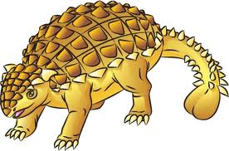
Ankylosaurus
Introduction | Task | Process | Resources | Evaluation | Conclusion
Click on the links below to find information about your dinosaur.
http://www.enchantedlearning.com/subjects/dinosaurs/
http://www.kidsdinos.com/dinosaurs-for-children.php?dinosaur=Ankylosaurus

Slide 18
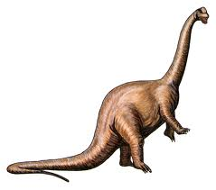
Apatosaurus
Introduction | Task | Process | Resources | Evaluation | Conclusion
Click on the links below to find information about your dinosaur.
http://www.enchantedlearning.com/subjects/dinosaurs/
http://www.kidsdinos.com/dinosaurs-for-children.php?dinosaur=Apatosaurus

Slide 19
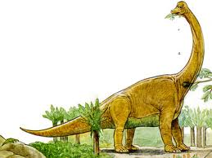
Brachiosaurus
Introduction | Task | Process | Resources | Evaluation | Conclusion
Click on the links below to find information about your dinosaur.
http://www.enchantedlearning.com/subjects/dinosaurs/
http://www.kidsdinos.com/dinosaurs-for-children.php?dinosaur=Brachiosaurus

Slide 20

Compsognathus
Introduction | Task | Process | Resources | Evaluation | Conclusion
Click on the links below to find information about your dinosaur.
http://www.enchantedlearning.com/subjects/dinosaurs/
http://www.kidsdinos.com/dinosaurs-for-children.php?dinosaur=Compsognathus

Slide 21
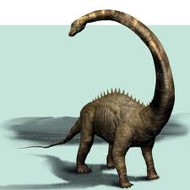
Diplodocus
Introduction | Task | Process | Resources | Evaluation | Conclusion
Click on the links below to find information about your dinosaur.
http://www.enchantedlearning.com/subjects/dinosaurs/
http://www.kidsdinos.com/dinosaurs-for-children.php?dinosaur=Diplodocus

Slide 22
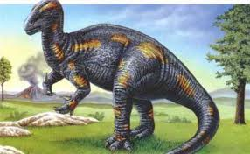
Iguanodon
Introduction | Task | Process | Resources | Evaluation | Conclusion
Click on the links below to find information about your dinosaur.
http://www.enchantedlearning.com/subjects/dinosaurs/
http://www.kidsdinos.com/dinosaurs-for-children.php?dinosaur=Iguanodon

Slide 23
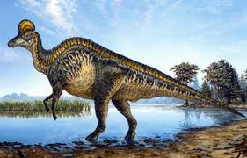
Lambeosaurus
Introduction | Task | Process | Resources | Evaluation | Conclusion
Click on the links below to find information about your dinosaur.
http://www.enchantedlearning.com/subjects/dinosaurs/
http://www.kidsdinos.com/dinosaurs-for-children.php?dinosaur=Lambeosaurus

Slide 24
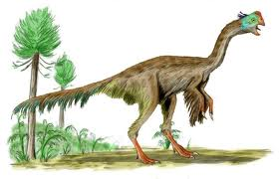
Oviraptor
Introduction | Task | Process | Resources | Evaluation | Conclusion
Click on the links below to find information about your dinosaur.
http://www.enchantedlearning.com/subjects/dinosaurs/
http://www.kidsdinos.com/dinosaurs-for-children.php?dinosaur=oviraptor

Slide 25
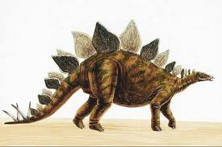
Stegosaurus
Introduction | Task | Process | Resources | Evaluation | Conclusion
Click on the links below to find information about your dinosaur.
http://www.enchantedlearning.com/subjects/dinosaurs/
http://www.kidsdinos.com/dinosaurs-for-children.php?dinosaur=Stegosaurus

Slide 26
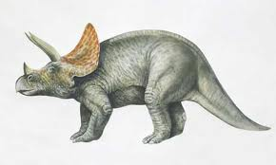
Triceratop
Introduction | Task | Process | Resources | Evaluation | Conclusion
Click on the links below to find information about your dinosaur.
http://www.enchantedlearning.com/subjects/dinosaurs/
http://www.kidsdinos.com/dinosaurs-for-children.php?dinosaur=Triceratops

Slide 27
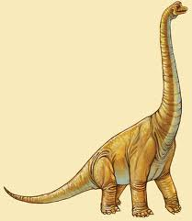
Ultrasaurus
Introduction | Task | Process | Resources | Evaluation | Conclusion
Click on the links below to find information about your dinosaur.
http://www.enchantedlearning.com/subjects/dinosaurs/
http://www.kidsdinos.com/dinosaurs-for-children.php?dinosaur=Ultrasauros

Slide 28
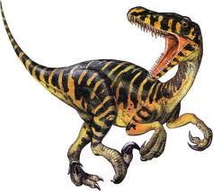
Velociraptor
Introduction | Task | Process | Resources | Evaluation | Conclusion
Click on the links below to find information about your dinosaur.
http://www.enchantedlearning.com/subjects/dinosaurs/
http://www.kidsdinos.com/dinosaurs-for-children.php?dinosaur=Velociraptor

Slide 29
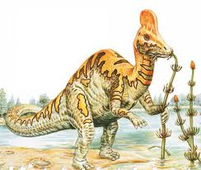
Corythosaurus
Introduction | Task | Process | Resources | Evaluation | Conclusion
Click on the links below to find information about your dinosaur.
http://www.enchantedlearning.com/subjects/dinosaurs/
http://www.kidsdinos.com/dinosaurs-for-children.php?dinosaur=Corythosaurus

Slide 30
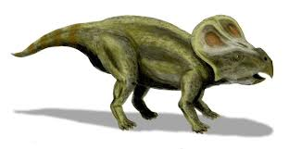
Protoceratops
Introduction | Task | Process | Resources | Evaluation | Conclusion
Click on the links below to find information about your dinosaur.
http://www.enchantedlearning.com/subjects/dinosaurs/
http://www.kidsdinos.com/dinosaurs-for-children.php?dinosaur=Protoceratops

Slide 31
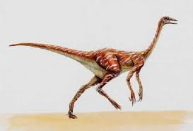
Ornithomimus
Introduction | Task | Process | Resources | Evaluation | Conclusion
Click on the links below to find information about your dinosaur.
http://www.enchantedlearning.com/subjects/dinosaurs/
http://www.kidsdinos.com/dinosaurs-for-children.php?dinosaur=Ornithomimus

Slide 32
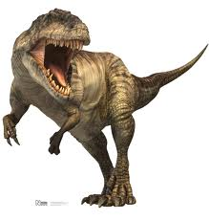
Giganotosaurus
Introduction | Task | Process | Resources | Evaluation | Conclusion
Click on the links below to find information about your dinosaur.
http://www.enchantedlearning.com/subjects/dinosaurs/
http://www.kidsdinos.com/dinosaurs-for-children.php?dinosaur=Giganotosaurus

Slide 33
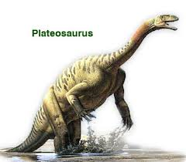
Plateosaurus
Introduction | Task | Process | Resources | Evaluation | Conclusion
Click on the links below to find information about your dinosaur.
http://www.enchantedlearning.com/subjects/dinosaurs/
http://www.kidsdinos.com/dinosaurs-for-children.php?dinosaur=Plateosaurus

Slide 34
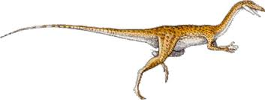
Coelophysis
Introduction | Task | Process | Resources | Evaluation | Conclusion
Click on the links below to find information about your dinosaur.
http://www.enchantedlearning.com/subjects/dinosaurs/
http://www.kidsdinos.com/dinosaurs-for-children.php?dinosaur=Coelophysis

Slide 35
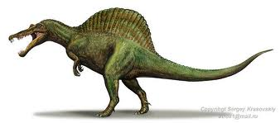
Spinosaurus
Introduction | Task | Process | Resources | Evaluation | Conclusion
Click on the links below to find information about your dinosaur.
http://www.enchantedlearning.com/subjects/dinosaurs/
http://www.kidsdinos.com/dinosaurs-for-children.php?dinosaur=Spinosaurus

Slide 36
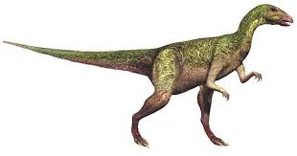
Camptosaurus
Introduction | Task | Process | Resources | Evaluation | Conclusion
Click on the links below to find information about your dinosaur.
http://www.enchantedlearning.com/subjects/dinosaurs/
http://www.kidsdinos.com/dinosaurs-for-children.php?dinosaur=Camptosaurus

Slide 37
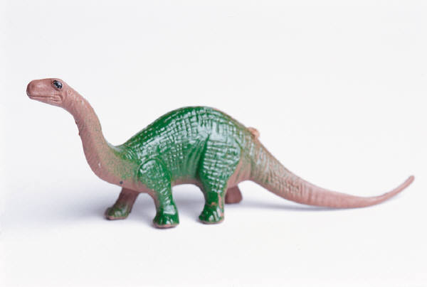
Directions for Job # 4
Dinosaur Model
Introduction | Task | Process | Resources | Evaluation | Conclusion
The President would like to see a three dimensional model of your dinosaur.
Go to the model station.
Take some clay and make a model of your dinosaur.
Once your clay has dried, paint your dinosaur.
Using materials at the station create a diorama showing your dinosaur’s habitat. Click on the link below to learn about making dioramas.
Place your model inside your diorama.
Dinosaur Diorama Directions

Slide 38
Directions for Story Boarding
Job # 5
Introduction | Task | Process | Resources | Evaluation | Conclusion
Remember to create a presentation for the President.
You will need 4 sheets of paper to create 4 slides.
Follow the table below for directions for each slide,
1. Name of Dinosaur Picture of Dinosaur Your Name | 2. Use your data chart to give facts about your dinosaur
3. Give the President some awesome facts about your dinosaur. | 4. Give the President your most persuasive argument for choosing your dinosaur.

Slide 39
Dinosaur Data Chart
Name: ______________________________________
Name of Dinosaur_____________________________________
Introduction | Task | Process | Resources | Evaluation | Conclusion
What its name means: | What it eat:
Length: Height: Weight: | Who named the dinosaur and when:
Where it lived: | When it lived:

Slide 40
Dinosaur Data Chart
Now write 4 awesome facts you found out about your dinosaur in complete sentences.
_____________________________________________________________
_____________________________________________________________
_____________________________________________________________
2. ______________________________________________________________
______________________________________________________________
______________________________________________________________
3. _______________________________________________________________
_______________________________________________________________
_______________________________________________________________
_______________________________________________________________
4. _______________________________________________________________
______________________________________________________________
_______________________________________________________________
Introduction | Task | Process | Resources | Evaluation | Conclusion

