Slide 1
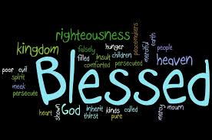
The Beatitudes

Slide 2
What are Beatitudes?
Beatitudes are a set of teachings by Jesus. They are intended to guide your behaviour.

Slide 3
There are two versions of beatitudes – one recorded in the gospel of Matthew, and another, least popular version is recorded in the Gospel of Luke.
The two versions have major differences, like the time and places they were recorded at.

Slide 4
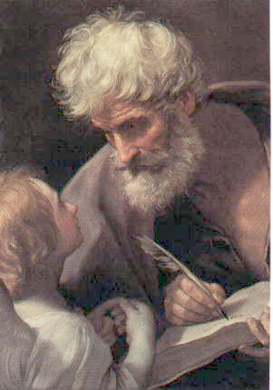
The Beatitudes of Matthew
(5:3-12)

Slide 5
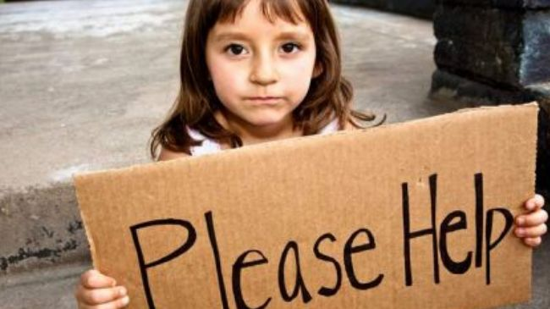
The First Beatitude
Blessed are the poor in spirit,
for theirs is the kingdom of heaven.

Slide 6
This means you ADMIT your weaknesses
and
You are not to consider yourself better than everyone else because of your strengths

Slide 7
People that are poor in spirit also admit that they need JESUS AND OTHER PEOPLE because they REASLIZE WE NEED HELP TO GET THROUGH LIFE!!

Slide 8
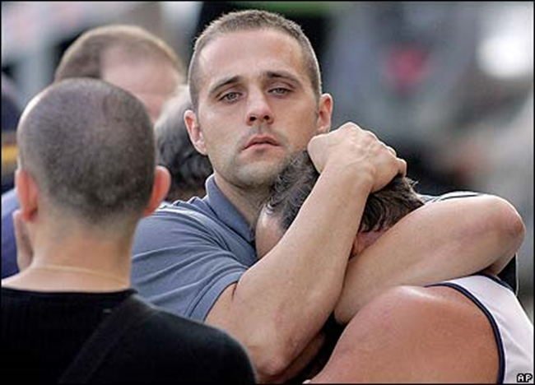
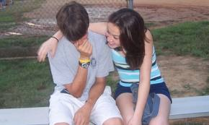
The Second Beatitude
Blessed are those who mourn,
for they shall be comforted

Slide 9
That means
When you see someone being sad, you come up to them and mourn with them, and that way not be selfish.

Slide 10

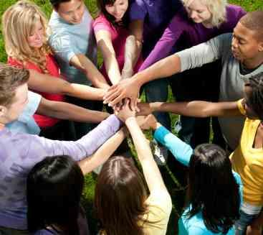
The Third Beatitude
Blessed are the meek, for they shall inherit the earth.

Slide 11
Being Meek means to be a friendly person, who doesn’t use verbal or physical violence to get what they want….
Meek people are anti-violent
Also they are Friendly
And are OK with who they are

Slide 12
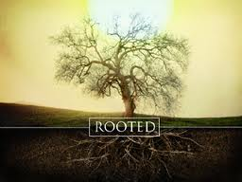
The Forth Beatitude
Blessed are those who hunger and thirst for Righteousness, for they will be filled.

Slide 13
People that hunger and thirst for righteousness are willing to stand up for their friends and what is right. These people are loyal and brave.

Slide 14
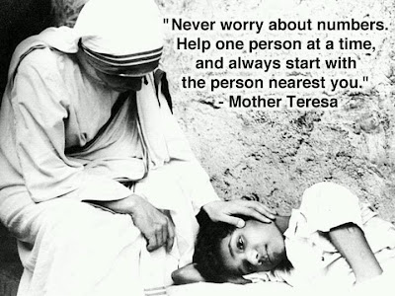
The Fifth Beatitude
Blessed are the Merciful,
For they should obtain mercy

Slide 15
This one is basic:
Be merciful to others in order to get the same in return.

Slide 16
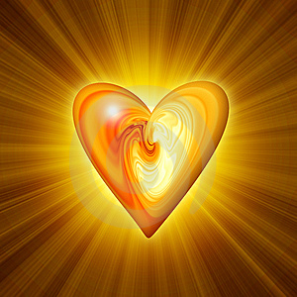
The Sixth Beatitude
Blessed are the Pure in Heart,
for they shall see God

Slide 17
People that are pure in heart are committed to others. They tell the truth, being honest and trustworthy people.
As Jesus Christ was pure when he died on the cross, people who follow this blessing are also committed to their goal or another person

Slide 18
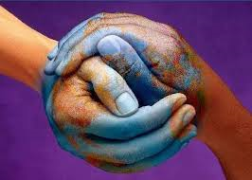
The Seventh Beatitude
Blessed are the peacemakers, for they shall be called the children of God.

Slide 19
This one can also be seen as self explanatory but it does require active participation
Turning a blind eye or simple witnessing is not peacemaking

Slide 20
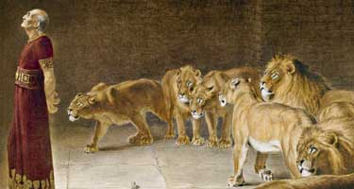
The Eighth Beatitude
Blessed are those who are persecuted for righteousness’ sake, for theirs is the kingdom of heaven.

Slide 21
This beatitude tells us that when we do right things we should not give up, even when others persecute us for doing it.

